Slide 1
Disclaimers
We hope you find the information on our website and resources useful.
ESL Disclaimer
This resource has been made for the purpose of teaching English language learners. We know that students can be learning English in many different places, in many different ways and at any age, so we try to keep these resources as general as possible.
There are many acronyms associated with English language teaching. These include (but are not limited to) ELT, TEFL, EFL, ELL, EAL and ESOL. While the term ESL may not fully represent the linguistic backgrounds of all students, it is the most widely recognised term for English language teaching globally. Therefore, we use the term ‘ESL’ in the names of our resources to make them easy to find but they are suitable for any student learning to speak English.
Editable
This resource is editable and can be adapted to meet the needs of different learners. Twinkl cannot be held responsible for any changes made once a resource has been downloaded. Please be aware that this content may have been edited and therefore
may no longer reflect our values.

Slide 2
Teens | B1

Slide 4
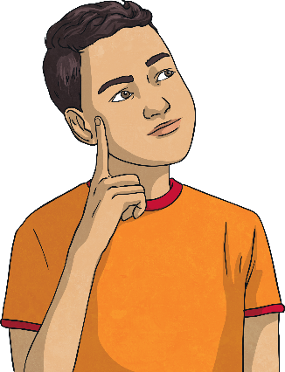
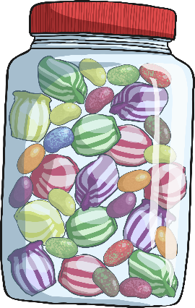
Warm Up: What Happens Next?
Look at the picture and try to imagine what will happen next.
If he eats all those candies…
he will get sick.

Slide 5
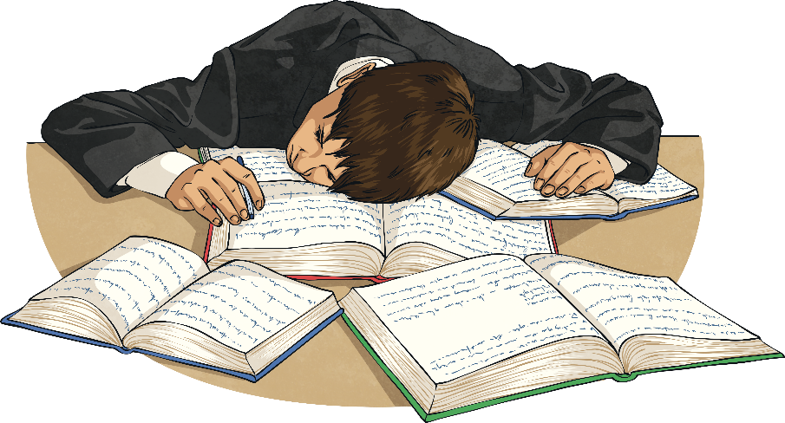
Warm Up: What Happens Next?
Look at the picture and try to imagine what will happen next.
If he doesn’t study for the test…
he won’t pass/he will fail.

Slide 6
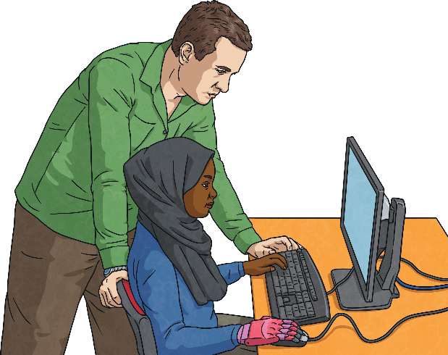
Warm Up: What Happens Next?
Look at the picture and try to imagine what will happen next.
If the student needs help…
the teacher helps them.

Slide 7
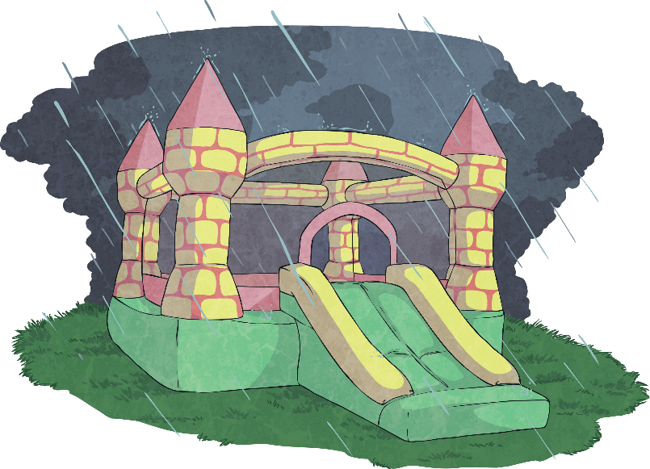
Warm Up: What Happens Next?
Look at the picture and try to imagine what will happen next.
If it rains in the party…
they won’t play in the castle.

Slide 8
Conditional Sentences
All these sentences are called conditionals. All conditional sentences have two parts:
If I drink too much coffee, I can’t sleep at night.
Condition
Result
This sentence is called a zero conditional.

Slide 9

Zero Conditional
We use the zero conditional for facts or things that are always true.
If/When + Present Simple + Present Simple
If it rains, the floor gets wet.
When I work too much, I feel tired.
If we arrive late to the station, we can’t take the train.
If you mix yellow and blue, you get green.

Slide 10
Grammar Challenge!
Match the halves to complete the sentences.
When the sun sets,
when it’s winter.
If you don’t eat,
it gets dark.
If you disconnect the battery,
when you take an exam.
The birds fly south
the computer turns off.
You need a pen
you get hungry.

Slide 11
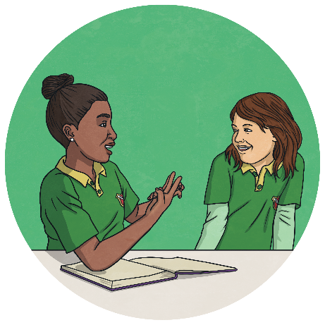
First Conditional
We use the first conditional for things that are very possible to happen in the present of the future.
If + Present Simple + Future Will
If my team wins the competition, they will celebrate it.
She will be very happy if you come to see her.
We will stay at home if the weather is bad.
If you come home late, you will be in trouble.

Slide 12
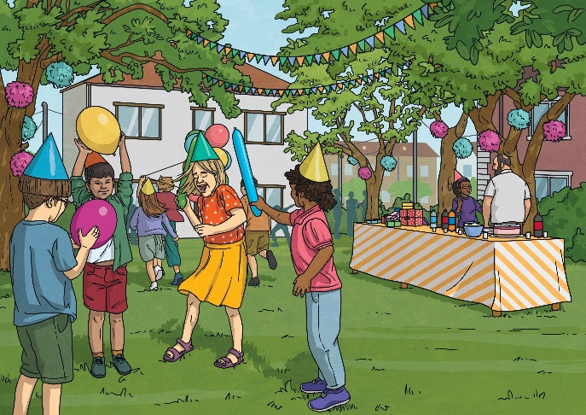
Grammar Challenge!
Choose the best answer using first conditional.
If the lesson is cancelled…
A. I went to the party.
B. I will go to the party.
B. I will go to the party.
C. I go to the party.
reveal answer

Slide 13
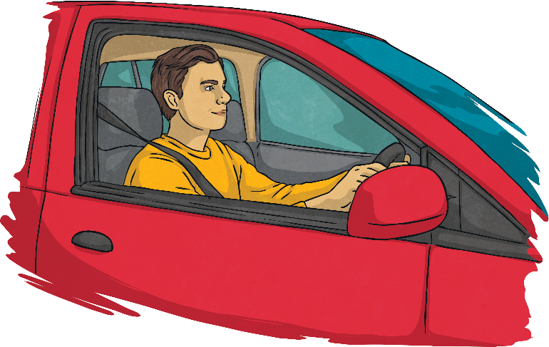
Grammar Challenge!
Choose the best answer using first conditional.
You won’t pass the driving test…
A. if you won’t practise every day.
B. you don’t practise every day.
C. if you don’t practise every day.
C. if you don’t practise every day.
reveal answer

Slide 14
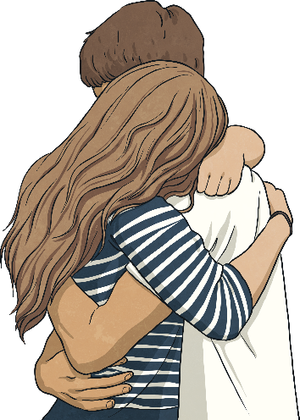
Grammar Challenge!
Choose the best answer using first conditional.
If I see Peter at the event…
A. I tell him I’m sorry.
B. I will tell him I’m sorry.
B. I will tell him I’m sorry.
C. if I will tell him I’m sorry.
reveal answer

Slide 15
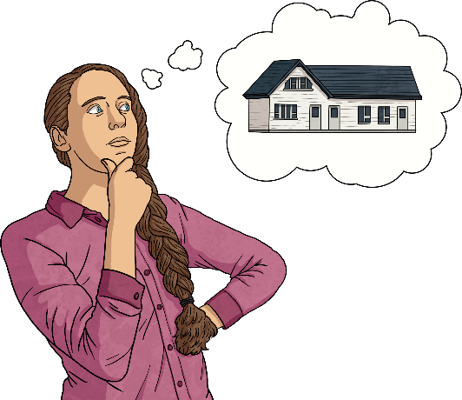
Grammar Challenge!
Choose the best answer using first conditional.
Alex will buy a new house…
A. if she gets the job.
A. if she gets the job.
B. if she will get the job.
C. if she get the job.
reveal answer

Slide 16

Grammar Challenge!
Choose the best answer using first conditional.
Be careful! If you touch that…
A. you will get burnt!
A. you will get burnt!
B. you get burnt!
C. you will got burnt!
reveal answer

Slide 17
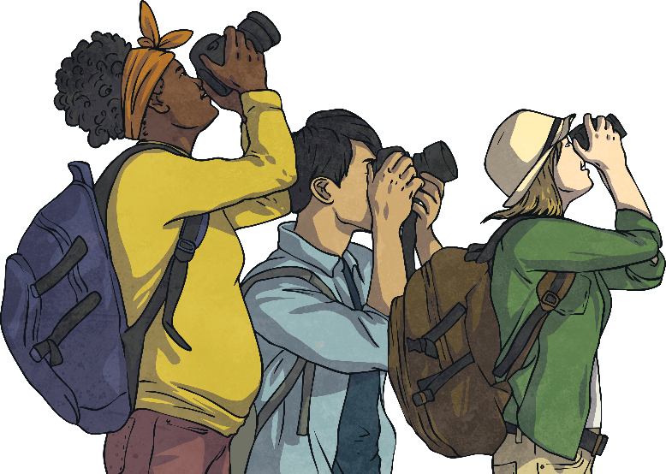
Grammar Challenge!
Grammar Challenge!
Choose the best answer using first conditional.
We won’t take the bus…
A. if you stopped taking pictures.
B. if you won’t stop taking pictures.
C. if you don’t stop taking pictures.
C. if you don’t stop taking pictures.
reveal answer

Slide 18
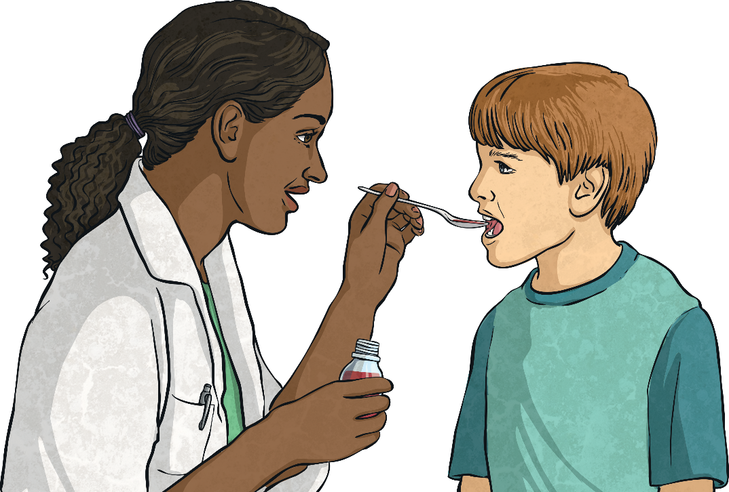
Look at the picture. Make a sentence using zero conditional.
Suggested Answer: If you take medicine you feel better.

Slide 19
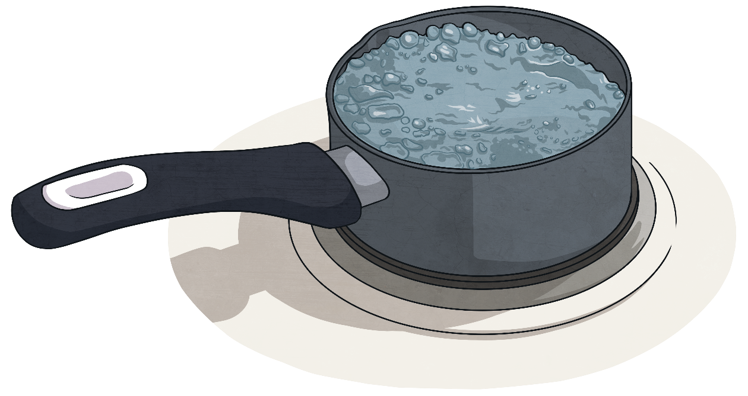
Look at the picture. Make a sentence using zero conditional.
Suggested Answer: If you heat water to 100ºC, it boils.

Slide 20
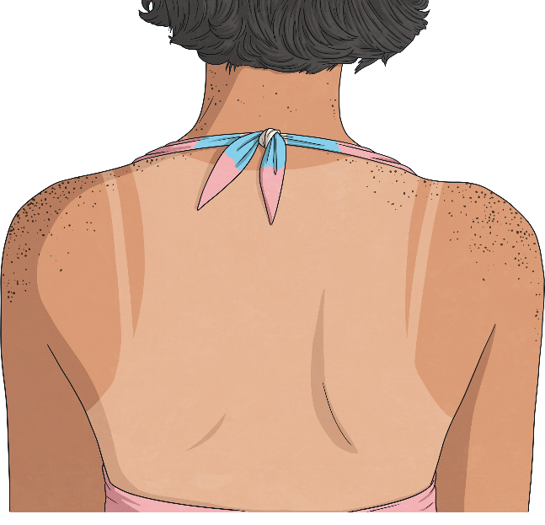
Look at the picture. Make a sentence using zero conditional.
Suggested Answer: If you don’t use suncream, you get burnt.

Slide 21
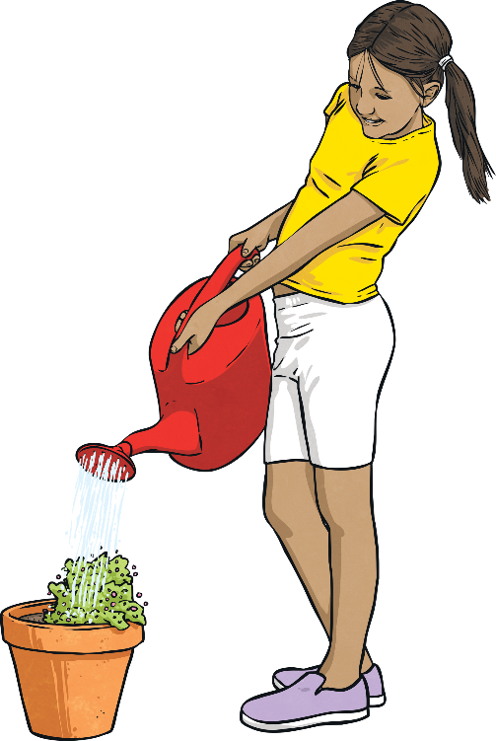
Look at the picture. Make a sentence using zero conditional.
Suggested Answer: If you don’t water the plants, they die.

Slide 22
Murphy’s Law
Do you know about Murphy’s Law? What does it mean?
“Anything that can go wrong, will go wrong”
Look at some examples:
If you drop some toast, it will fall on the butter side.
If you have an important presentation, the computer won’t work that day.
If you forget your umbrella, it will rain.

Slide 23
Complete the first conditional sentences using Murphy’s Law.
If you wear something white…
you will get dirty.
If you wash your car today…
it will rain.
If you lose a lottery ticket…
you will win the lottery.
If you are in a hurry…
all the traffic lights will be red.
If you are in the supermarket and change lines…
the other line will go faster.
If you find something you really like…
they will stop making it.

Slide 24
Wrap Up!
We use the zero conditional for facts and things that are always true.
If/When + Present Simple + Present Simple
We use the first conditional for situations that are possible to happen in the present or the future.
If + Present Simple + Future Will

