Slide 1
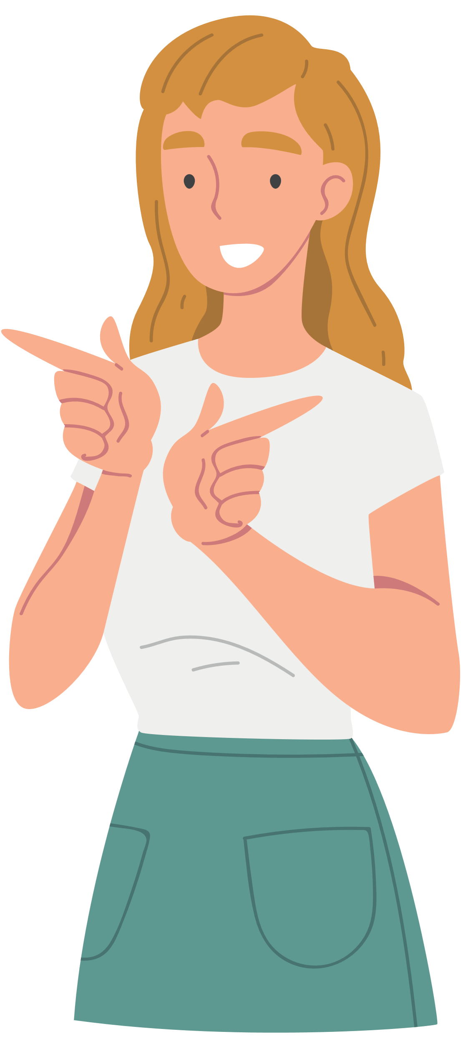
Conditional
Sentences
And other expressions of conditions

Slide 2
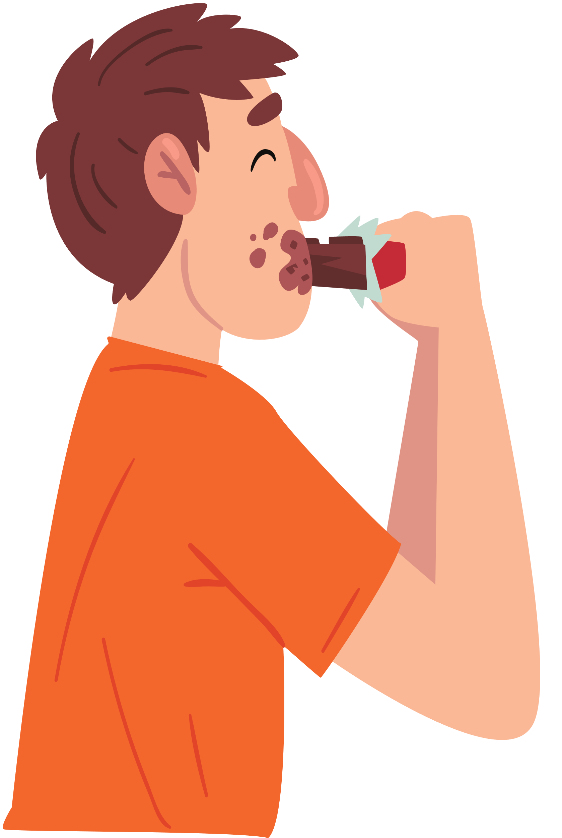
Zero Conditional
if/when + present + present/imperative
if/when + past + past
We use the Zero or Real Conditional to talk about things that are generally true in the present or in the past, in particular laws and rules, or to give instructions if a condition is met.
If I eat too much chocolate, I feel sick.
If you see a spider, run!
It gets cold here when the sun goes down.
If we called each other names, my parents grounded us for a week.
The terms "present" and "past" are used instead of "present tense (simple or continuous)" and "past tense (simple or continuous"), for the sake of simplicity.

Slide 3


First Conditional
if/when + present + future simple/ modal verbs with future meaning
We use the First Conditional to talk about future situations we think are likely or probable to happen.
If it rains tomorrow, we won't go camping.
I can't go out if I don't finish my homework.
If you pay attention, you may see a shooting star.
They might arrive on time if there isn't much traffic.

Slide 4

Second Conditional
if+ past simple + modal verb with future-in-the-past meaning
We use the Second Conditional to talk about present or future situations we think are impossible or unlikely to happen.
I might work harder if they paid me better.
If you really wanted to help, you would be trying harder.
If you studied harder, you could do better at school.
If I were* you, I'd tell my parents the truth.
*We use "were" with all subject pronouns in the Second Conditional (Subjunctive mood).

Slide 5
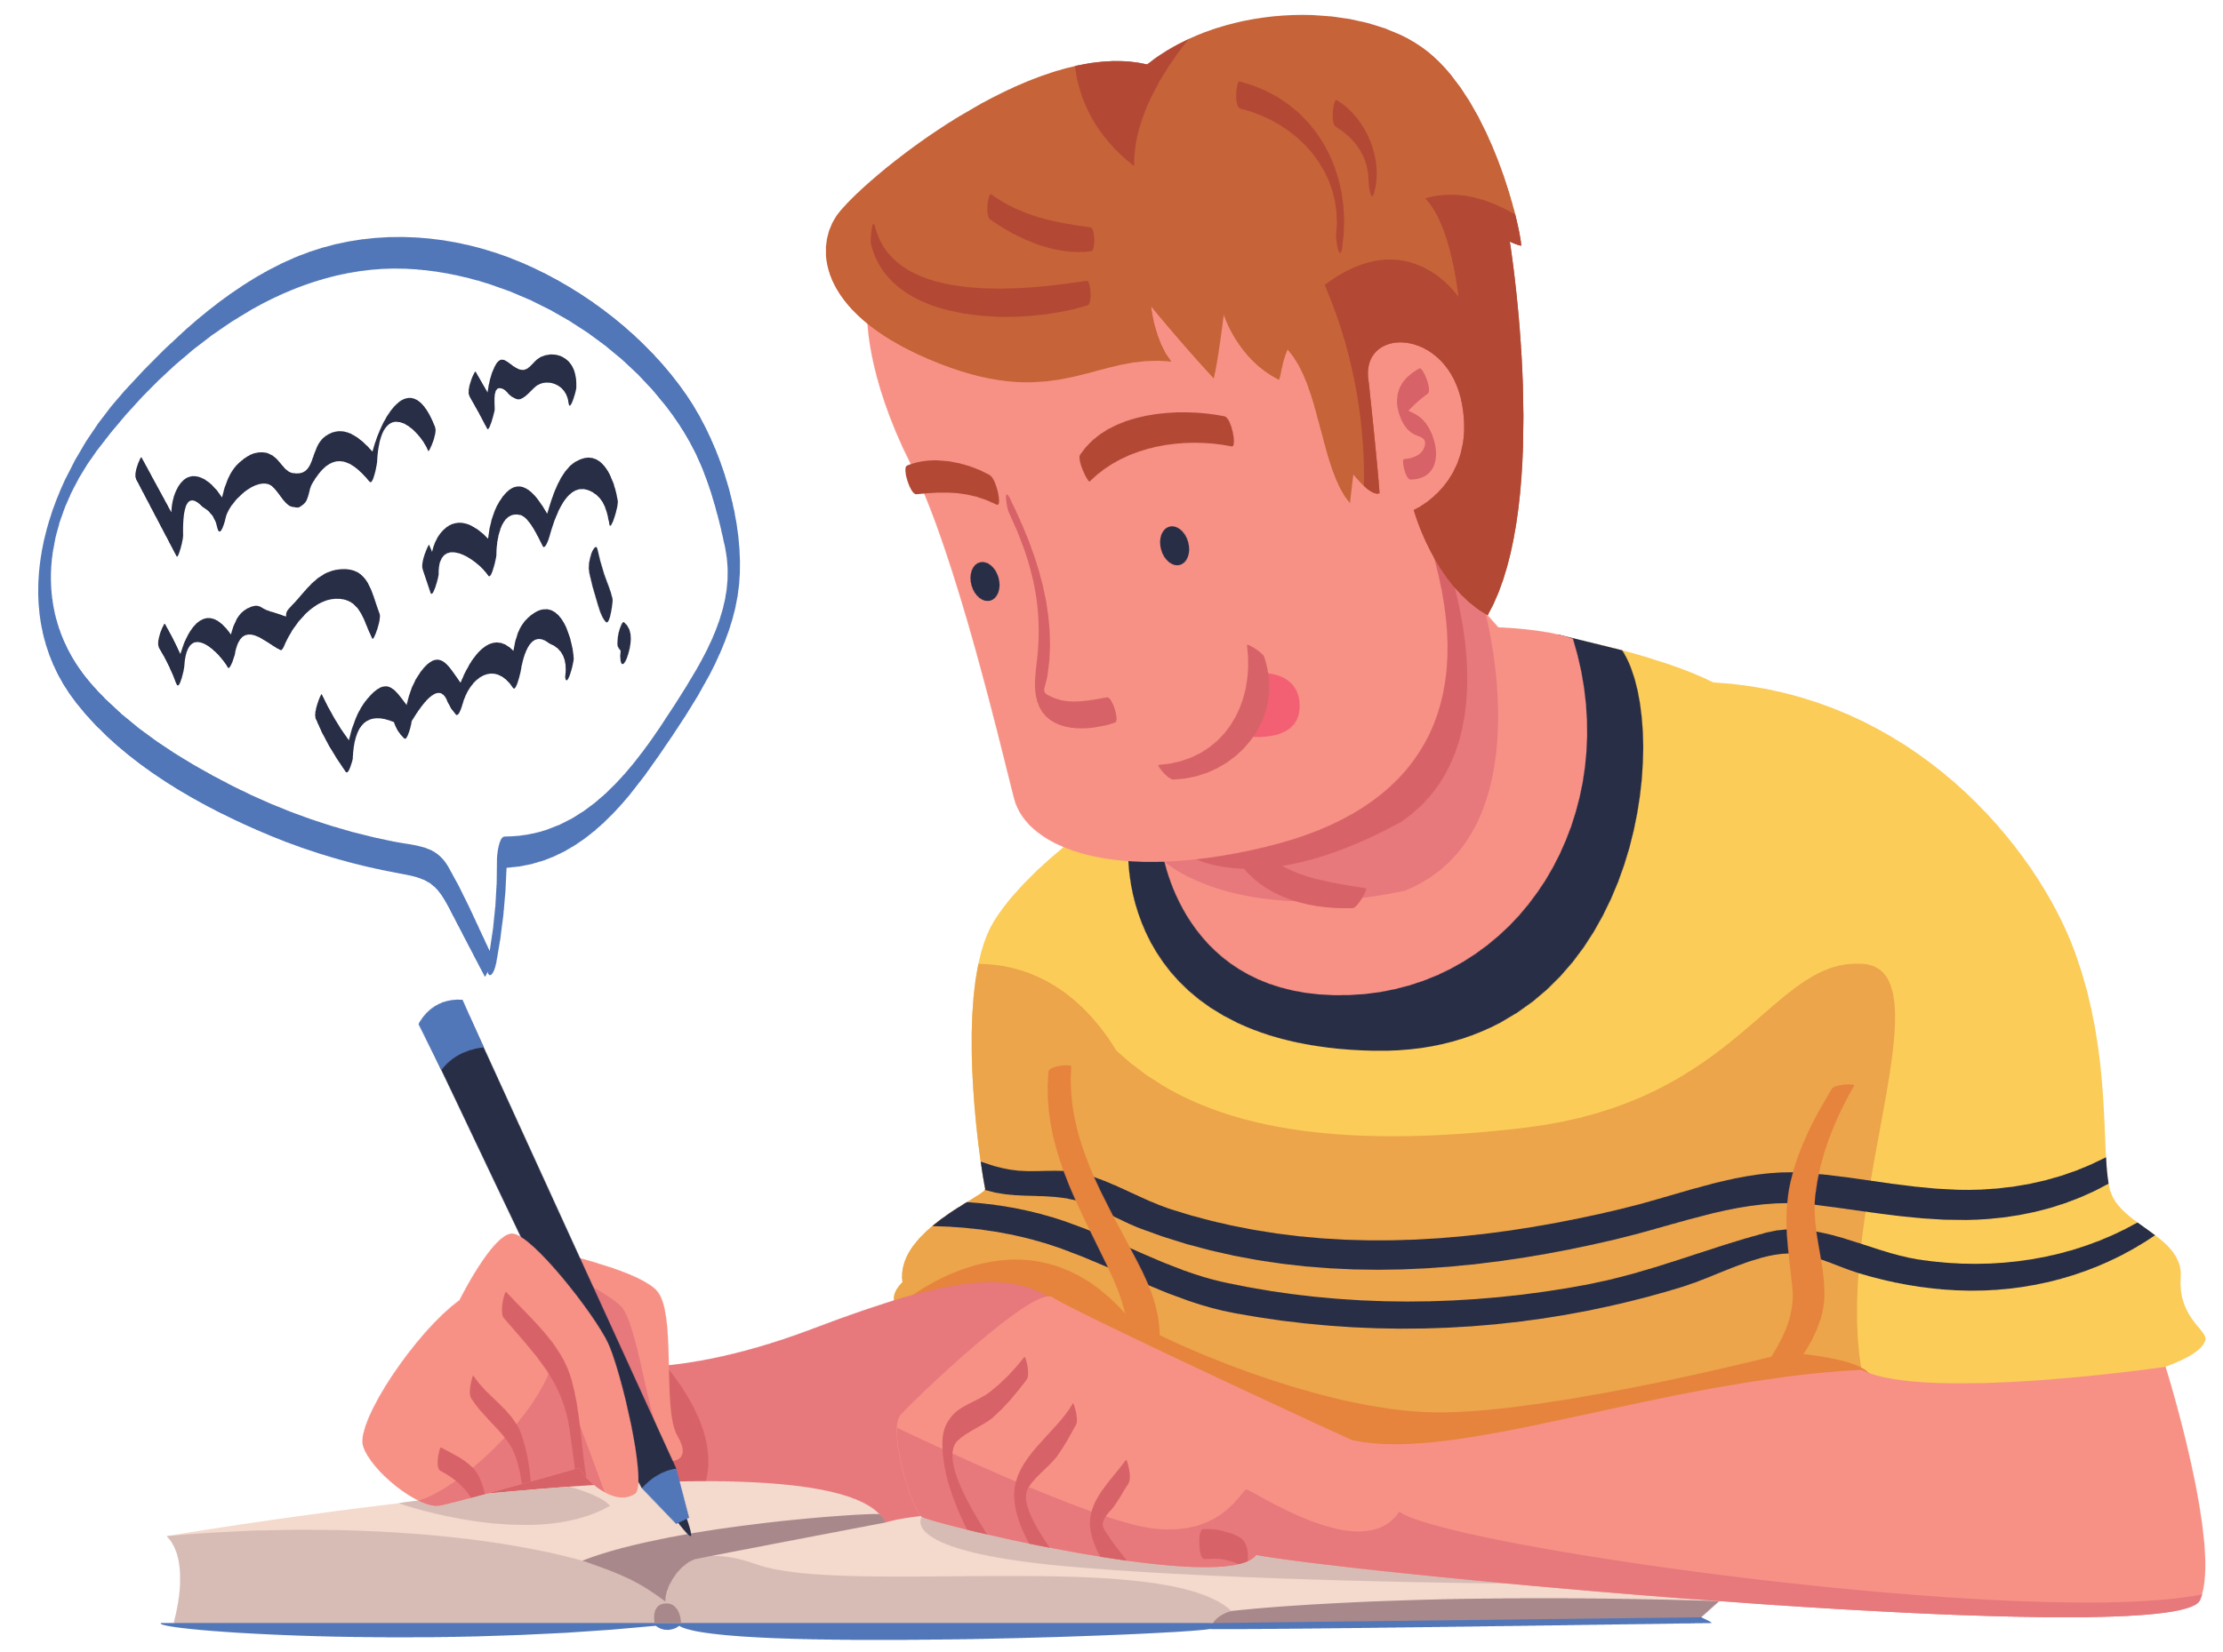
Notes
The use of the comma
When the if clause comes before the main clause, it is followed by a comma.
If you don't hurry, you'll miss the plane!
When the if clause comes after the main clause, there is no comma between the clauses.
You'll miss the plane if you don't hurry!

Slide 6

Summary
 | Zero or Real | First | Second
Condition | generally true | possible or likely to happen | imaginary or less likely to happen
Result | present or past | future | present or future

Slide 7

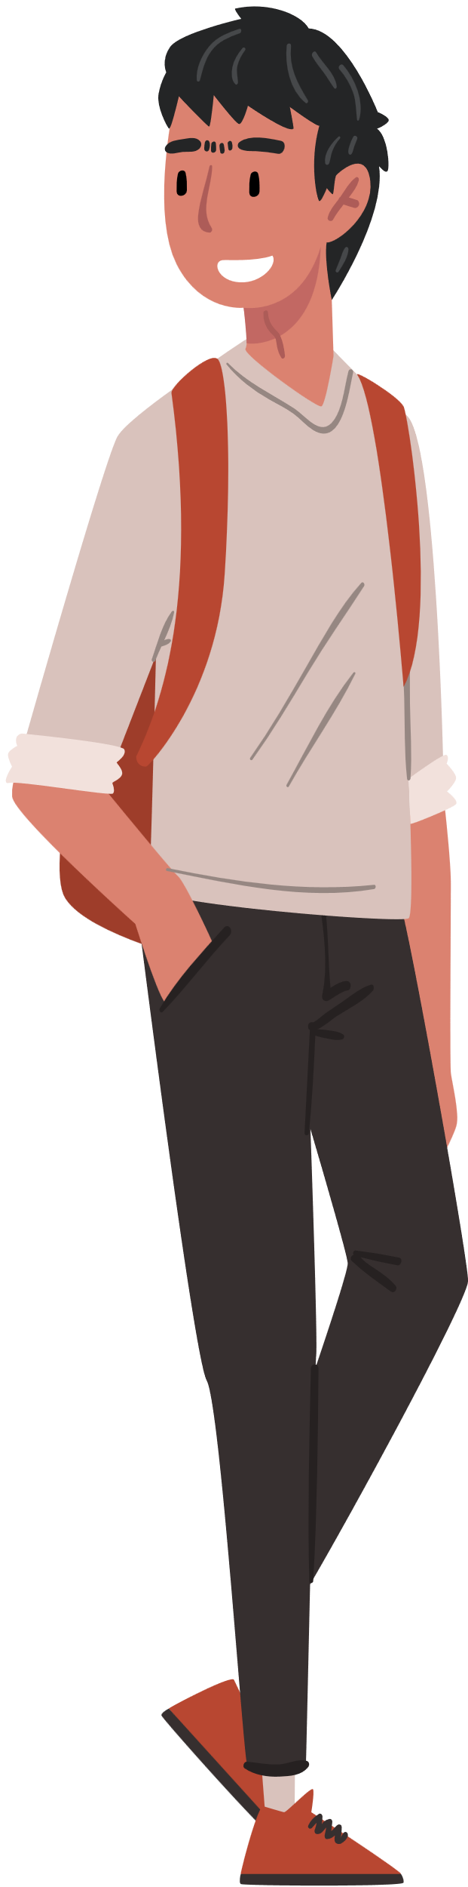
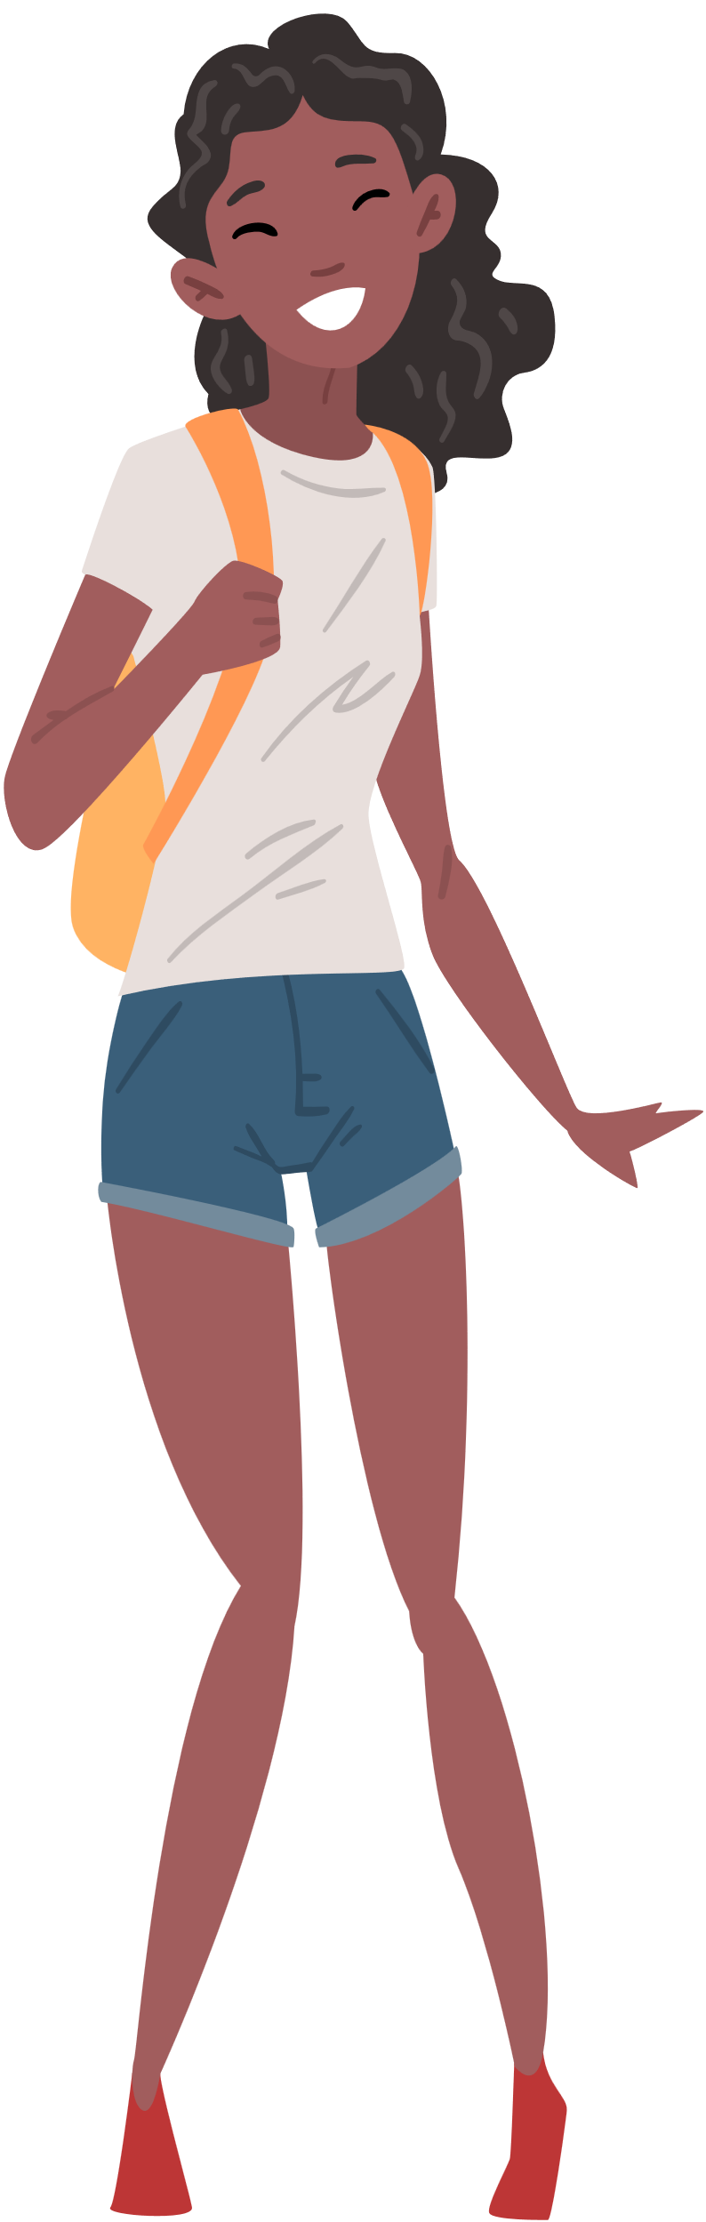
Happy learning!

