Slide 2
Use and Structure
The first conditional is used to talk about future situations
that are real or possible.
Can you identify the structure?
If I stay home tonight, I will be rested tomorrow.
If
+
present simple
,
will
+
infinitive.

Slide 3
Use and Structure
You can also change the order of the ‘clauses’ or different parts of the sentence:
I will be rested tomorrow if I stay home tonight.
Notice that in this order there is no comma!
Your turn! Try to make a sentence with: drink coffee / sleep
If I drink coffee, I won’t sleep tonight.
Or
I won’t sleep tonight, if I drink coffee.

Slide 4


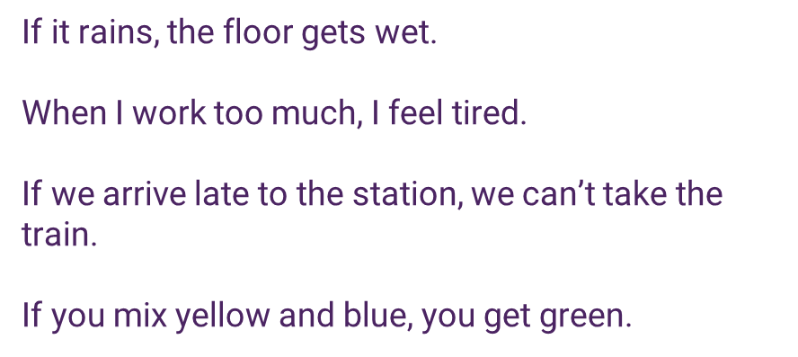
Use and Structure
We use the zero conditional for facts or things that are always true.

Slide 5
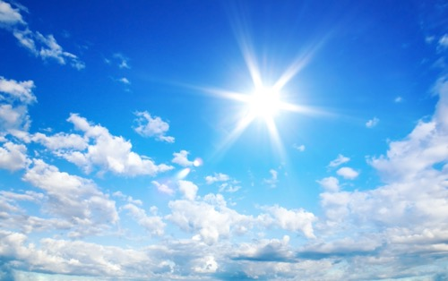
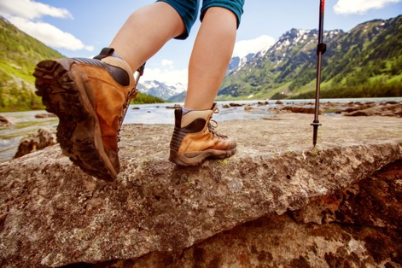
Make sentences in the first conditional
using the pictures
If
,
we
Suggestion: If it is sunny, we will go on a hike tomorrow.
Click to reveal suggestion

Slide 6
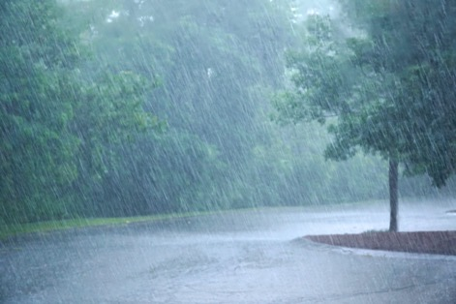
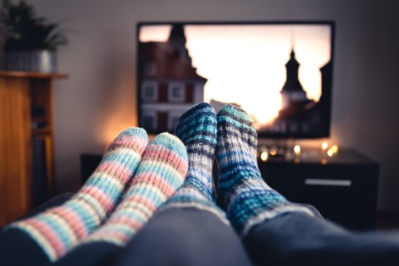
Make sentences in the first conditional
using the pictures
If
,
we
Suggestion: If it rains, we will watch a film at home.
Click to reveal suggestion

Slide 7

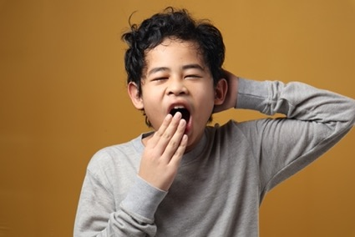
Make sentences in the first conditional
using the pictures
If I don’t
,
I
Suggestion: If I don’t drink coffee this morning, I will feel
very sleepy later.
Click to reveal suggestion

Slide 8
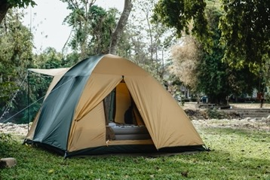
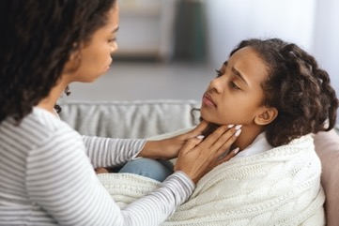
Make sentences in the first conditional
using the pictures
We
if my daughter
Suggestion: We won’t go camping if my daughter is still sick.
Click to reveal suggestion

Slide 9
Complete the gaps
If I __________ time, I __________ for a walk this evening. (have / go)
If we __________ the restaurant, we __________ back. (like / come)
I __________ the train if I __________ work late. (miss / leave)
They __________ to visit us on the weekend if Joe __________ better. (come / feel)
If the weather __________ nice, we __________ to the beach. (be / go)
If I ___________ early tomorrow, I ___________ tired for the rest of the day. (wake up / be )
Click to reveal answers

Slide 10
Complete the gaps
If I have time, I will go for a walk this evening.
If we like the restaurant, we will come back.
I __________ the train if I __________ work late. (miss / leave)
They __________ to visit us on the weekend if Joe __________ better. (come / feel)
If the weather __________ nice, we __________ to the beach. (be / go)
If I ___________ early tomorrow, I ___________ tired for the rest of the day. (wake up / be )
Click to reveal answers

Slide 11
Complete the gaps
If I have time, I will go for a walk this evening.
If we like the restaurant, we will come back.
I will miss the train if I leave work late.
They __________ to visit us on the weekend if Joe __________ better. (come / feel)
If the weather __________ nice, we __________ to the beach. (be / go)
If I ___________ early tomorrow, I ___________ tired for the rest of the day. (wake up / be )
Click to reveal answers

Slide 12
Complete the gaps
If I have time, I will go for a walk this evening.
If we like the restaurant, we will come back.
I will miss the train if I leave work late.
They will come to visit us on the weekend if Joe feels better.
If the weather __________ nice, we __________ to the beach. (be / go)
If I ___________ early tomorrow, I ___________ tired for the rest of the day. (wake up / be )
Click to reveal answers

Slide 13
Complete the gaps
If I have time, I will go for a walk this evening.
If we like the restaurant, we will come back.
I will miss the train if I leave work late.
They will come to visit us on the weekend if Joe feels better.
If the weather is nice, we will go to the beach.
If I ___________ early tomorrow, I ___________ tired for the rest of the day. (wake up / be )
Click to reveal answers

Slide 14
Complete the gaps
If I have time, I will go for a walk this evening.
If we like the restaurant, we will come back.
I will miss the train if I leave work late.
They will come to visit us on the weekend if Joe feels better.
If the weather is nice, we will go to the beach.
If I wake up early tomorrow, I will be tired for the rest of the day.
Click to reveal answers

Slide 15
Make sentences using the verbs given
cook / tidy up
Suggestion: If you cook dinner, I will tidy up the kitchen.
drive / dizzy
Suggestion: If you drive fast, I will get dizzy.
rains / go
Suggestion: If it rains, I won’t go to the concert.
Click to reveal suggestions

Slide 16
I will be late
If he doesn’t call back,
I will be upset,
if they don’t come tonight.
if I don’t leave soon.
I will go by myself.
If I stay up until late,
She will be alone,
If you lie,
I will be very tired tomorrow.
if we go on holiday this weekend.
nobody will like you.

Slide 17
If you don’t hurry,
If I she her this afternoon,
He will be exhausted
we will miss the train.
if keep working so hard.
I will talk to her.
If I don’t finish this project at the end of the week,
I won’t be able to
join you,
If it doesn’t rain,
if my daughter is still sick.
we will go out tonight.
I will be fired.

Slide 18
Conversation with a partner: What will you do….
if you finish work earlier today?
if your family comes for a surprise visit?
if it rains a lot on the weekend?
if you can’t find the keys for your car after work?

Slide 19
Thank you!

