Slide 1
Amal Al Ismaili

Slide 2
In this lesson, you will:
Learn what reported speech is and why it is important
Unscramble sentences
Practise writing in reported speech

Slide 3
What Is Reported Speech and Why Do We Use It?
Reported speech is when we tell someone what another person said.
We use it to share information or convey someone else's message.

Slide 4
How to Write Reported Speech
Step 1:
Remove quotation marks
Step 2:
Change the pronoun
Step 3:
Change the tense to past tense
Step 4:
Remember to change the time and place words in your sentence to be past tense as well

Slide 5
The Difference between Reported Speech and Direct Speech
Step 1:
Remove
quotation marks
Direct Speech Example:
She said, "I like ice cream."
Reported Speech Example:
She said that she liked ice cream.
For reported speech, we need to remember to not have any quotation marks!

Slide 6
Pronoun Changes in Reported Speech
Step 2:
Change
the pronoun
In reported speech, the pronoun changes.
I → he/she,
my → his/her,
me → him/her
Eg: He said, “I am going for a run.”
He said that he was going for a run.

Slide 7
Step 3:
Change the tense to past tense
Changes in verb tenses happen in reported speech.
present → past, past → past perfect
Eg: He said, “My teacher likes books.”
He said that his teacher liked books.

Slide 8
Step 4:
Remember to change the time and place words in your sentence to be past tense as well
Changes in time and place words happen in reported speech.
here → there
Eg: She said, “I am going to put my keys down here.”
She said that she was going to put her keys down there.
This is because these words will change to be past tense

Slide 9

Let’s Practise!
Choose the correct reported speech:
Direct: "I am reading a book.”
He said that he reads a book.
He said that he was reading a book.
He said that he read a book.

Slide 10

Let’s Practise!
Choose the correct reported speech:
Direct: "They are my friends."
He said they were his friends.
He said they are his friends.
He said they is his friends.

Slide 11

Let’s Practise!
Choose the correct reported speech:
Direct: He said, "She likes chocolate."
He said that she likes chocolate.
He said that she liked chocolate.
He said that she like chocolate.

Slide 12
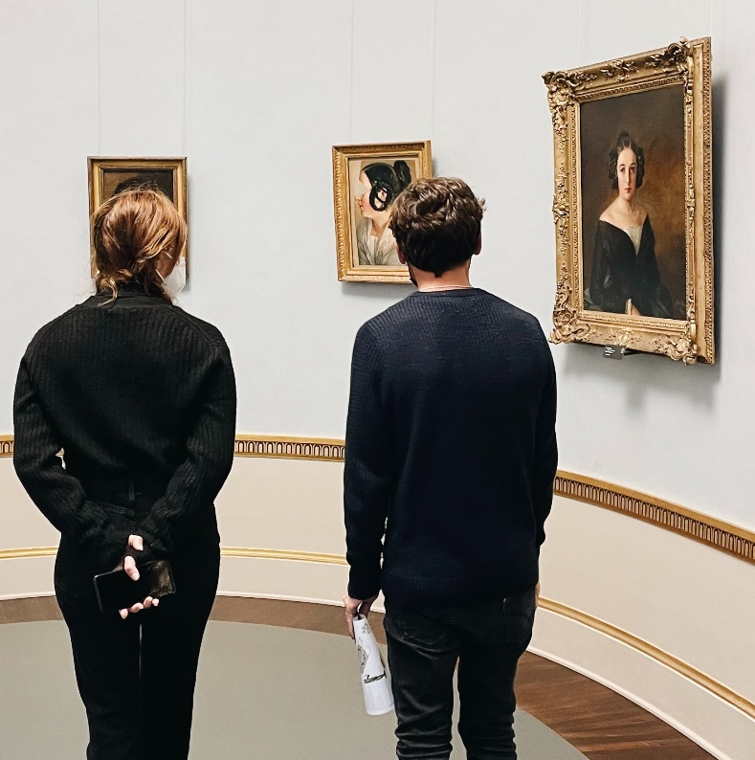
Let’s Practise!
Choose the correct reported speech:
Direct: They said, "We can visit the museum tomorrow."
They said they can visit the museum tomorrow.
They said they visits the museum tomorrow.
They said they could visit the
museum tomorrow.

Slide 13
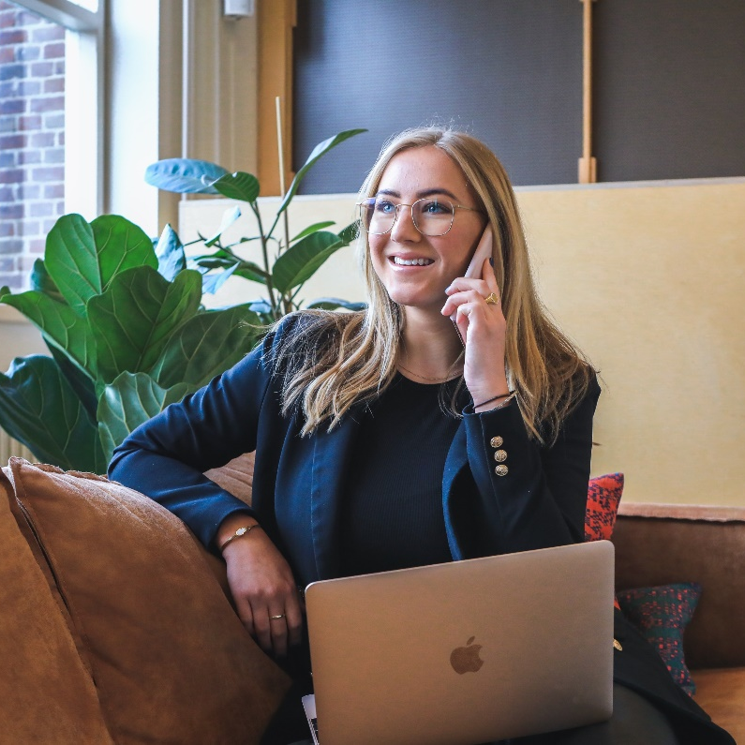
Let’s Practise!
Choose the correct reported speech:
Direct: She said, "I will call you later."
She said she will call me later.
She said she would call me later.
She said she calls me later.

Slide 14
Unscramble the Sentence:
told / that / homework /. / finish / you / your / she / that / should
Answer: She told you that you should finish your homework.

Slide 15
Unscramble the Sentence:
movie / wanted / to / watch / she / the / .
Answer: She wanted to watch the movie.

Slide 16
Unscramble the Sentence:
school / to / going / said/ he / that / he / is / .
Answer: He said that he is going to school.

Slide 17
Create Your Own Reported Speech
Direct: "I have never been to London," she said.
Answer: She said that she had never been to London.

Slide 18
Create Your Own Reported Speech
Direct: He said, “I really love chocolate!”
Answer: He said that he really loved chocolate.

Slide 19
Free Discussion
Use these questions to discuss with a partner and practise your reported speech!
What was the best advice you've ever heard?
Can you think of a time you had a miscommunication with a friend?
Can you remember something important a teacher told you?

Slide 20
Summary
Step 1:
Remove quotation marks
Step 2:
Change the pronoun
Step 3:
Change the tense to past tense
Step 4:
Remember to change the time and place words in your sentence to be past tense as well

