Slide 1


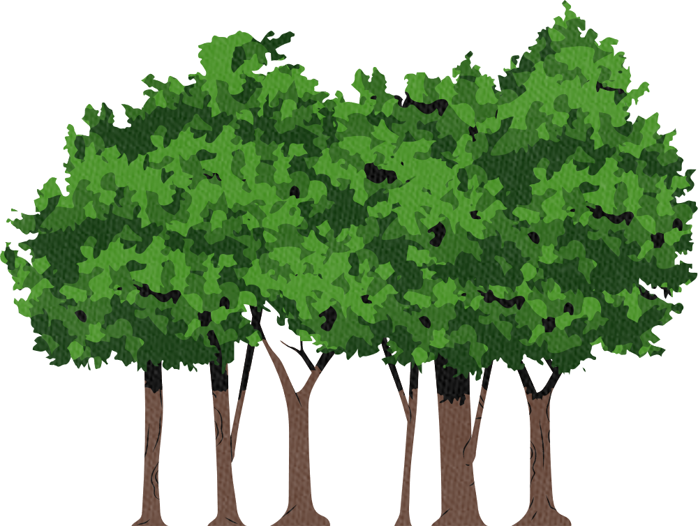

Our Planet
Amal Al Ismaili

Slide 2

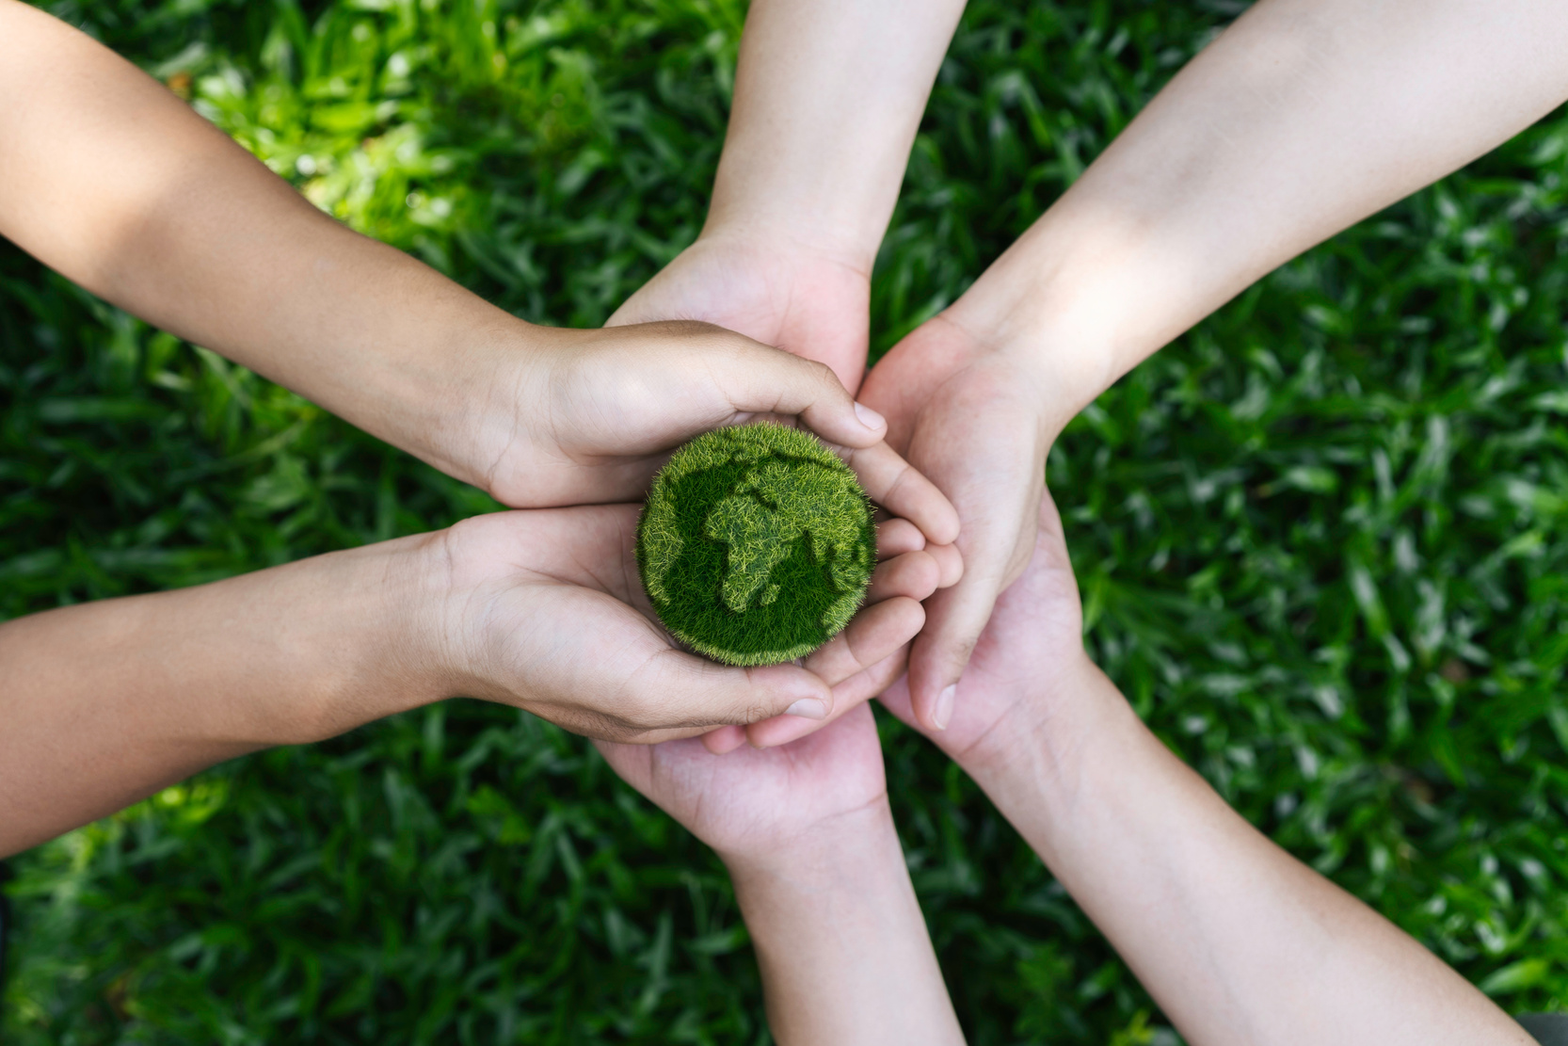


revising vocabulary

Slide 3

Climate Change

Slide 4

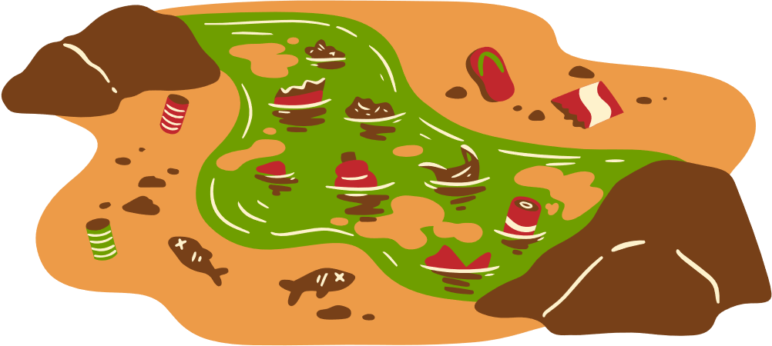
Pollution

Slide 5
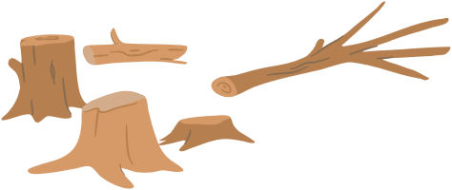

Deforestation

Slide 6
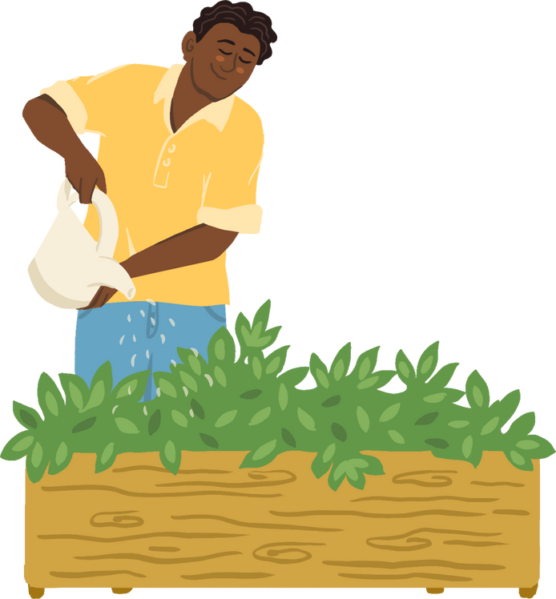

Plants tree

Slide 7
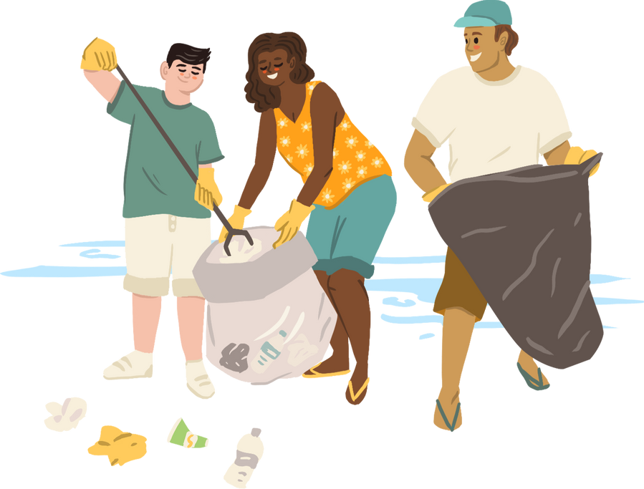

Pick up rubbish

Slide 8
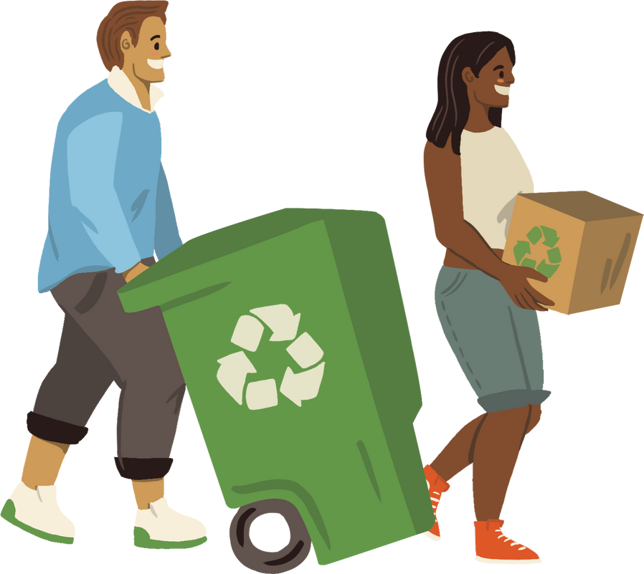
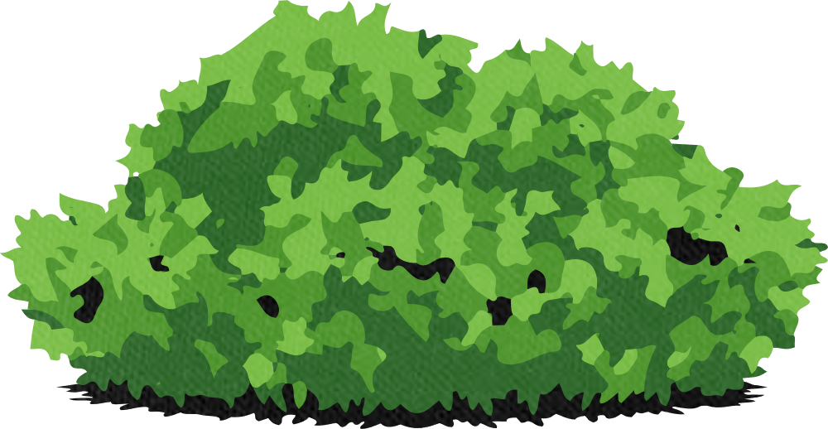
recycle

Slide 9
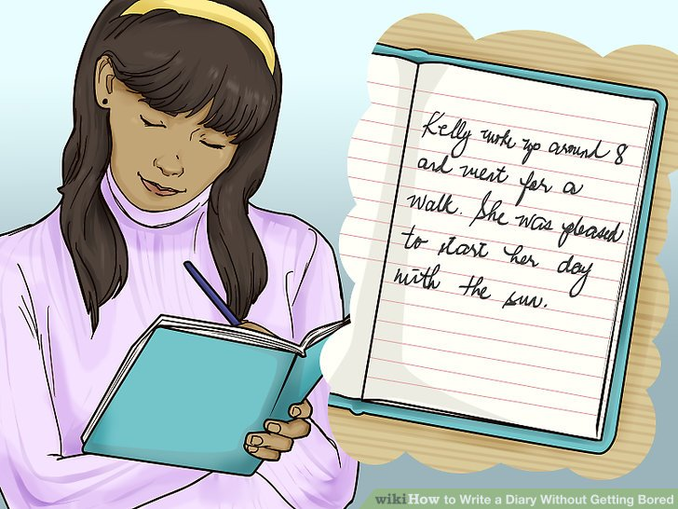
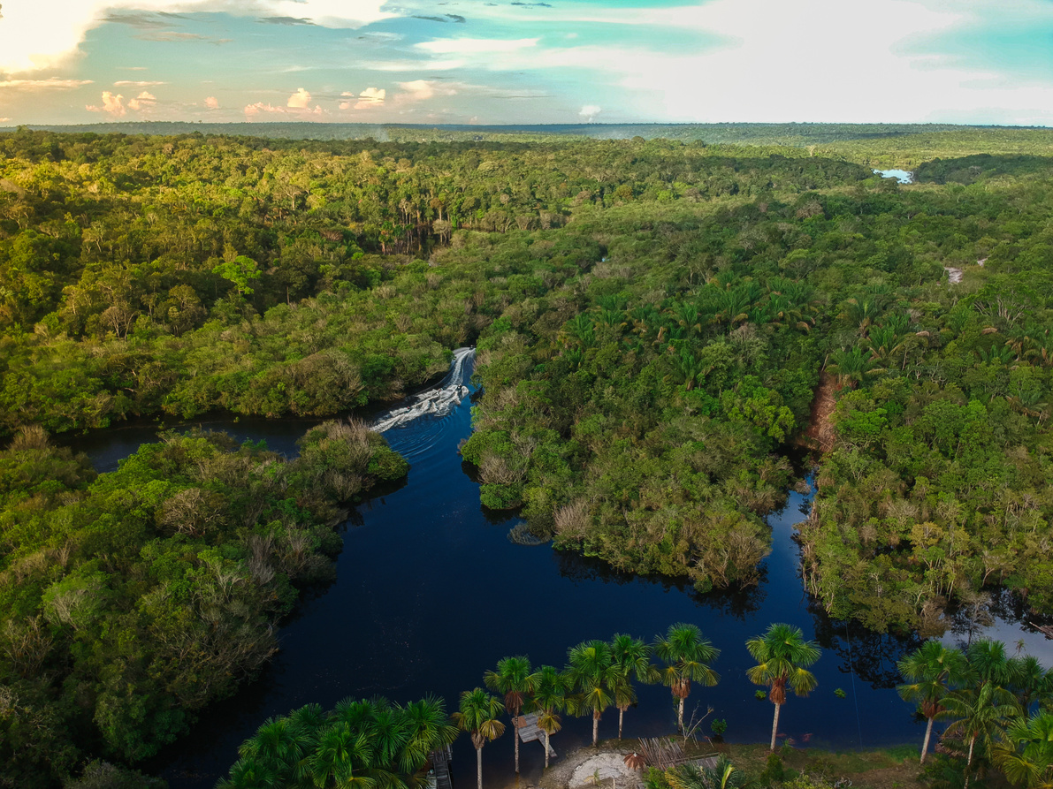
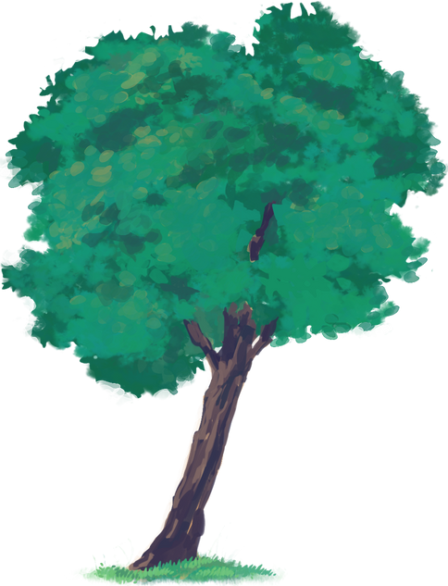
diary

Slide 10
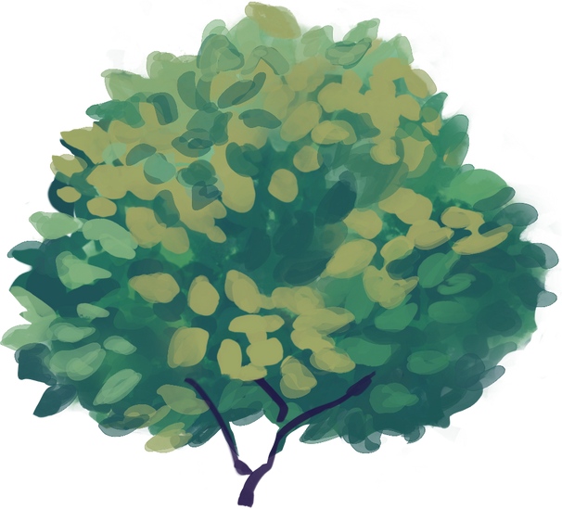
First person
informal
Writer’s life
feelings

Slide 11
He saw the news on his phone.
He spent the first morning in the dining room.
It was the safest place in the house.
They put it in front of the doors.
He told him to hold his hand.

