Slide 1
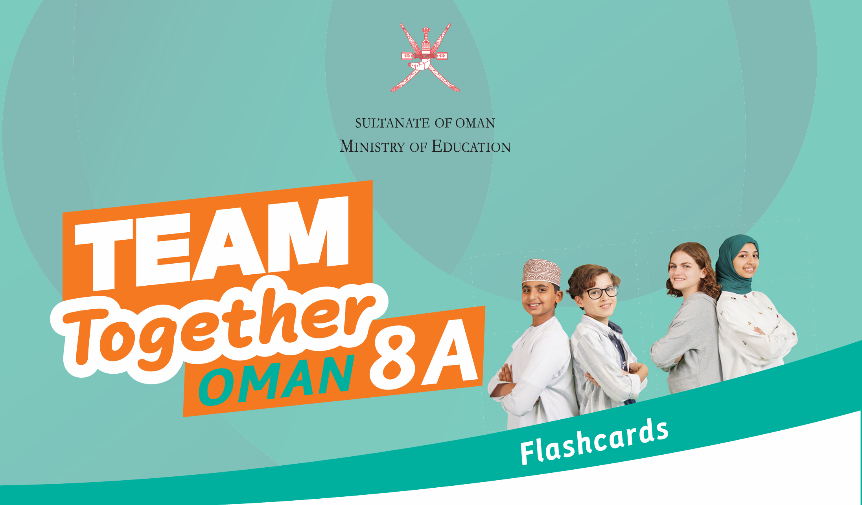
Lesson 9

Slide 2
Grade 8A
Lesson 9
Part 1 & 2

Slide 3
Part 1

Slide 4
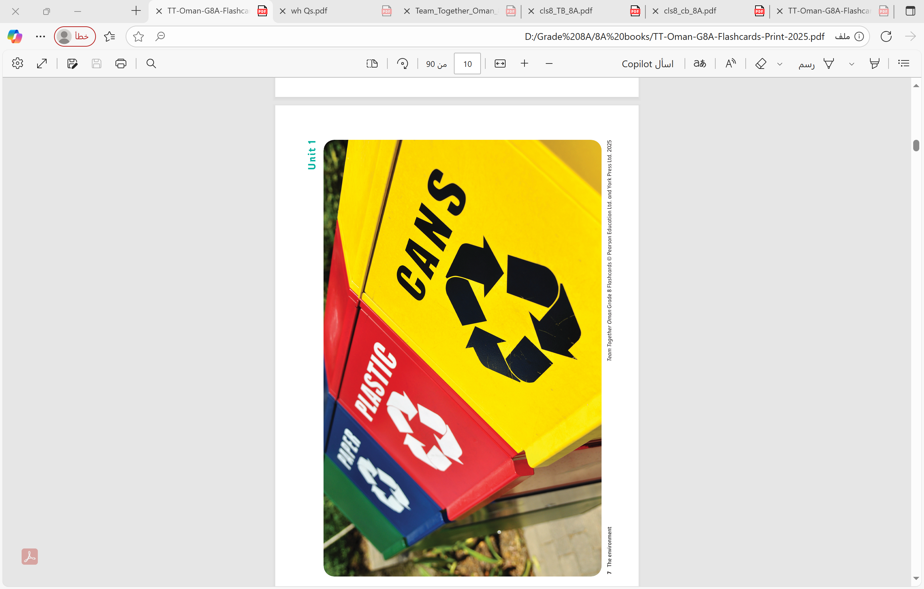
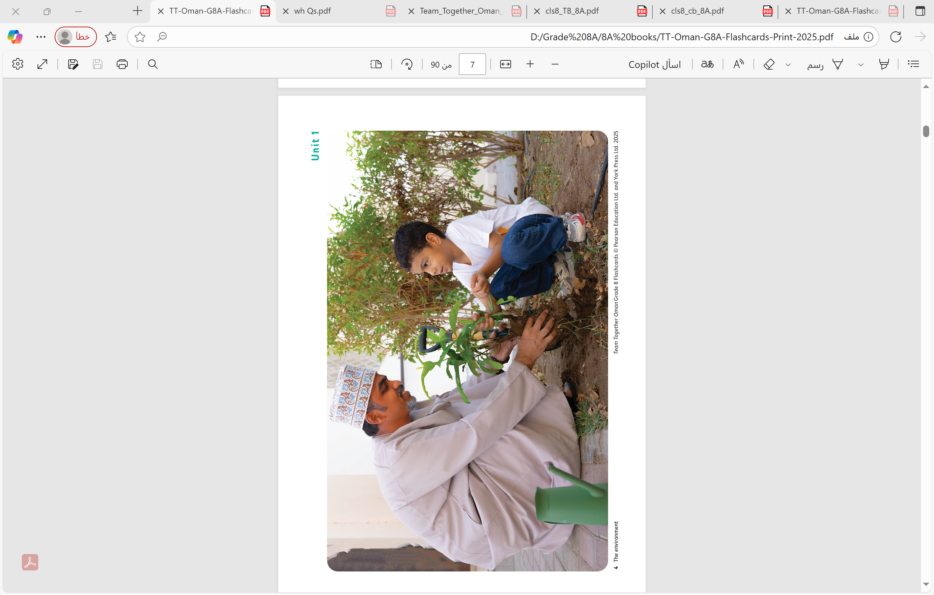

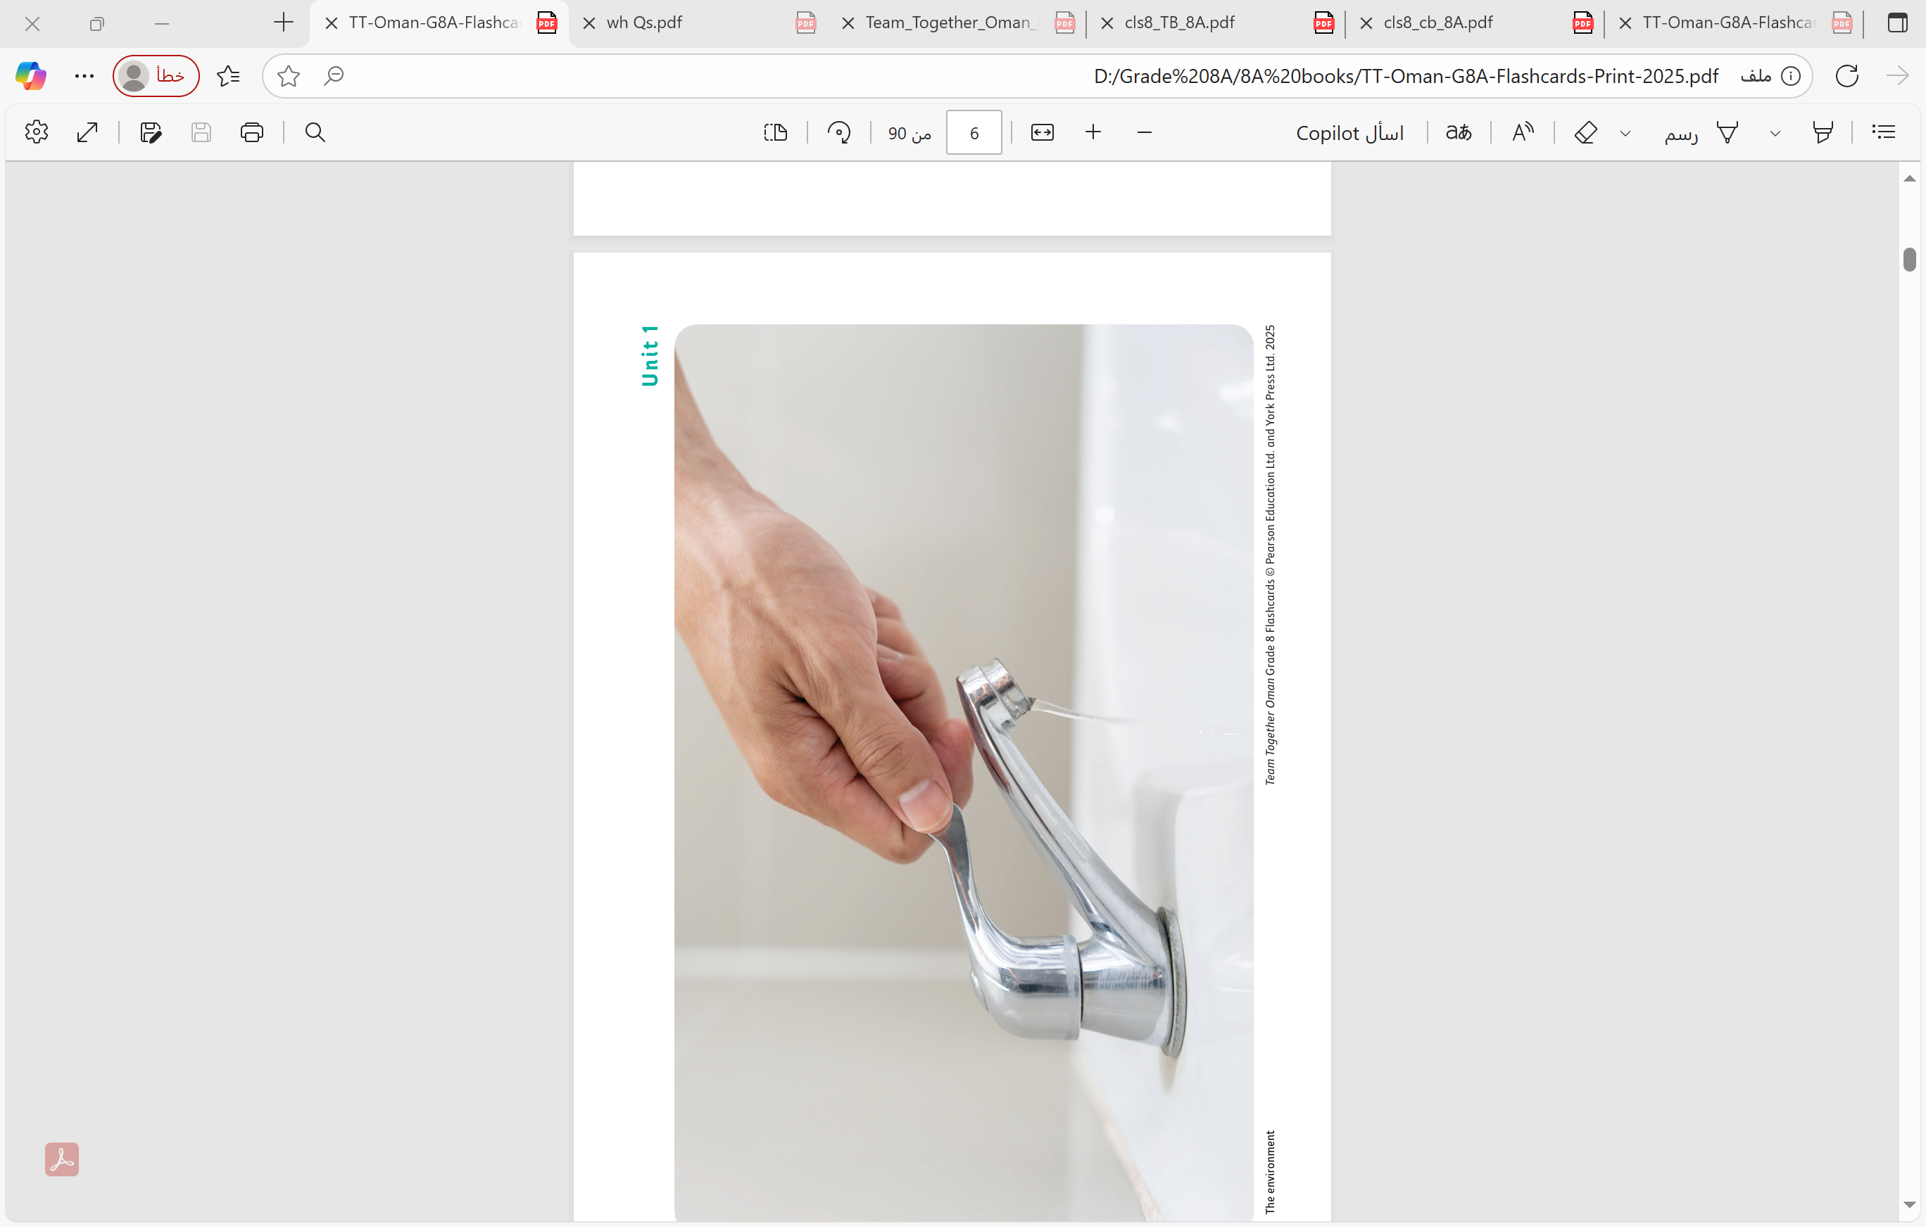

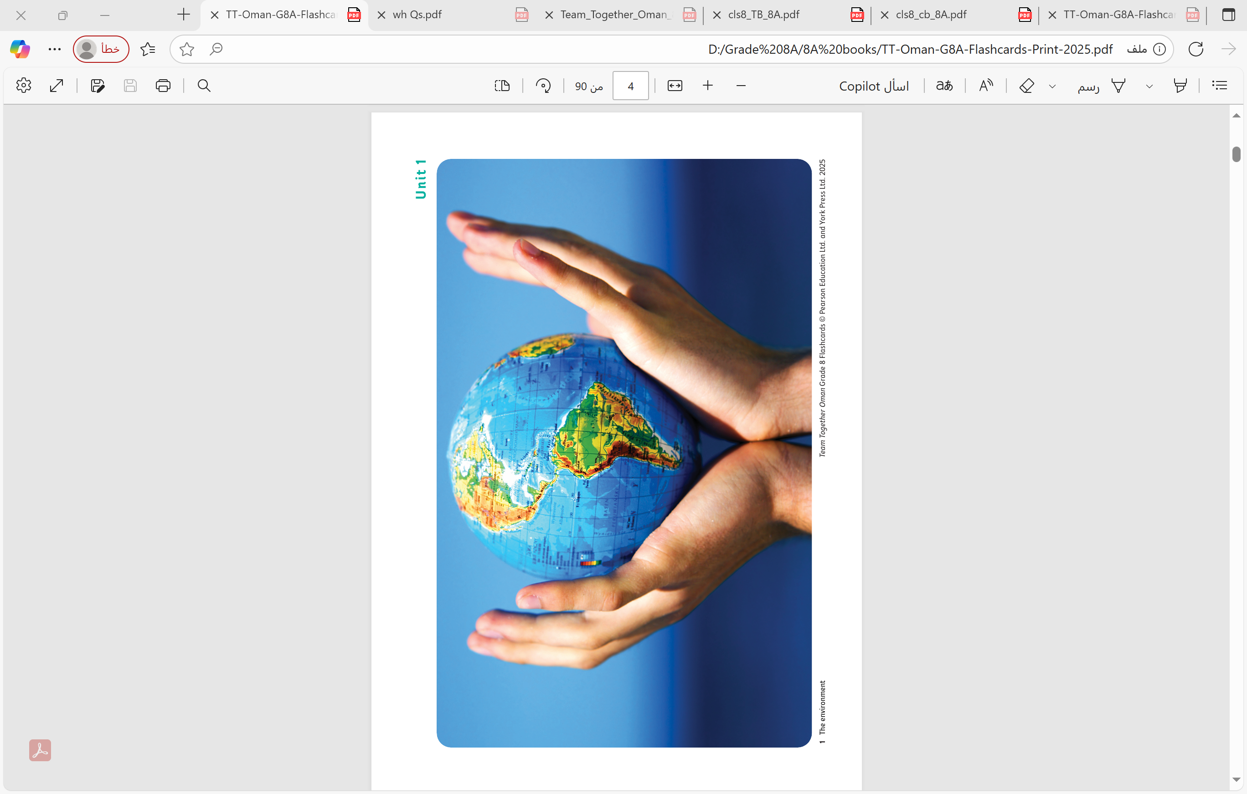
Warming up
Write as many environment words as you can remember.
You have 1 minute ONLY

Slide 5
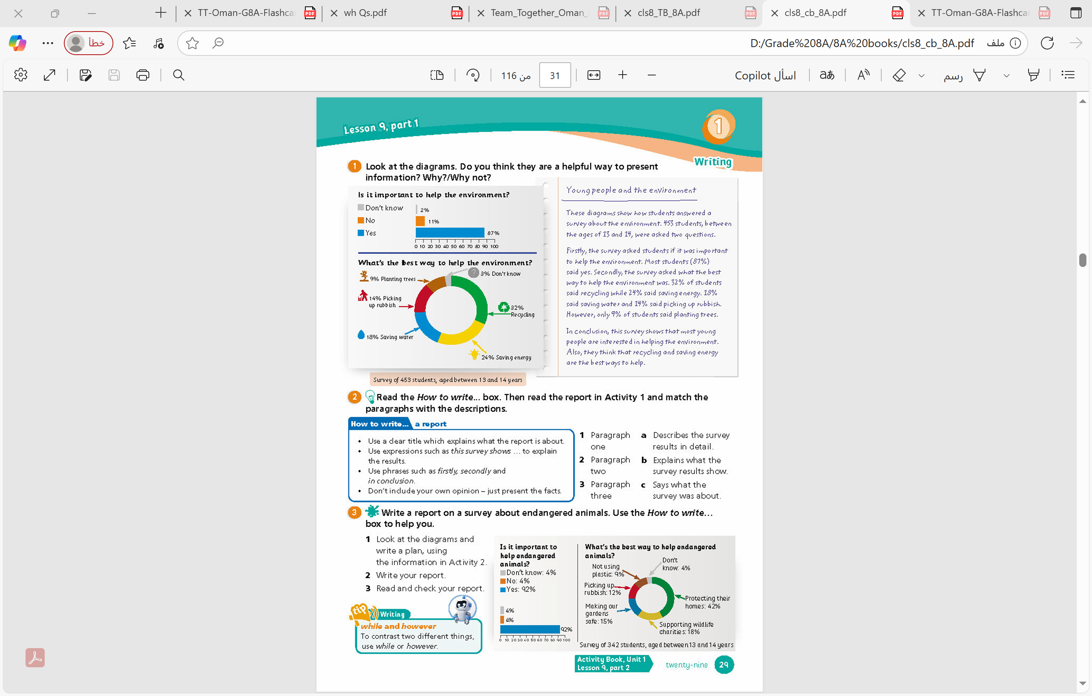
Class Book
Page 29
Activity 1

Slide 6
Yes, because you can easily see the answers in visual form.
Class Book
Page 29
Activity 1

Slide 7
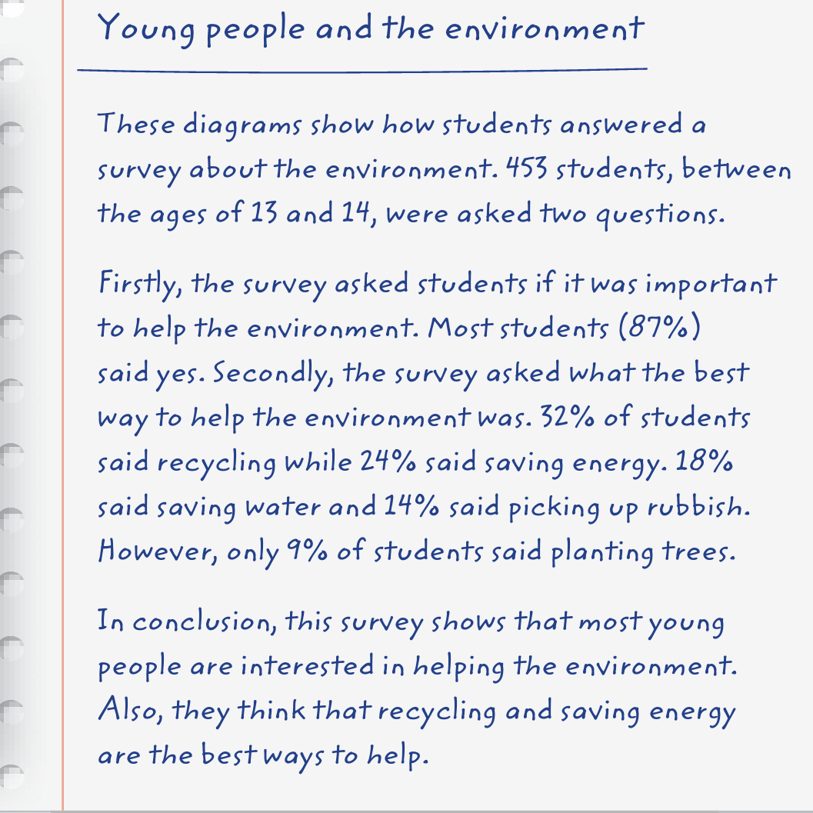
Read
and
understand

Slide 8
Answer the Following Questions Orally
1- What was the survey about?
(the environment)
2- How old were the students who took part?
(between 13 and 14)
3- How many students thought picking up rubbish was the best way to help?
(14%)
4- Did the survey show that students are interested or not interested in the environment?
(interested)

Slide 9
Class Book
Page 29
Activity 2

Slide 10
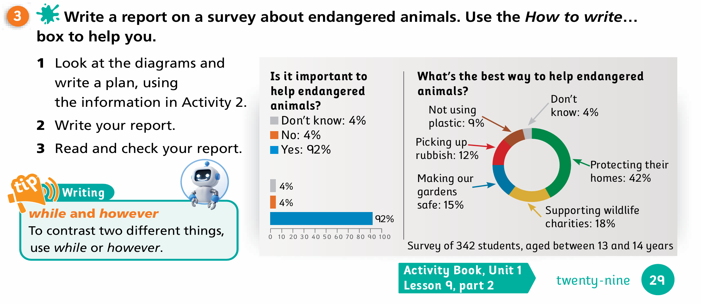
Class Book
Page 29
Activity 3

Slide 11
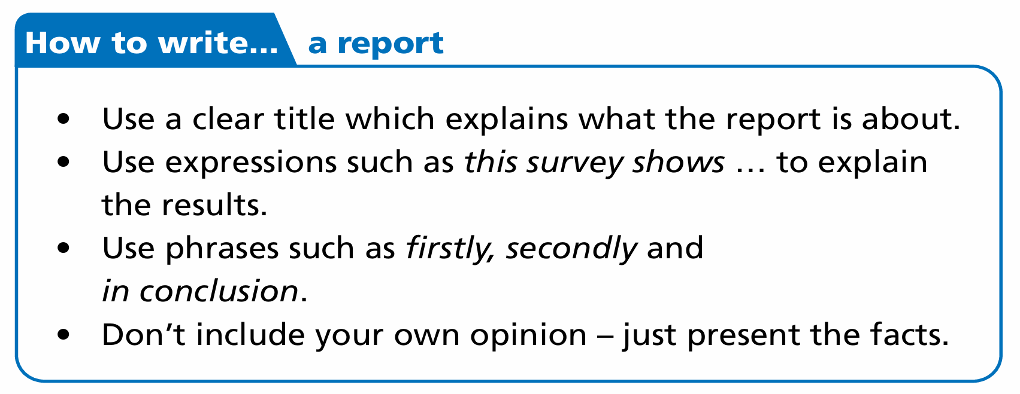

Slide 12

VS

Slide 13
- We use while in the same sentence to contrast two ideas
(e.g. I like swimming while my best friend likes running),
- We use however at the start of a new sentence and is followed by a comma.
(e.g. I like swimming. However, my best friend likes running)

Slide 14
Let’s play a game

Slide 15


Slide 16
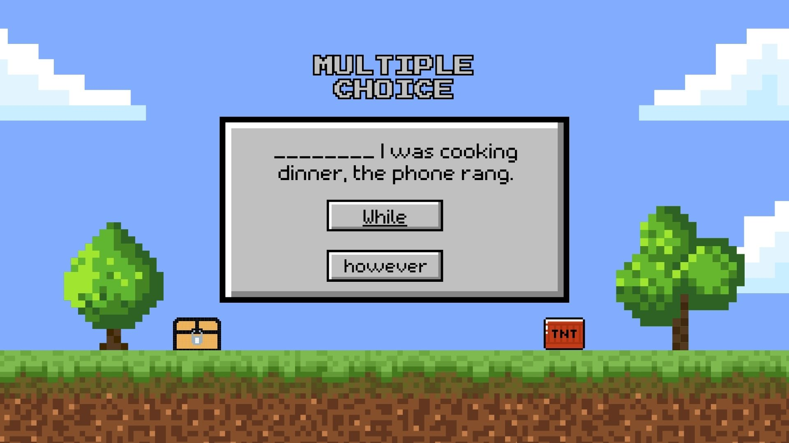
1

Slide 17

2

Slide 18
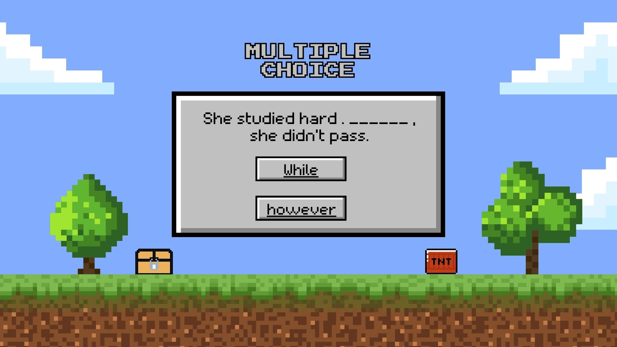
3

Slide 19
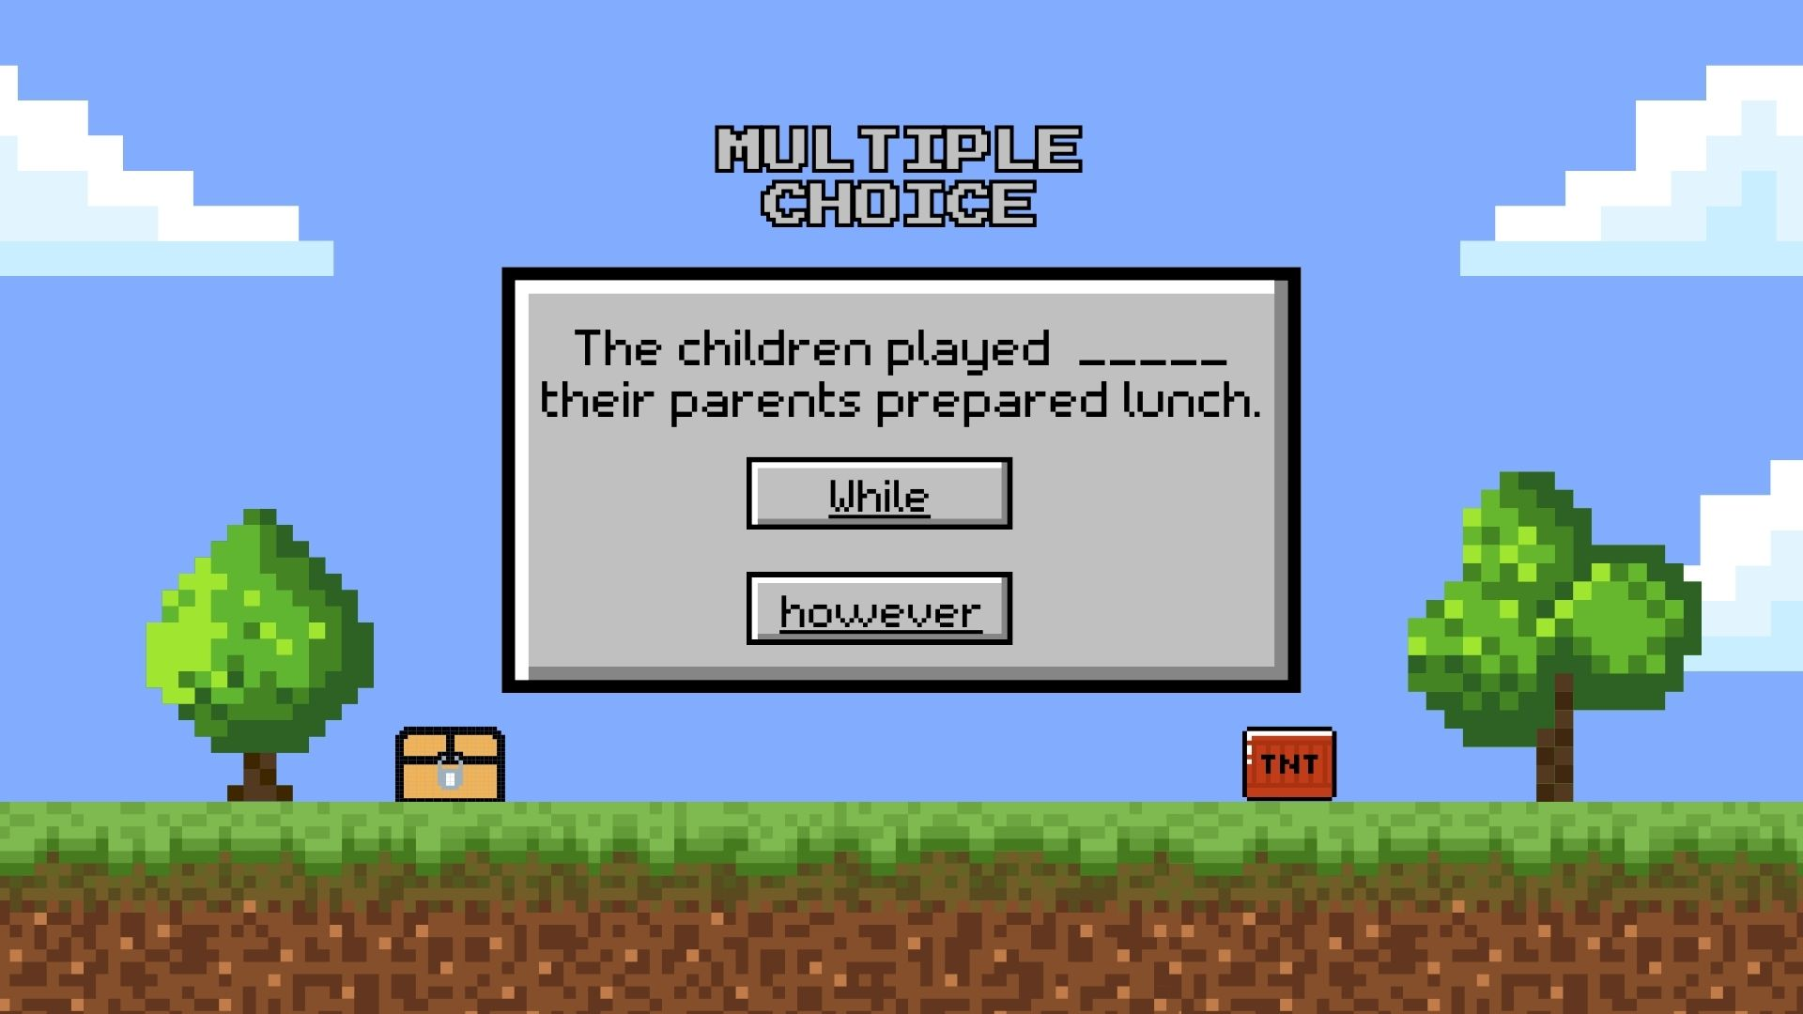
4

Slide 20
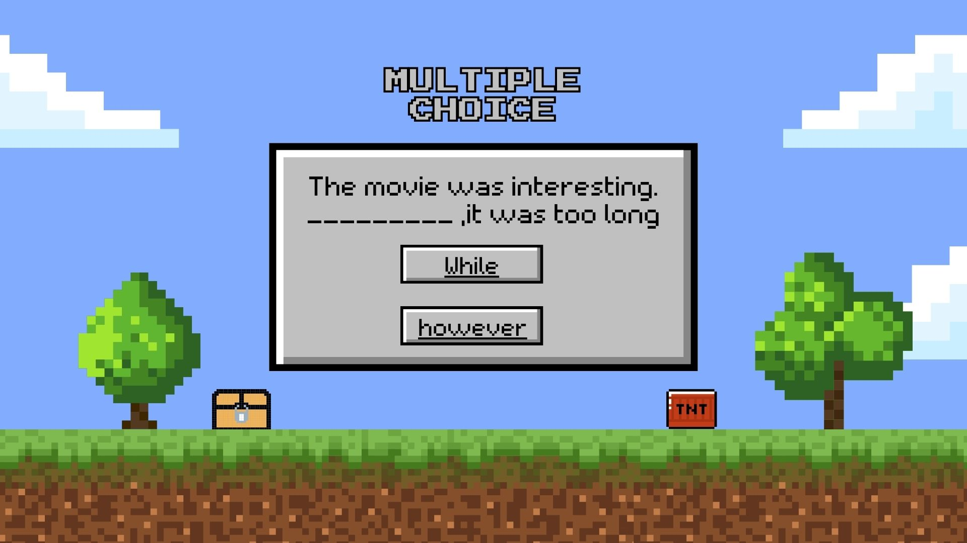
5

Slide 21

6

Slide 22
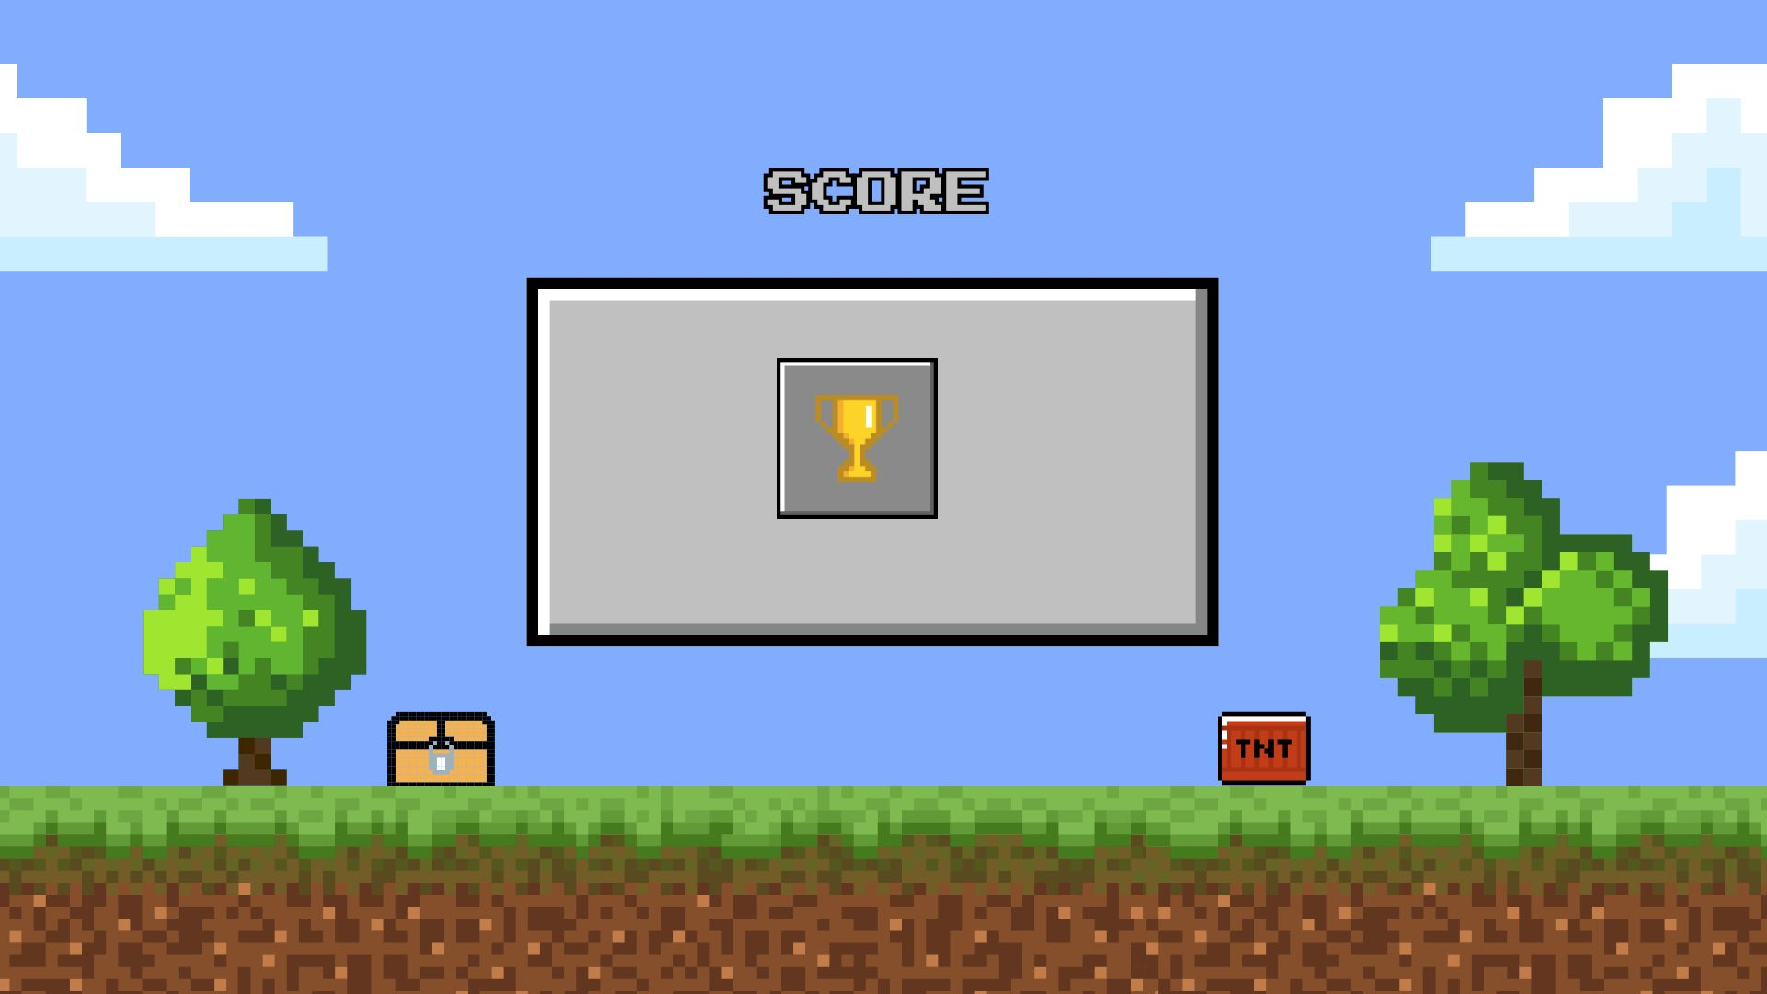

Slide 23
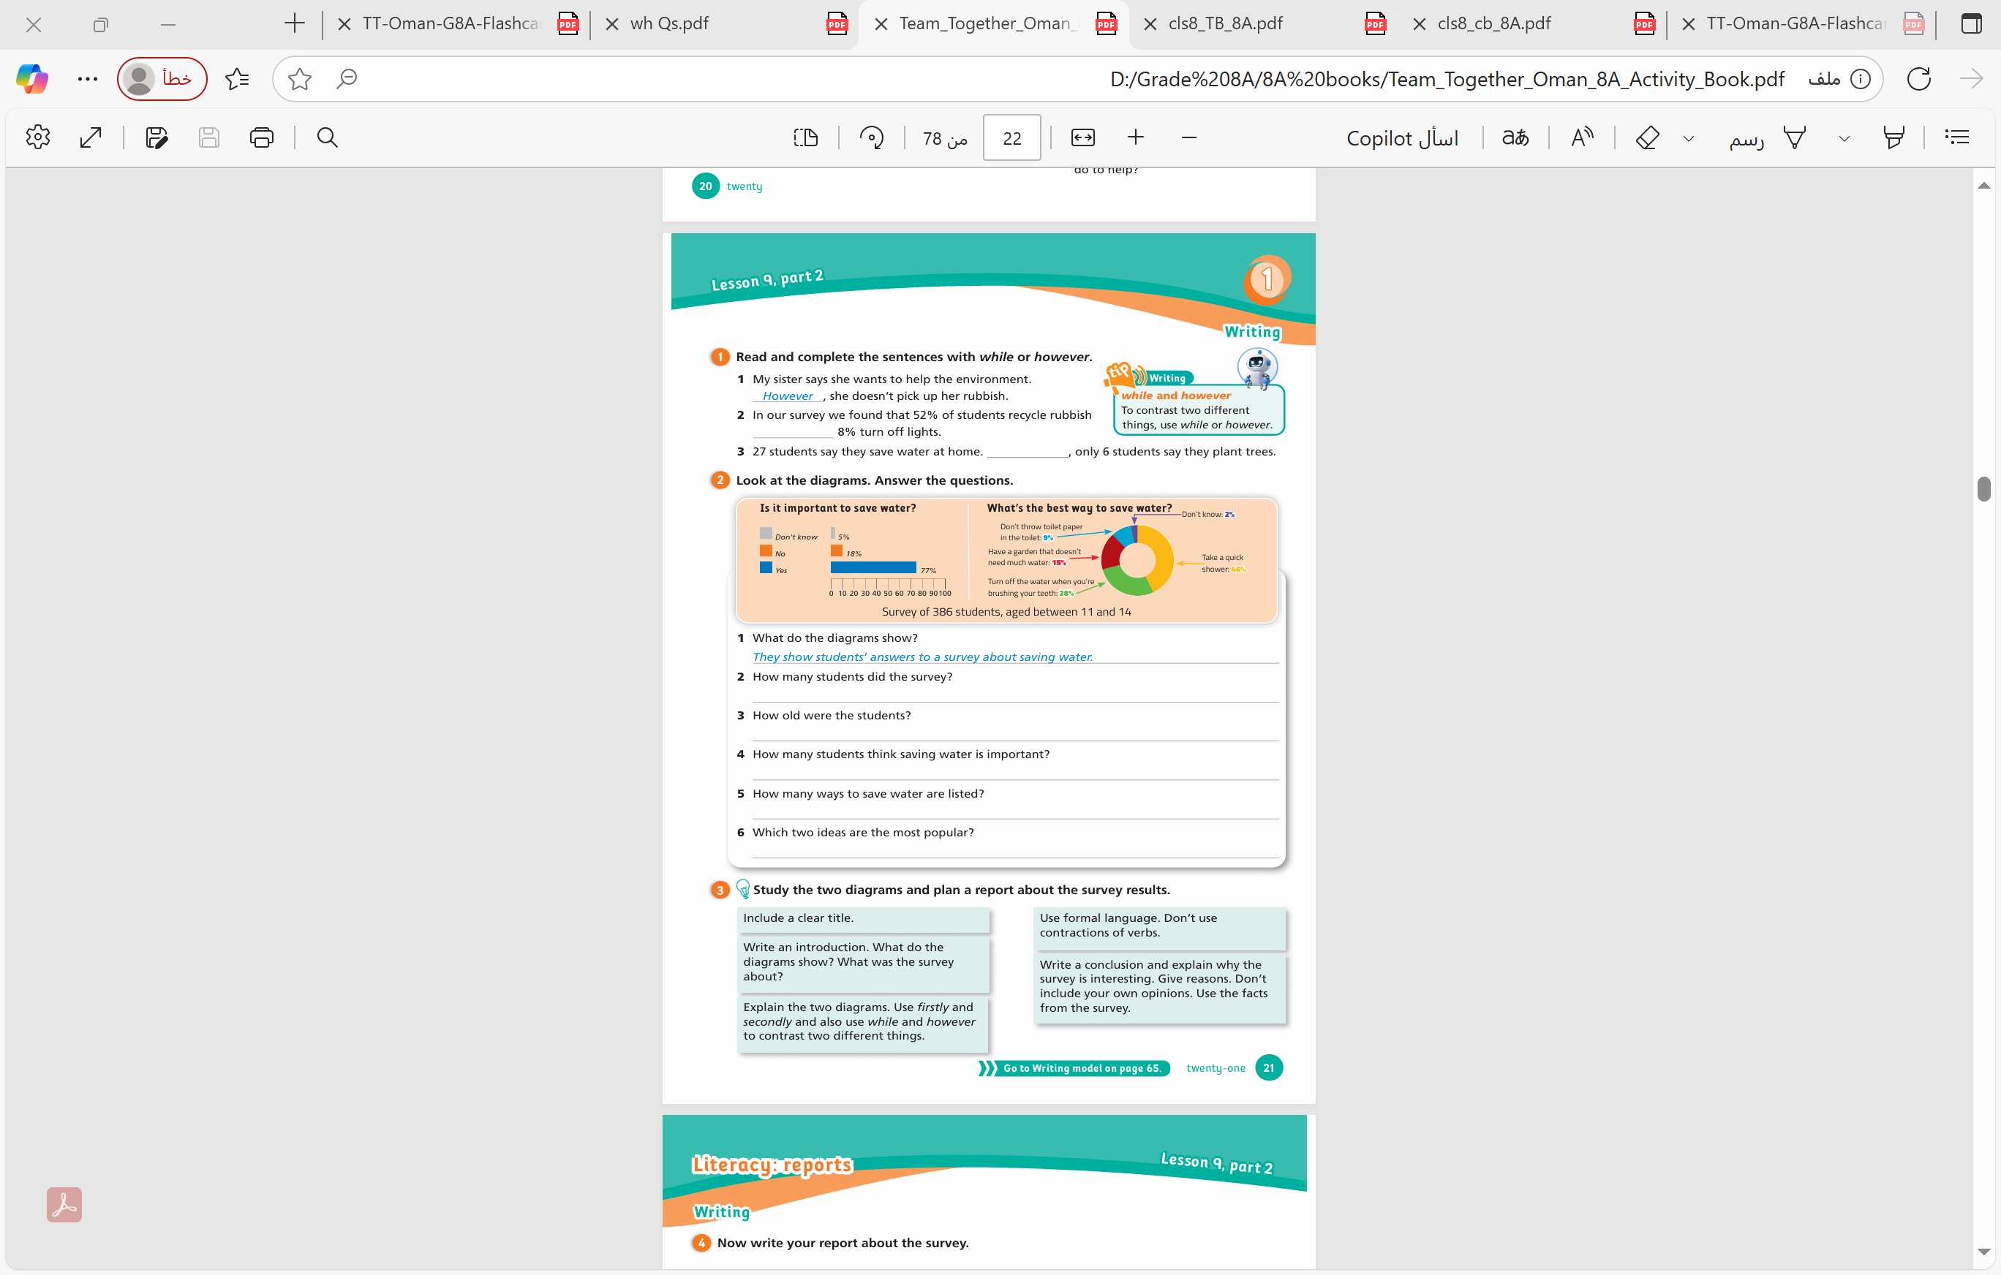
Activity Book
Page 21
Activity 1

Slide 24
Activity Book
Page 21
Activity 1
while
However

Slide 25
Lesson 9. part 2

Slide 26
Activity Book
Page 21
Activity 2
Group work

Slide 27
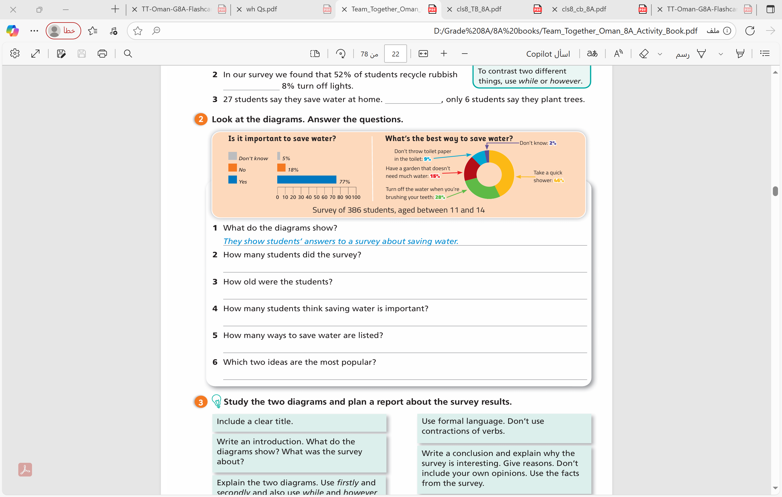
Group work
386 students did the survey.
between 11 and 14
77% of students think saving water is important.
Four ways to save water are listed
Taking a quick shower and turning off the water when brushing your teeth are the most popular ideas.

Slide 28
Writing report ?

Slide 29
What is a report ?
A report is a formal, nonfiction written document that presents factual information and analysis on a specific topic, event, or issue for a designated audience.

Slide 30
How to write a report

Slide 31



title
------------------
introduction
Explain the diagrams
conclusion

Slide 32
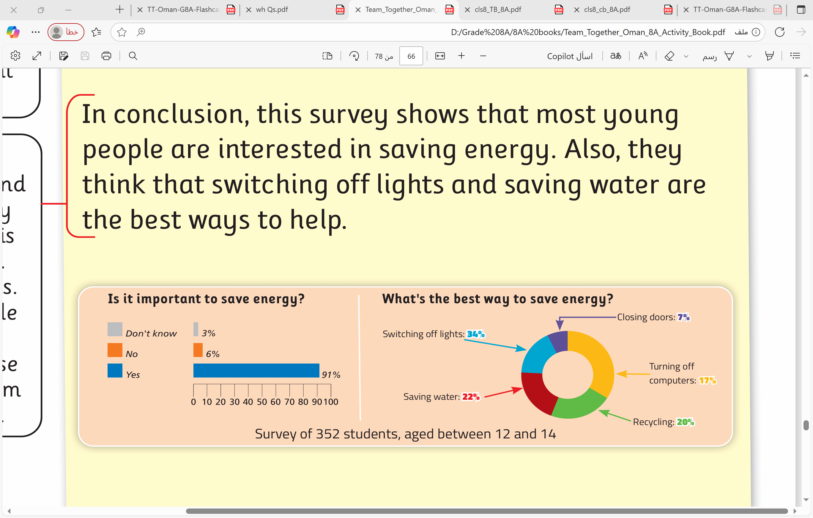
title
Young people and saving energy
These diagrams show how students answered a survey about ___________. _____ students, between the ages of _________, were asked ____ questions.
introduction
saving energy
352
12 and 14
two

Slide 33
introduction
Young people and saving energy
These diagrams show how students answered a survey about saving energy. 354 students, between the ages of 12 and 14 were asked two questions.

Slide 34
Explain the diagrams
Question 1
Question 2

Slide 35
Question 1
We use firstly to explain the results of question 1

Slide 37
Question 2
# We use firstly to explain the results of question 2.
# Start from the highest percentage to the lowest.

Slide 38
# Start from the highest percentage to the lowest.
5
1
4
2
3

Slide 39
Explain the diagrams
Start from the highest percentage to the lowest
if it was important to save
energy
(91%) said yes
Firstly, the survey asked students _______________________
__________. Most students ______________. Secondly, the survey asked ____________________________________. __% of students said ________________ while ___% said _________
_______. ___% said _______ and ____% said ___________. However, only _____% of students said ___________________.
what is the best way to save energy
34
saving
switching off lights
22
water
20
recycling
17
turning off computers
7
closing doors

Slide 40
Explain the diagrams
Firstly, the survey asked students if it was important to save energy. Most students (91%) said yes. Secondly, the survey asked what the best way to save energy was. 34% of students said switching off lights while 22% said saving water. 20% said recycling and 17% said turning off computers. However, only 7% of students said closing doors

Slide 41
conclusion
In conclusion, this survey shows that most young people are interested in ___________________. Also, they think that __________________and __________________ are the best ways to help.
saving energy.
switching off lights
saving water

Slide 42
title
Young people and saving energy
These diagrams show how students answered a survey about saving energy. 352 students, between the ages of 12 and 14, were asked two questions.
introduction
Explain the diagrams
Firstly, the survey asked students if it was important to save energy. Most students (91%) said yes. Secondly, the survey asked what the best way to save energy was. 34% of students said switching off lights while 22% said saving water. 20% said recycling and 17% said turning off computers. However, only 7% of students said closing doors
In conclusion, this survey shows that most young people are interested in saving energy. Also, they think that switching off lights and saving water are the best ways to help.
conclusion

Slide 43
title
----------------------------
These diagrams show how students answered a survey about ___________. _____ students, between the ages of _________, were asked ____ questions.
introduction
Explain the diagrams
Firstly, the survey asked students ____________. Most students ______________. Secondly, the survey asked _____________________. __% of students said ________________ while ___% said _________
_______. ___% said _______ and ____% said ___________. However, only _____% of students said ___________________.
conclusion
In conclusion, this survey shows that most young people are interested in ___________________. Also, they think that __________________and __________________ are the best ways to help.
Handle Sheet

Slide 44
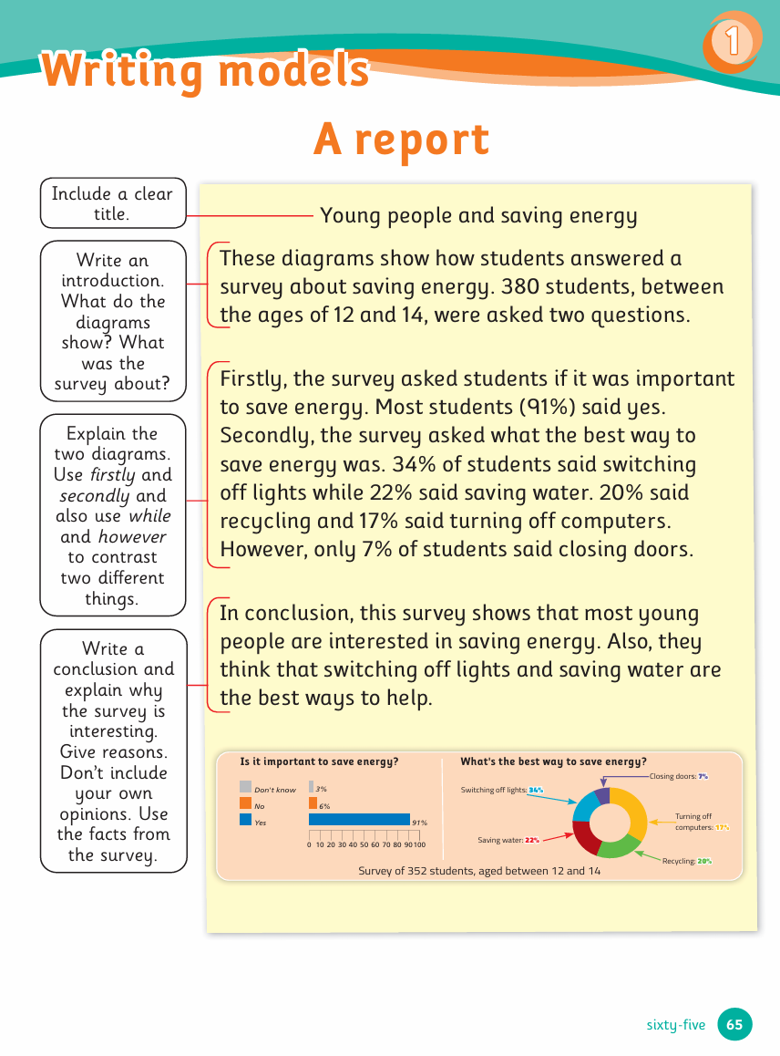
Activity Book
Page 65

Slide 45
Activity Book
Page 21
Activity 3

Slide 46
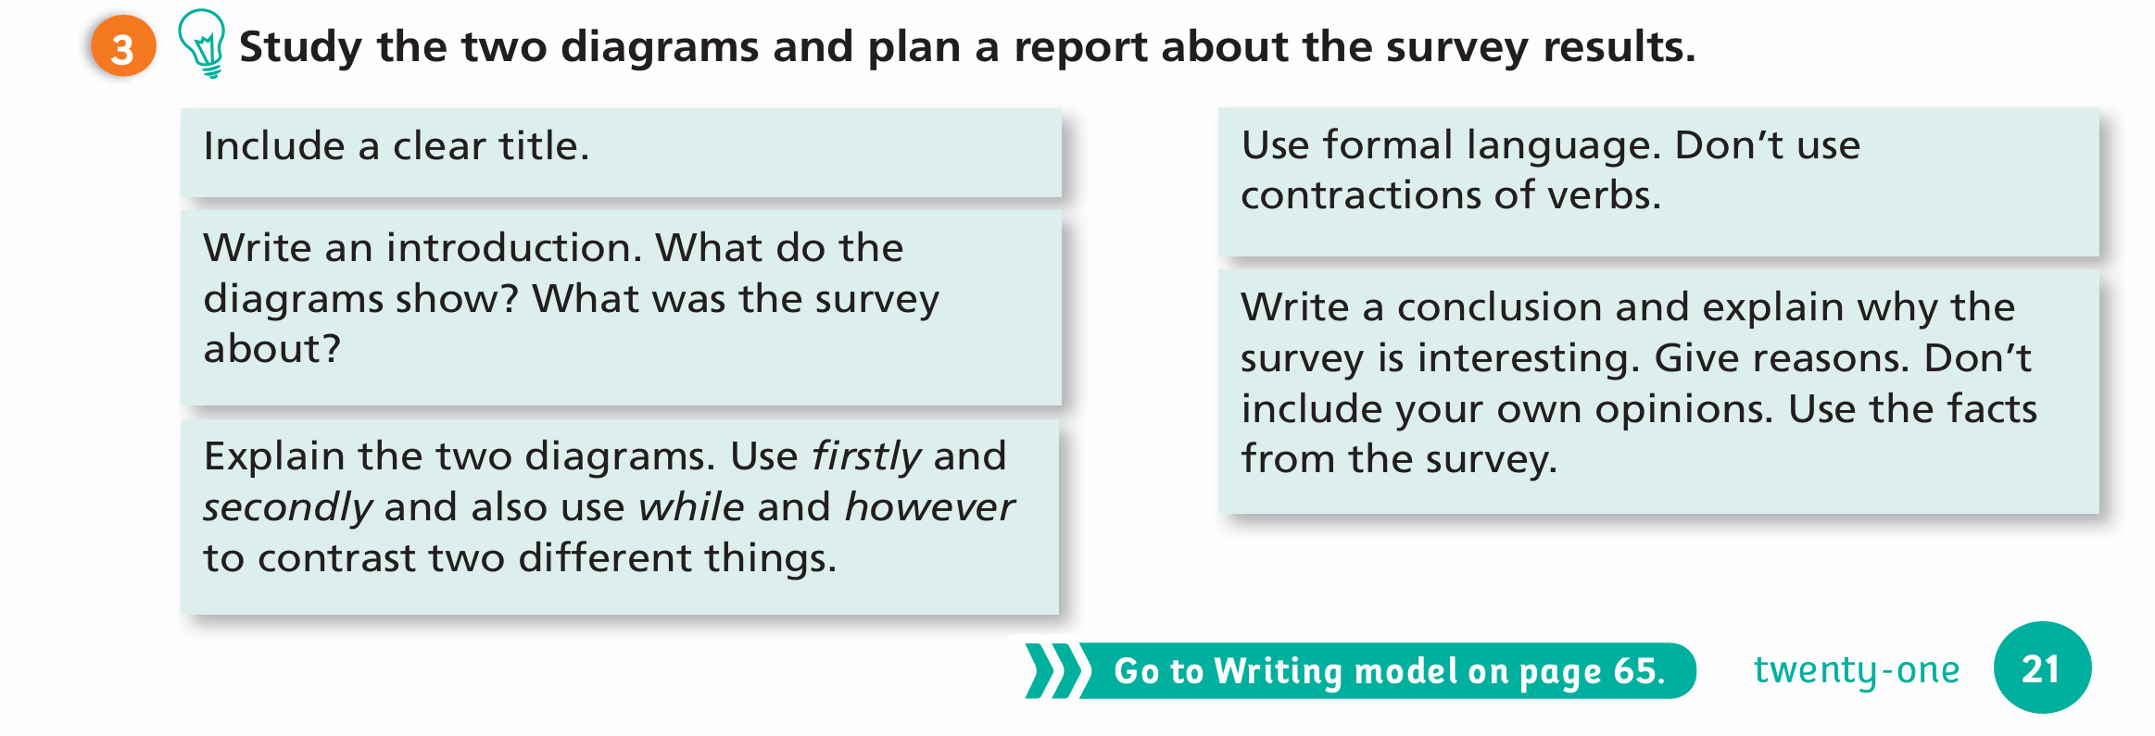

Slide 47
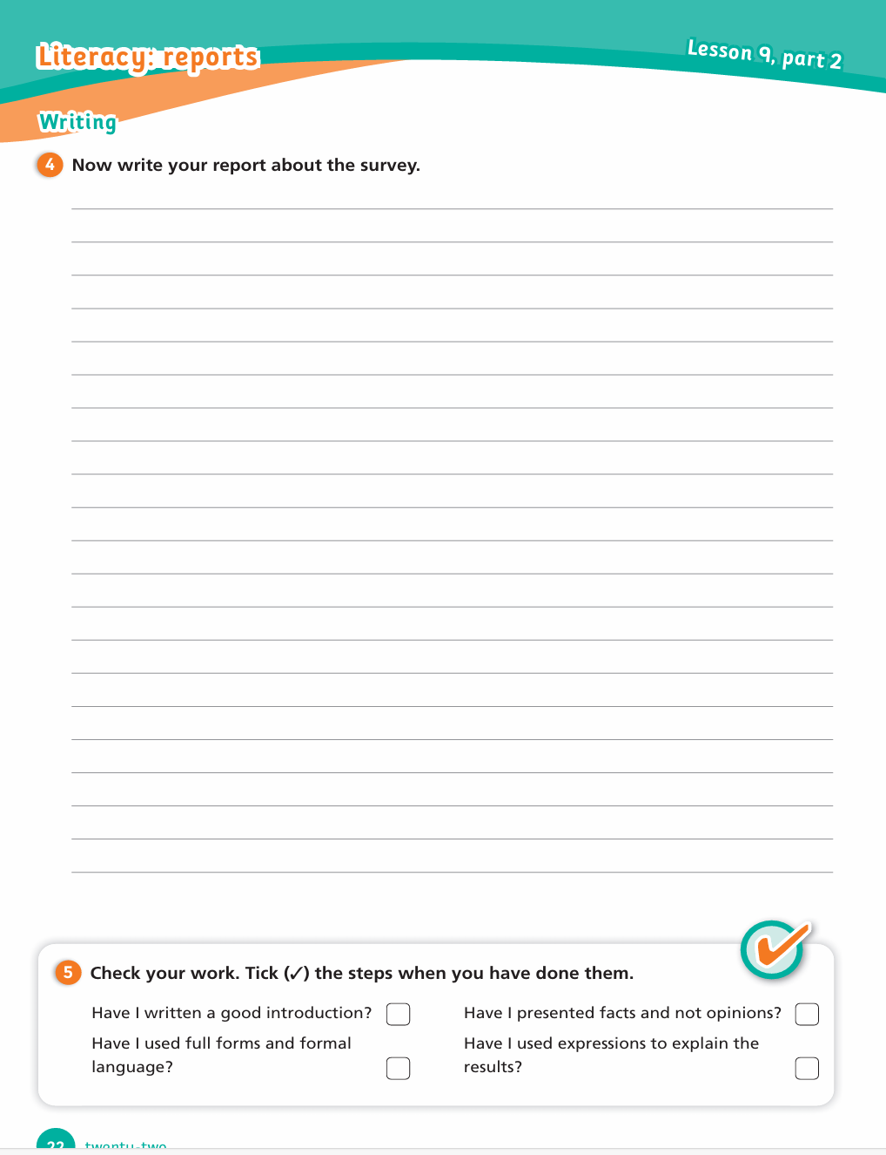
Activity Book
Page 22
Activity 4

Slide 48
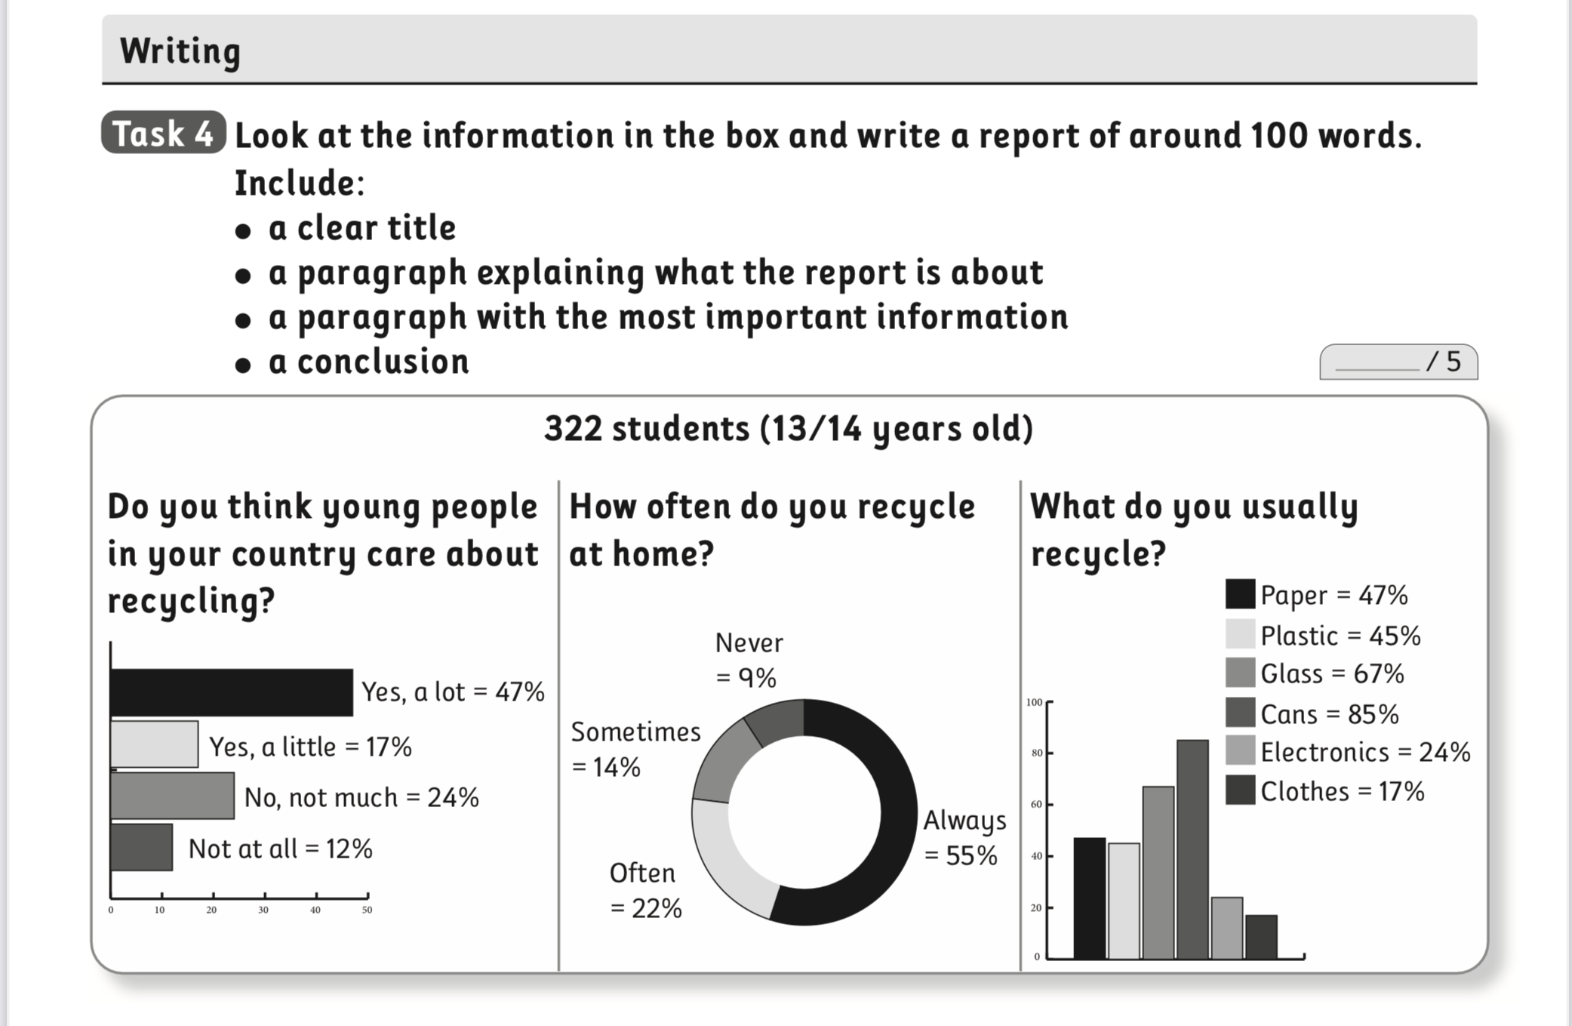

Slide 49
Young people and recyclingThese diagrams show how students answered a survey about recycling. 322 students, between the ages of 13 and 14, answered three questions.
Firstly, the survey asked students if they thought young people cared about recycling. Most students (64%) said yes, and only 12% said they didn’t care. Secondly, the survey asked how often they recycled at home. 55% of the students said always and only 9% never recycle. Finally, the survey asked what students usually recycled. The most recycled material was cans (85%), and then glass (67%).
In conclusion, this survey shows that most young people care about recycling and recycle frequently. However, they could increase their recycling of some materials.

