Slide 1

Objectives:
At the end of the lesson students will be able to
Use words related to the environment.
Can express their opinions.
Our planet

Slide 2



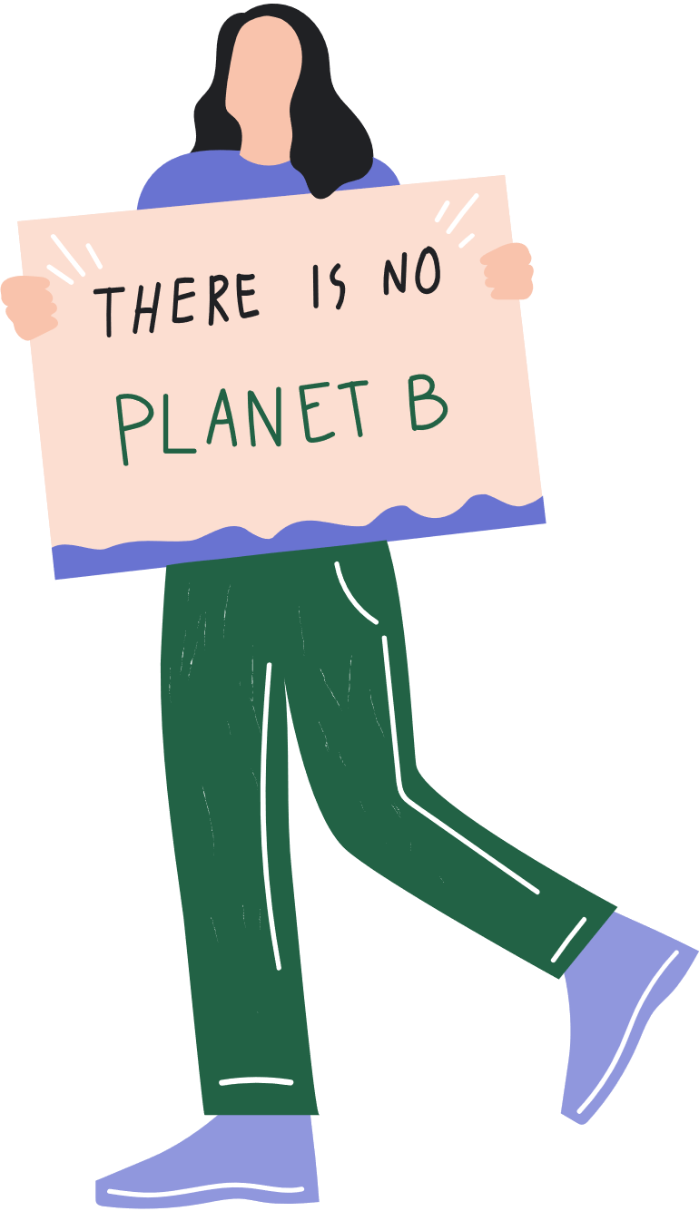




What can we do to save our environment?

Slide 3





Slide 4
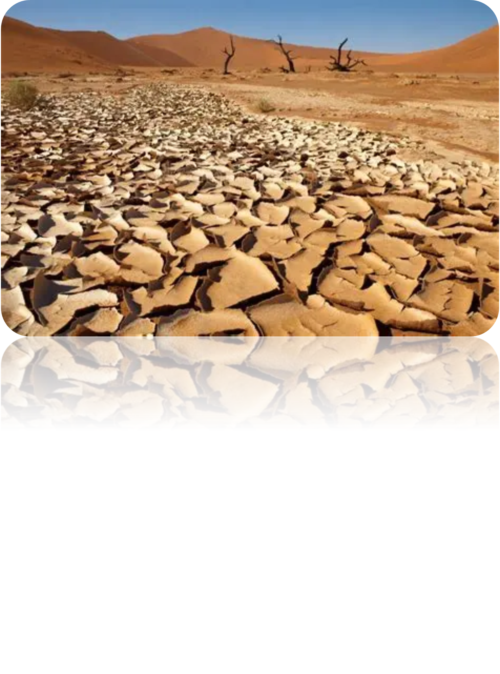

Slide 5
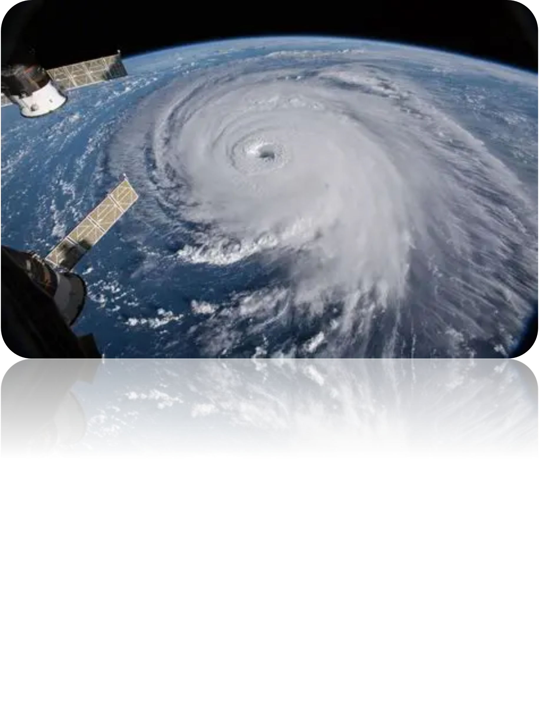

Slide 6


Slide 7

Waste energy
Protect the environment
Global warming
Climate change
Save water
Plant trees

Slide 8
7) Pollution
8) Destroy rainforest
9) Switch off lights
10) Use renewable energy
11) Pick up rubbish
12) recycle

Slide 9


1) What are our planet’s problems?
2) Things we can do to help our environment
3) Which children help the environment?

Slide 10
Activity book p.10
Recycle
Protect
Waste
Global
Change
pollution
Once each goal is completed, place this tick on it or use a pencil to mark it off

Slide 11
Activity book p.10
Switch off / lights
Save water
Pick up rubbish
Use renewable energy
Plants trees
Once each goal is completed, place this tick on it or use a pencil to mark it off

Slide 12
homework
Write three sentences about what you and
your family do to help protect the environment
Once each goal is completed, place this tick on it or use a pencil to mark it off

Slide 13
Use your lollipop to express your feeling towards lesson today

