Slide 1




Have fun with English

Slide 2
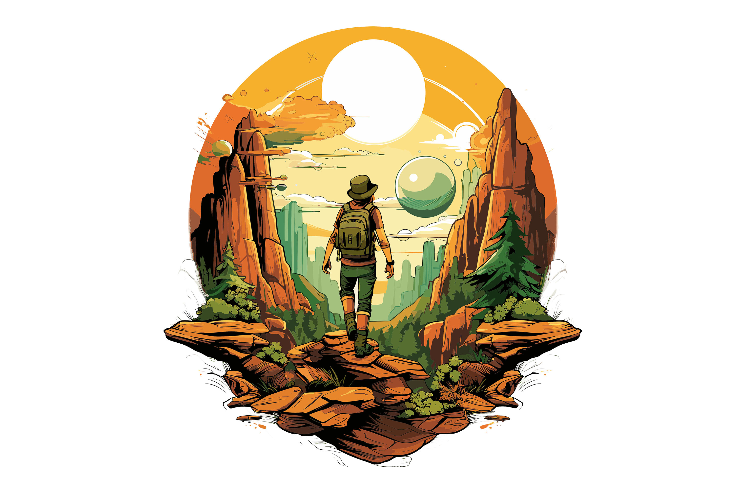
What is this picture?
adventure

Slide 3

What is this picture?
stormy

Slide 4
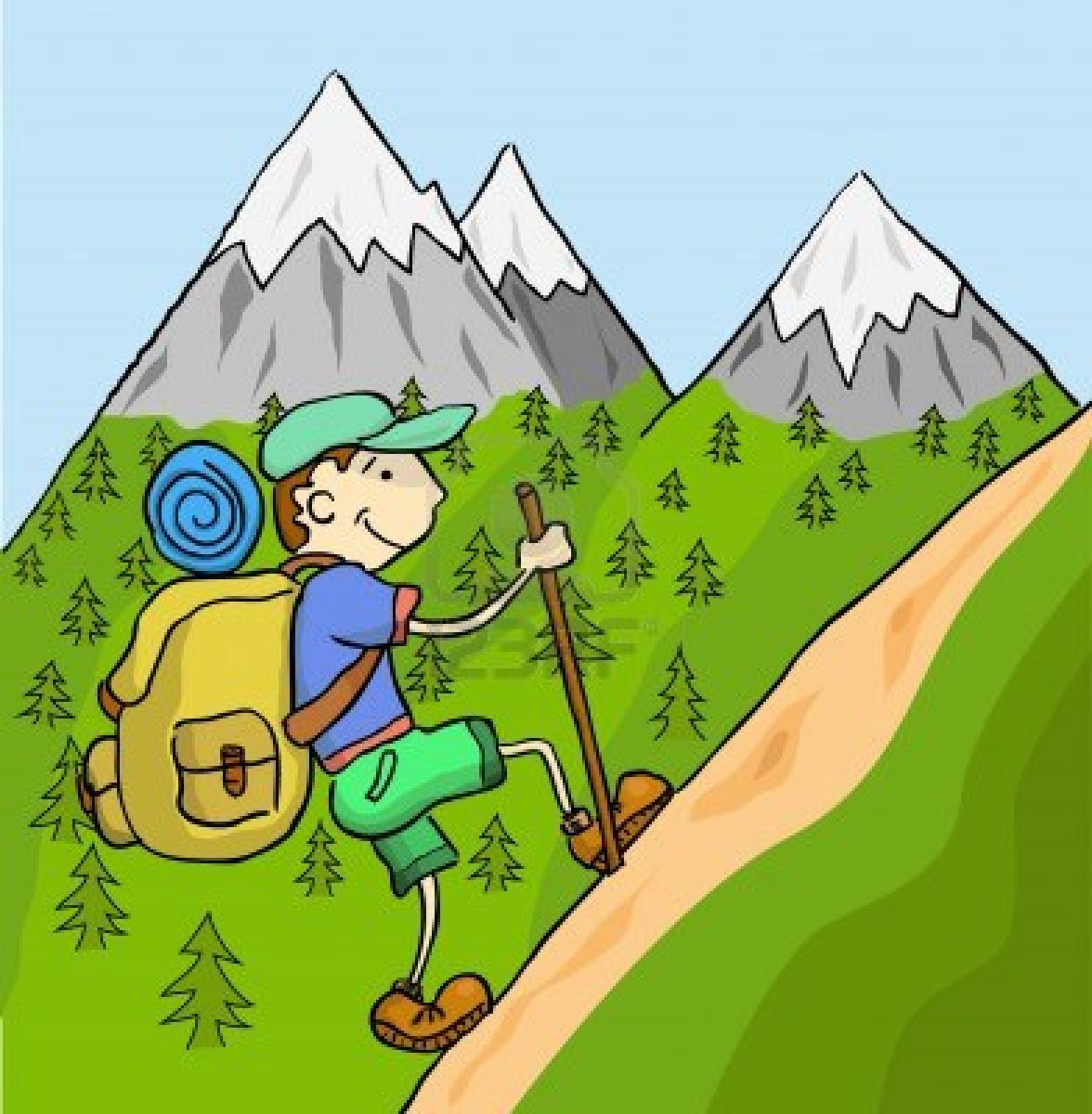
What is this picture?
hiking

Slide 5
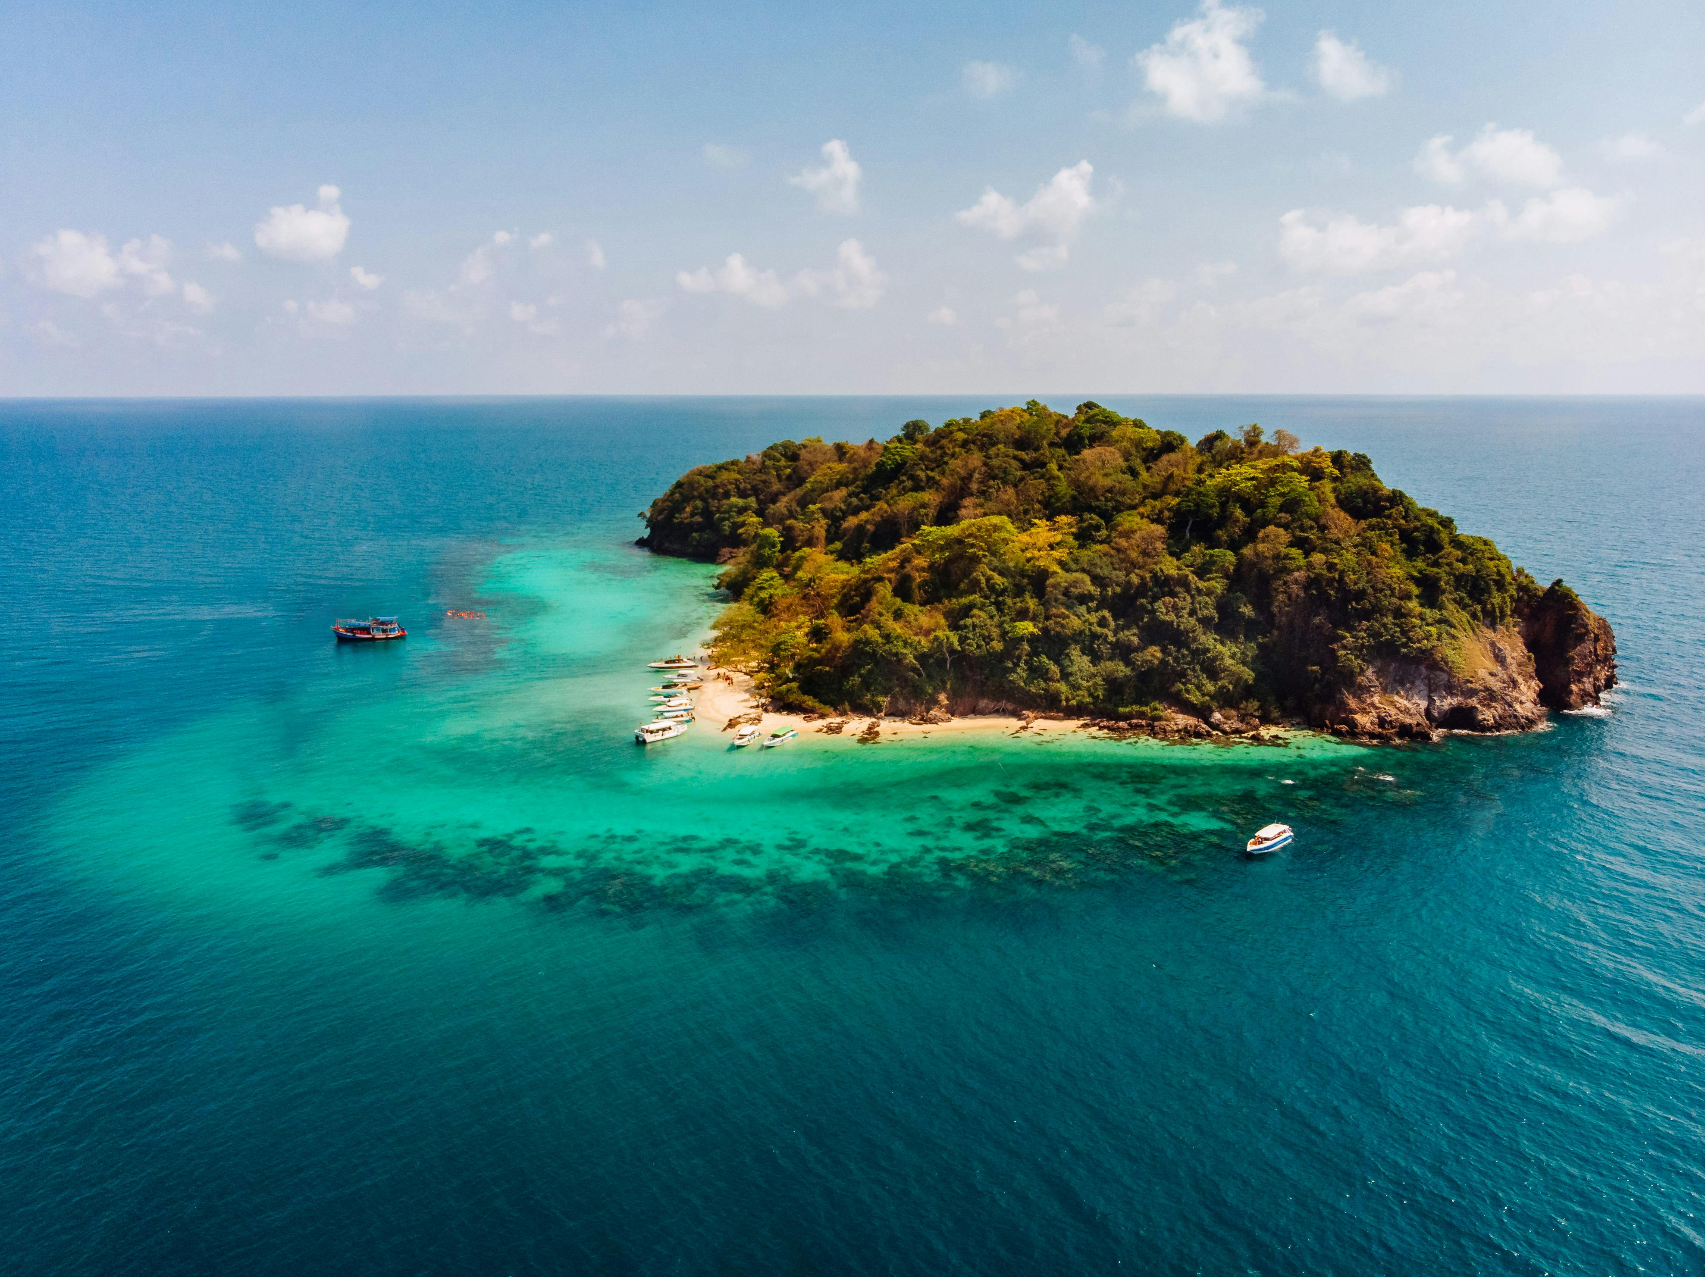
What is this picture?
island

Slide 6
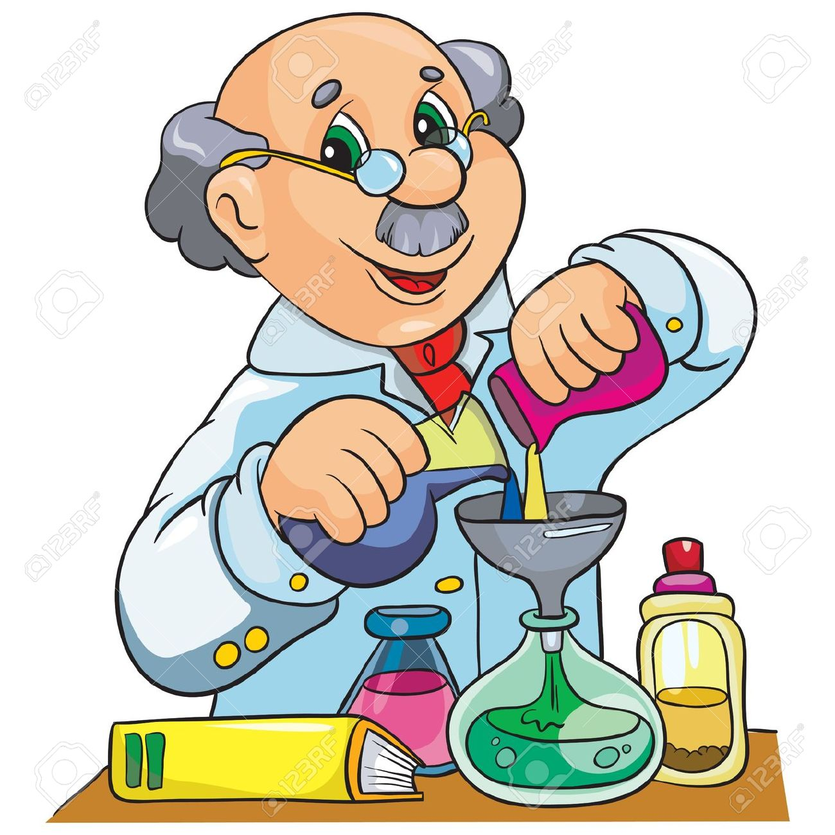
What is this picture?
inventor

Slide 7
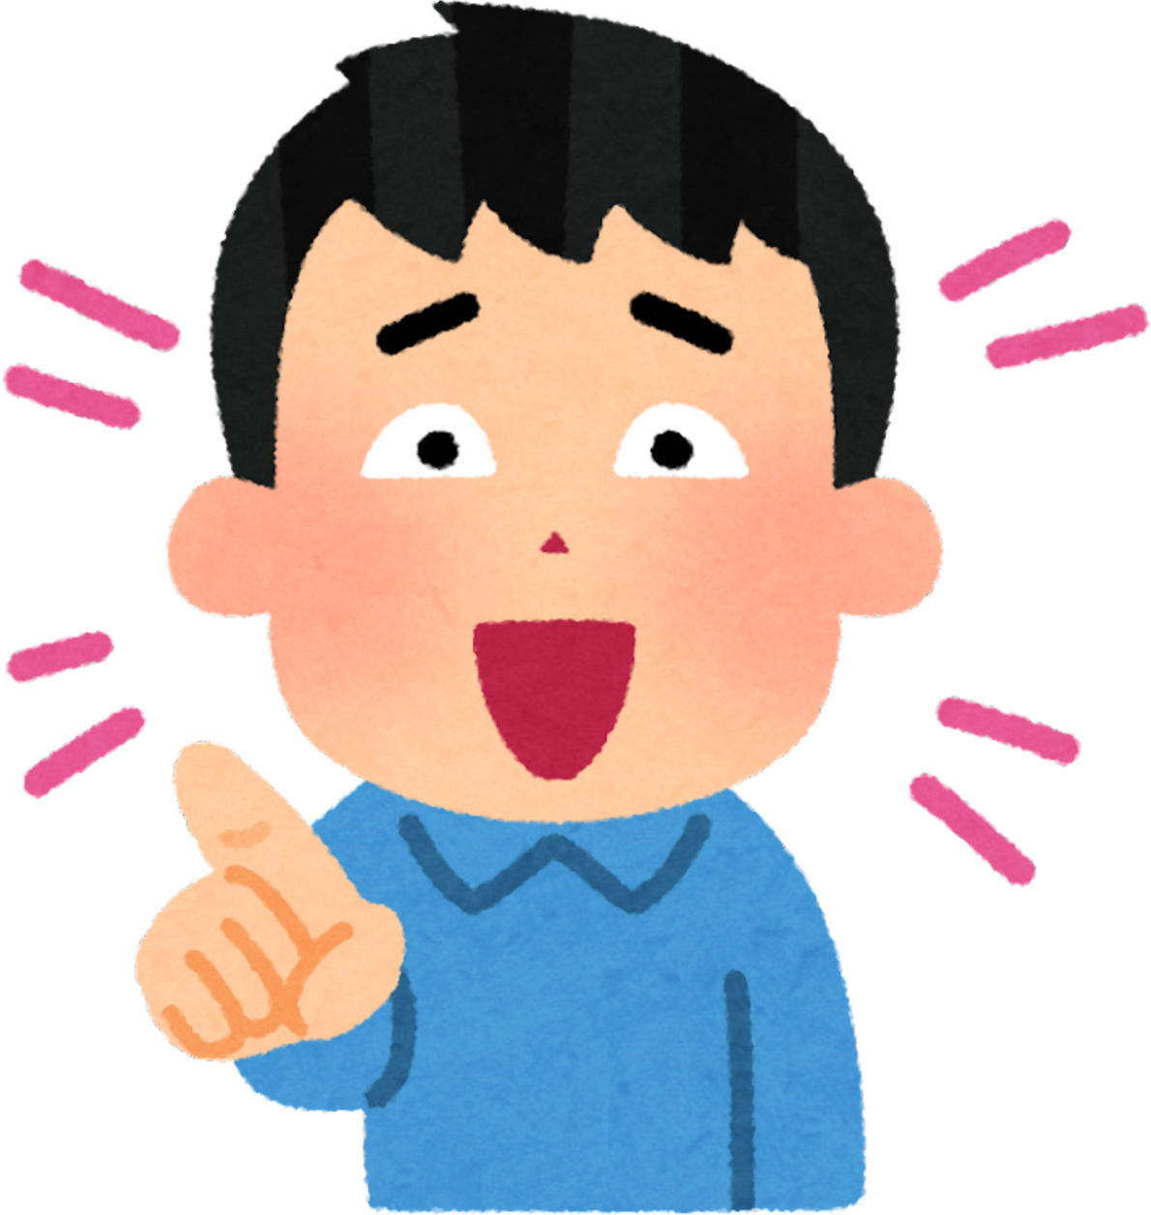
How many members in wow team
A. 2
B. 3
C. 4
B. 5

Slide 8
The magazine has interesting stories
B. yes
C. no

Slide 9
Activity book p.8
1) New
Team
3) Articles
Find out
4) Reading
Ideas
2) everyone

Slide 10
Activity book p.26
4) Amir
1) Razan
5) Jasika
2) Selina
6) Abdulaziz
3) luisa

Slide 11
Objectives for today
Describe appearance.
Skim for general information
Scan for specific information.
Express your opinion

Slide 12

Lets revise our vocabulary
Team Together - Hangman

Slide 13
Skim for general information
Matching
Activity book p.9
Scan for specific information.
.

Slide 14
2) She loves reading and her favorite subject is English.
3) It is fun to be part of a team.
4) He goes skiing
5) He lives in Muscat and he misses going to sea.
6) All the students are very kind.
7) She designs and makes her own clothes.
.

Slide 15

Find out the word
curly
A.
.

Slide 16
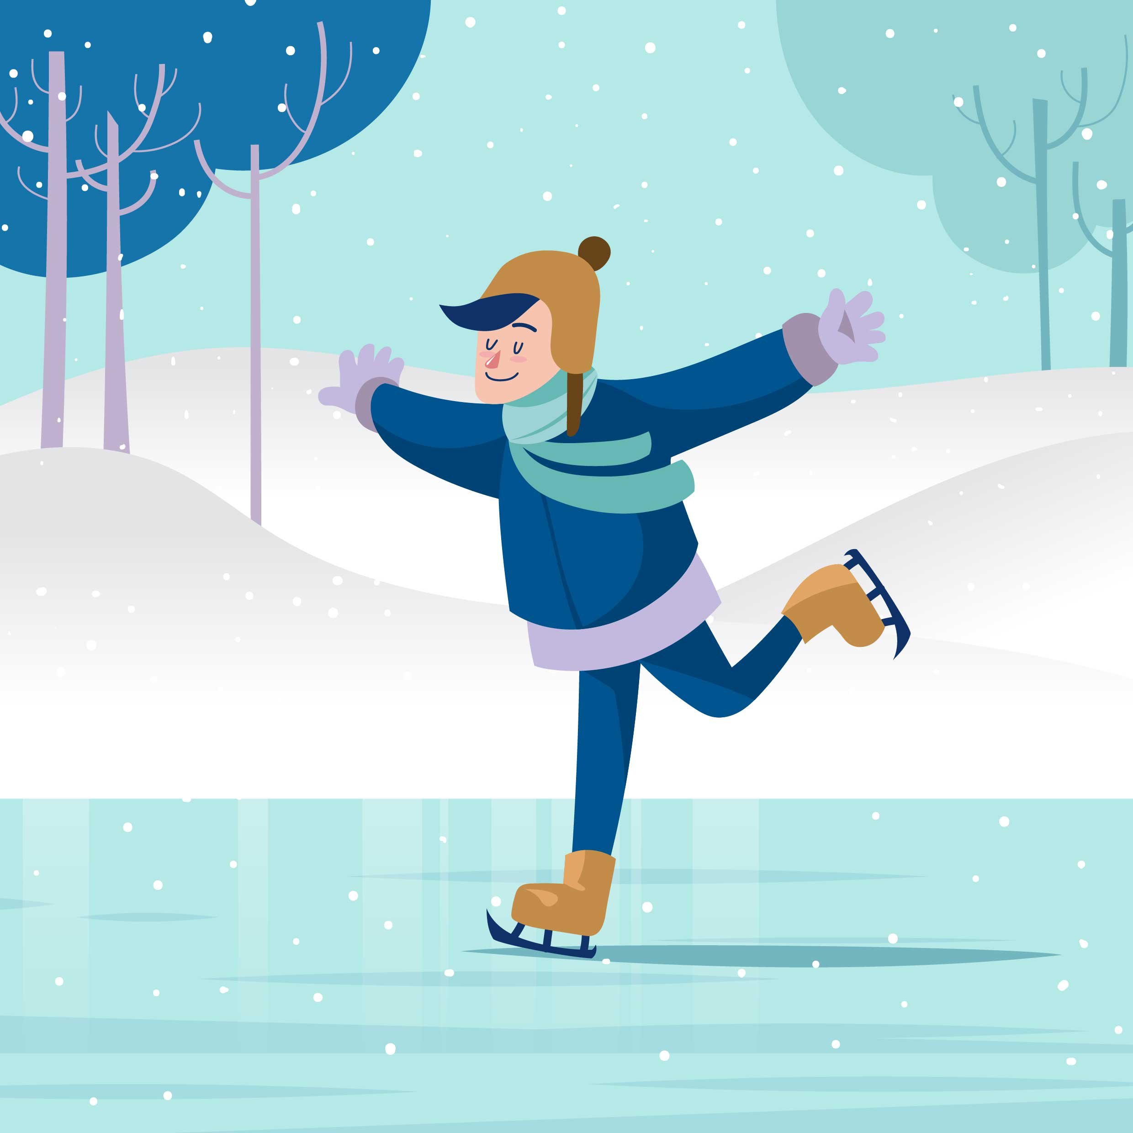
Find out the word
Ice-skating
A.
.

Slide 17
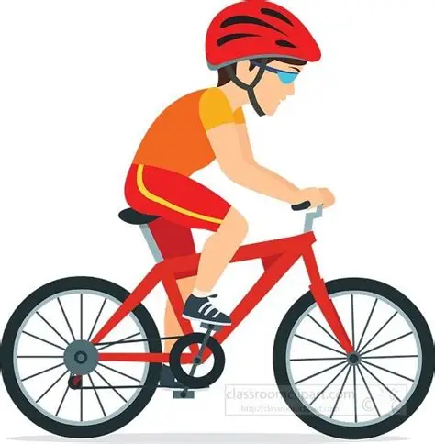
Find out the word
cycling
A.
.

Slide 18
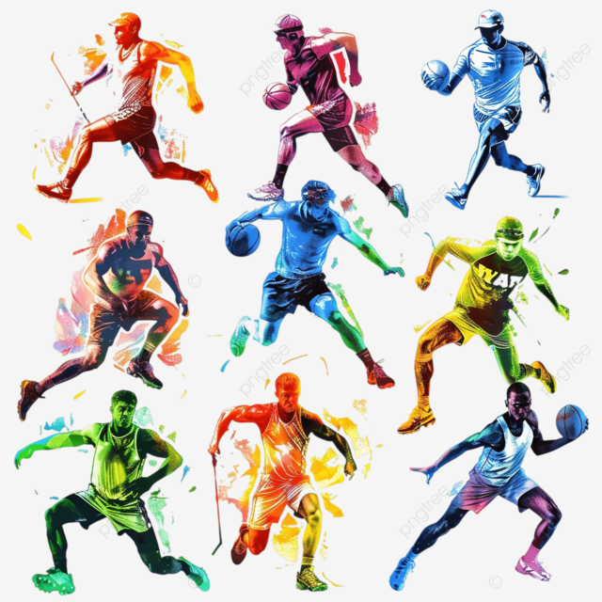
Find out the word
athletics
A.
.

Slide 19
Activity book p. 9
2) Manar, because she loves design and she makes her own cloths.
3) Ali, because he is interested in science, nature and the environment.
4) Ali and Manar, because Ali comes from Sur and Manar is from Muscat.
.

Slide 20
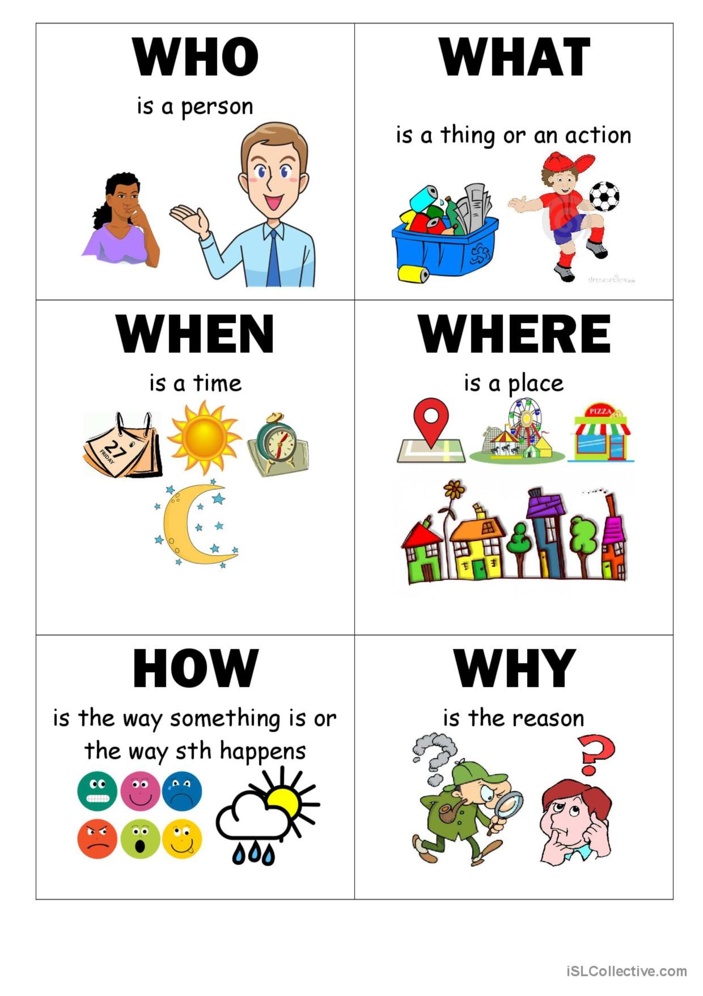
Asking questions
.

Slide 21

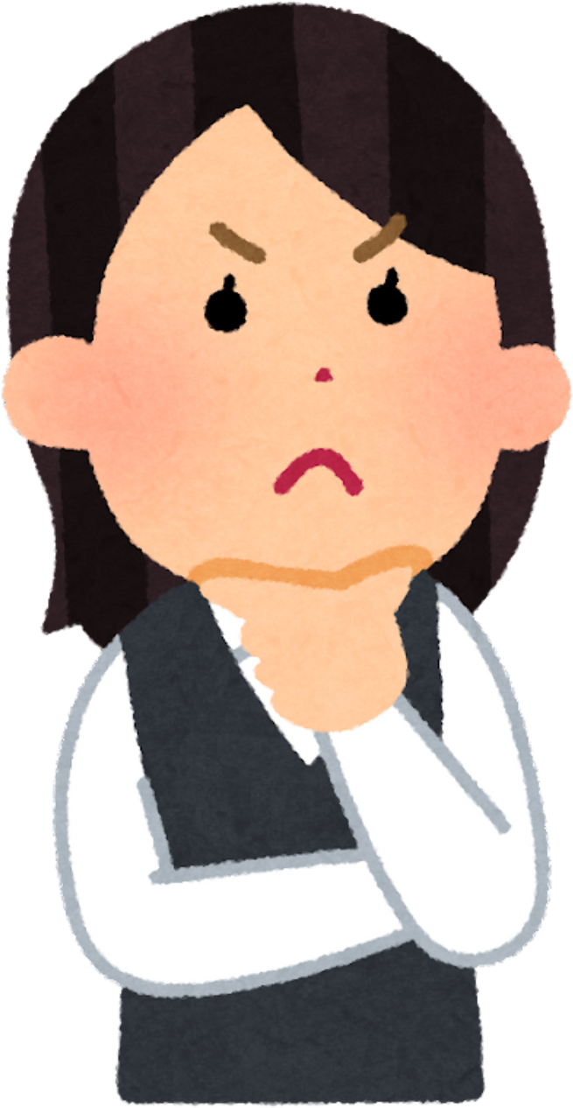
practicing
C.B P.13
Activity book p.9

Slide 22
practicing
C.B P.13
Ask your friend questions

Slide 23
.

