Slide 1





PAST PERFECT
tense
AMAL ALISMAILI

Slide 2
Sunset
North
West
Scenery
Field
Wood
valley
8) Bay
9)South
10)Sunrise
11) Tide
12) east

Slide 3

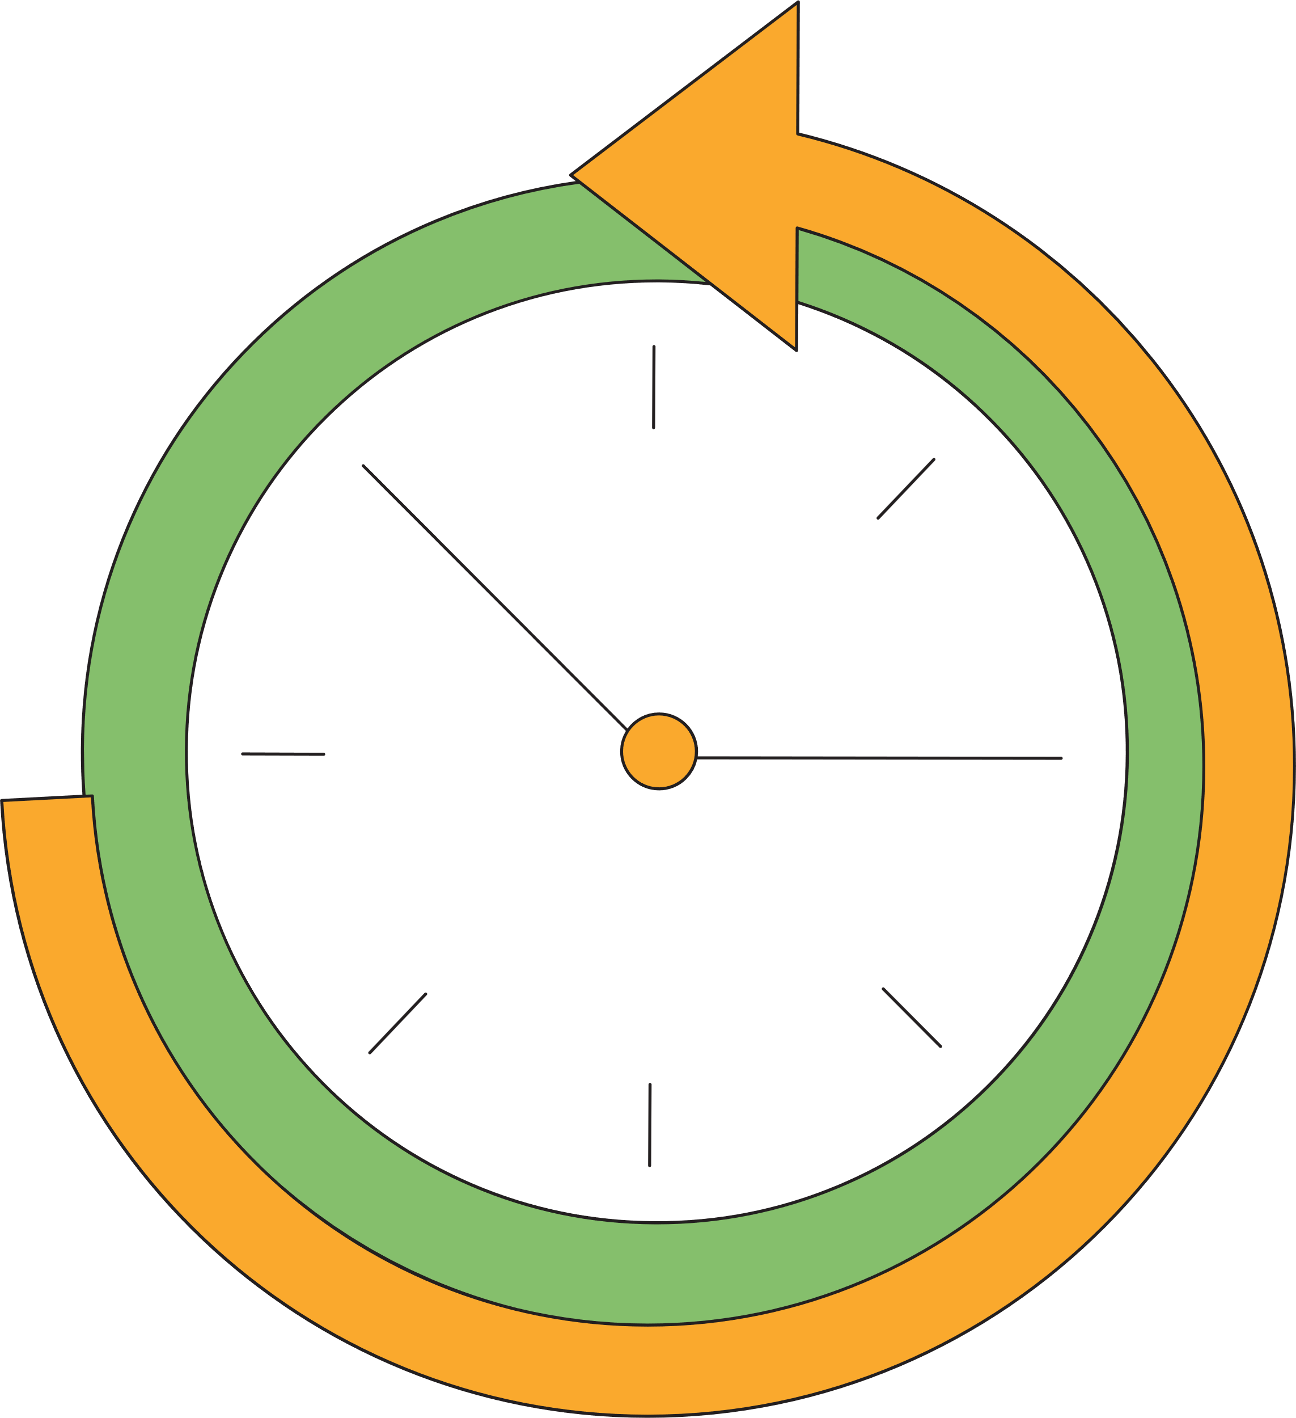

When to use?
We use the Past Perfect Tense to:
Describe an action that was completed
before another action or time in the past.
Show the order of events in the past.

Slide 4

EXAMPLES
BEFORE ANOTHER ACTION:
She had left the office before I arrived.
ORDER OF EVENTS:
By the time we got there, the movie had started.

Slide 5

How to use?
POSITIVE STRUCTURE:
All subjects take the past participle (V3) form of the verb.
EXAMPLE:
Subject
Pronoun
+
had
+
V3
I had finished my homework
before I went out with my friends.

Slide 6
How to use?
NEGATIVE STRUCTURE:
All subjects take the past participle (V3) form of the verb.
EXAMPLE:
Subject
Pronoun
+
hadn’t
+
V3
She hadn’t read the book before
its movie adaptation came out.

Slide 7
How to use?
QUESTION STRUCTURE:
All subjects take the past participle (V3) form of the verb.
EXAMPLE:
Subject
Pronoun
Had
+
+
V3
Had you completed the project
before the manager said so?

Slide 8

Attention!
In the English language, the verbs are divided into two:
REGULAR VERBS
Regular verbs form their past participle forms by adding -d, -ed or -ied to the base form.
IRREGULAR VERBS
Irregular verbs do not follow a consistent pattern for their past participle forms.
Each irregular verb has a unique past participle form!

Slide 9
REGULAR VERBS

Slide 10
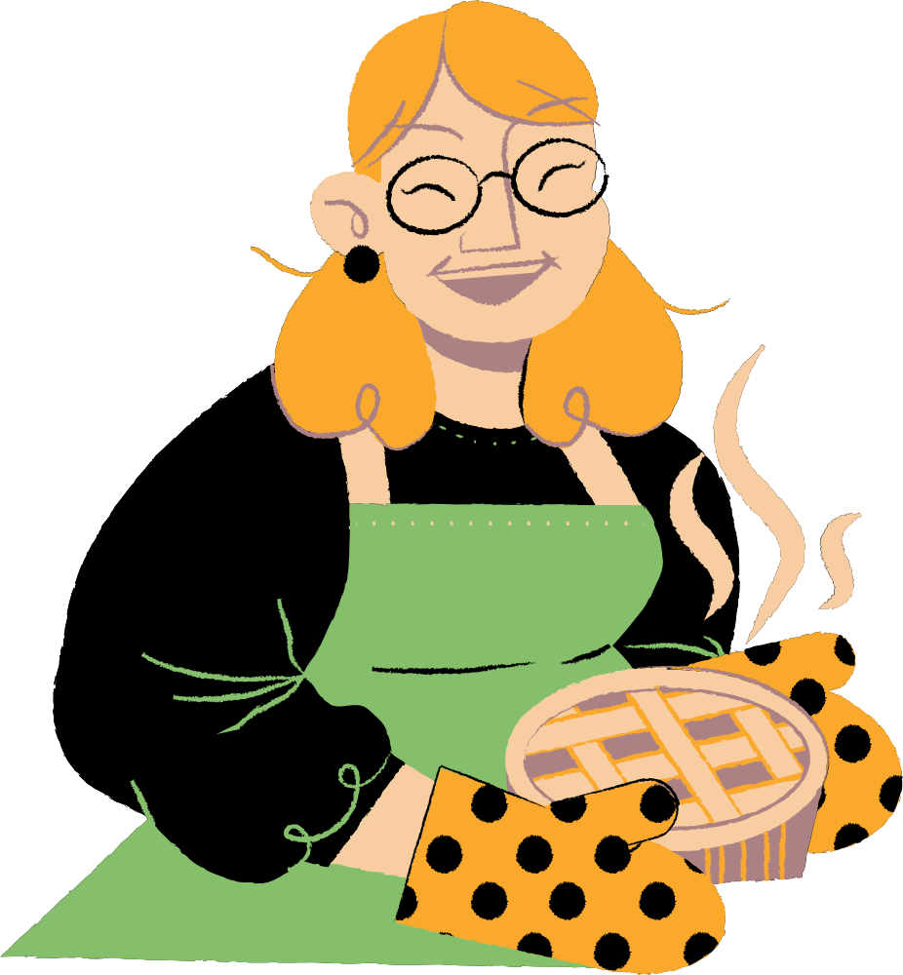

How to spell?
If the verb ends in a silent e, simply add -d.
live
hate
bake
lived
hated
baked
My mum had baked a pie before
dad came home with one.

Slide 11

How to spell?
For most verbs, simply add -ed.
talk
clean
watch
talked
cleaned
watched
She had already watched that movie before her friend recommended.

Slide 12

How to spell?
If the verb ends in a consonant + y,
change the "y" to "i" and add -ed.
cry
carry
study
cried
carried
studied
He went out after he
had studied for the exam.

Slide 13
IRREGULAR VERBS

Slide 14
Here’s a list of some of the most common irregular verbs:
be
begin
bite
break
bring
build
buy
catch
come
been
begun
bitten
broken
brought
built
bought
caught
come
cut
do
draw
drink
drive
eat
fall
feel
find
cut
done
drawn
drunk
driven
eaten
fallen
felt
found
fly
get
give
go
grow
have
keep
know
leave
flown
gotten/got
given
gone/been
grown
had
kept
known
left

Slide 15
time expressions

Slide 16

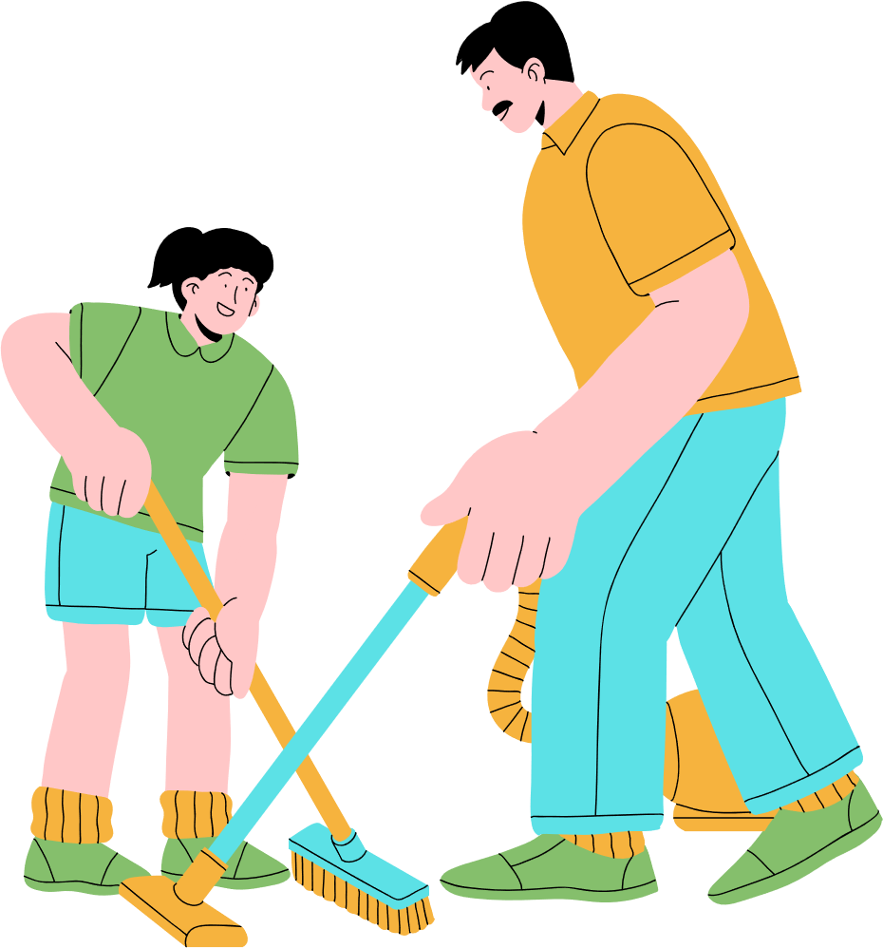

We usually use the following time expressions:
before
after
by the time
already
just
She had cleaned the house
before the guests arrived.
By the time she arrived,
the party had already started.

Slide 17
THANK YOU
for listening!

