Slide 1
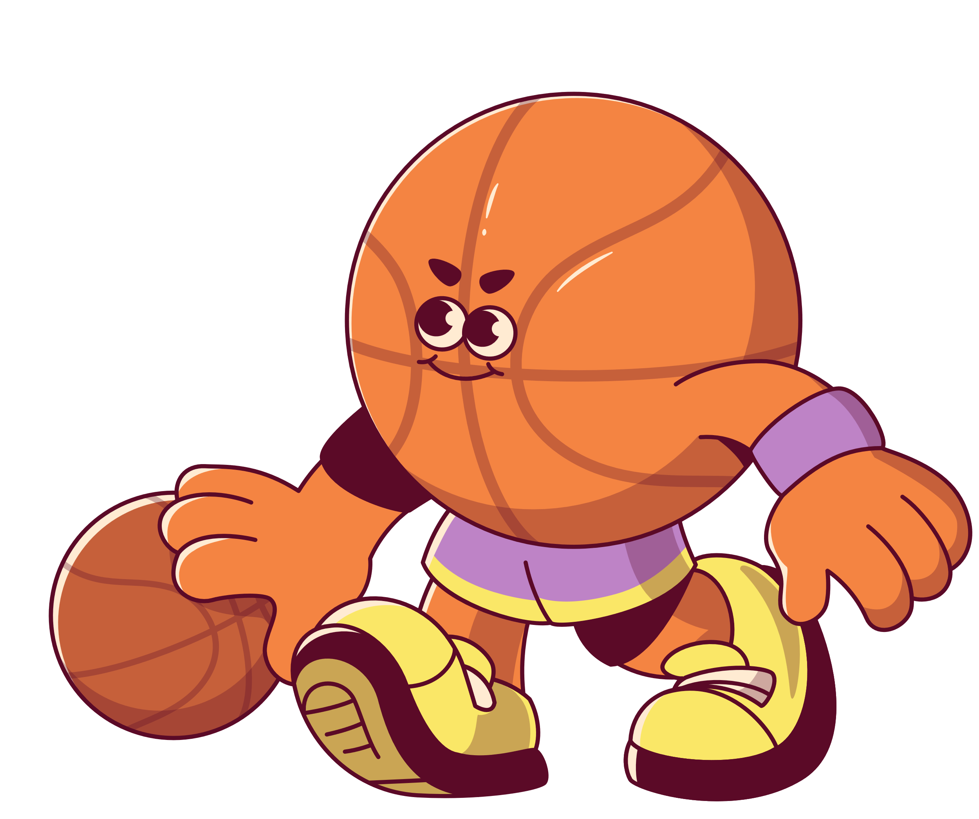


Adventure Sport
Amal Al Ismaili
2025–2026

Slide 2


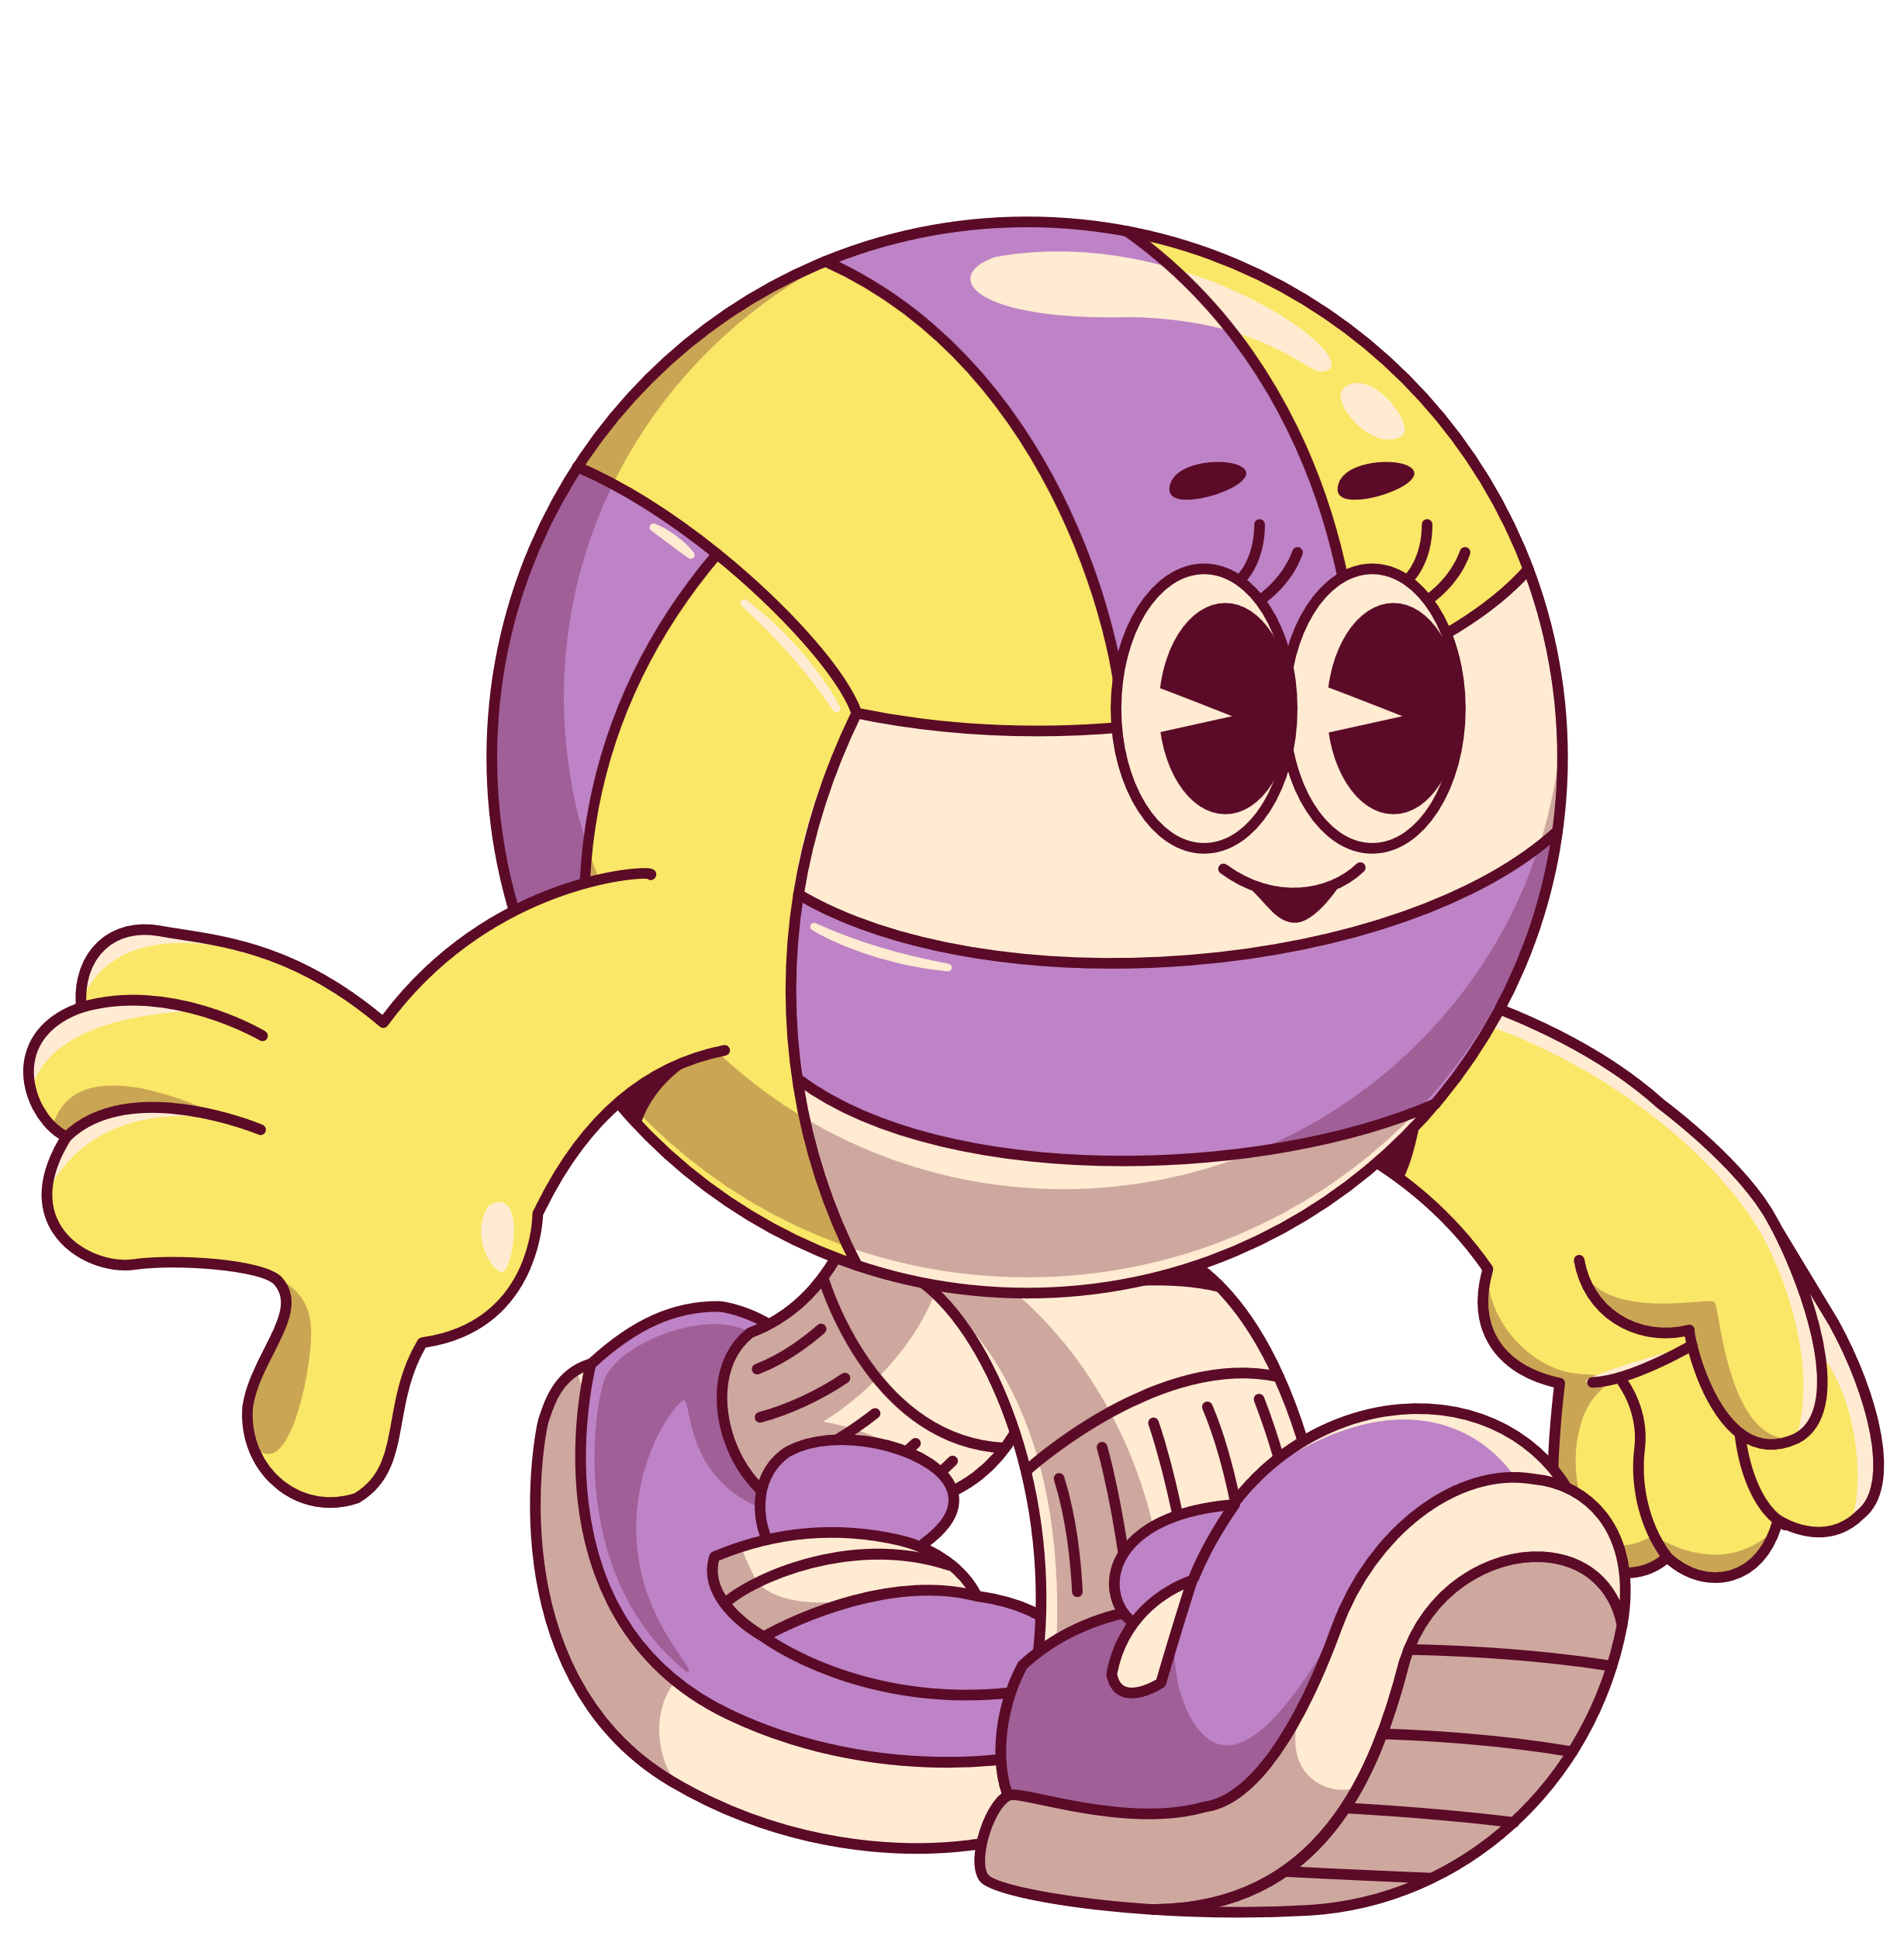
Spelling
BEST GAME:
7–4 vs. “The Hawks”
BEST SETTER:
Chiaki Sato
SEASON RECORD:
6 games – 6 wins

Slide 3


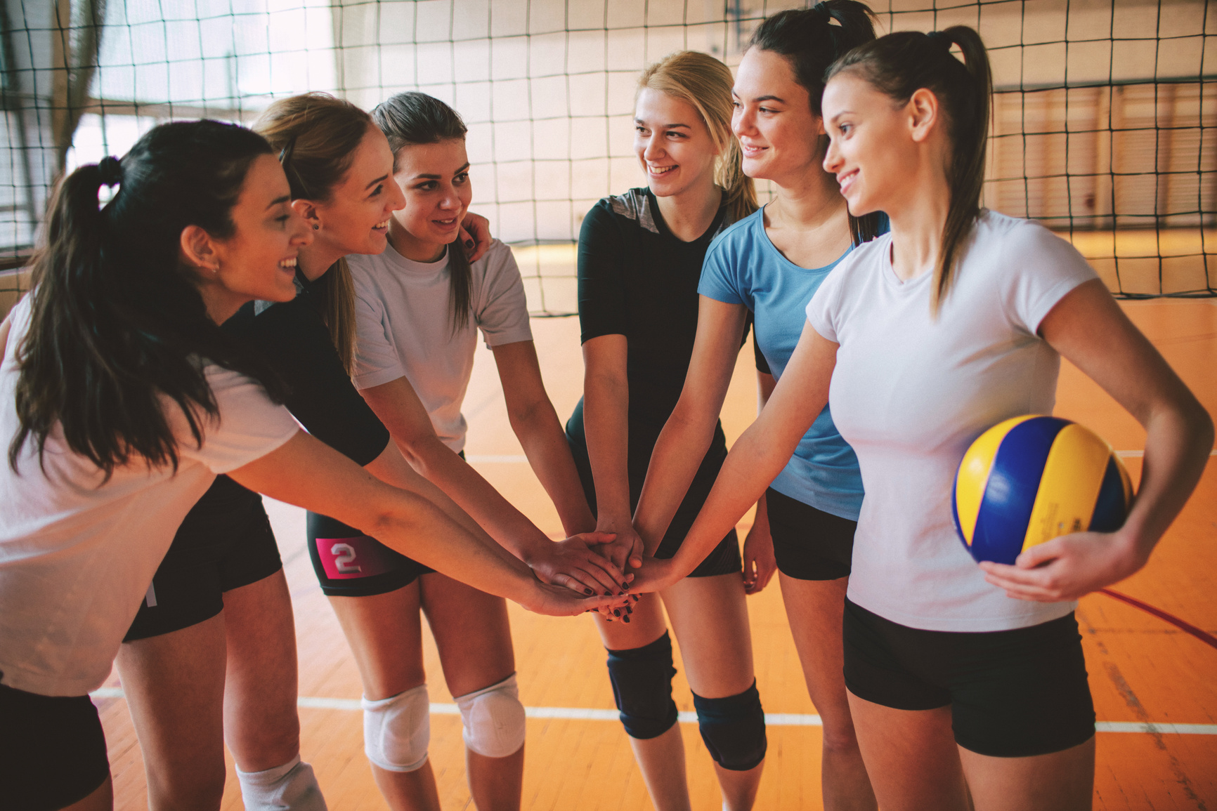
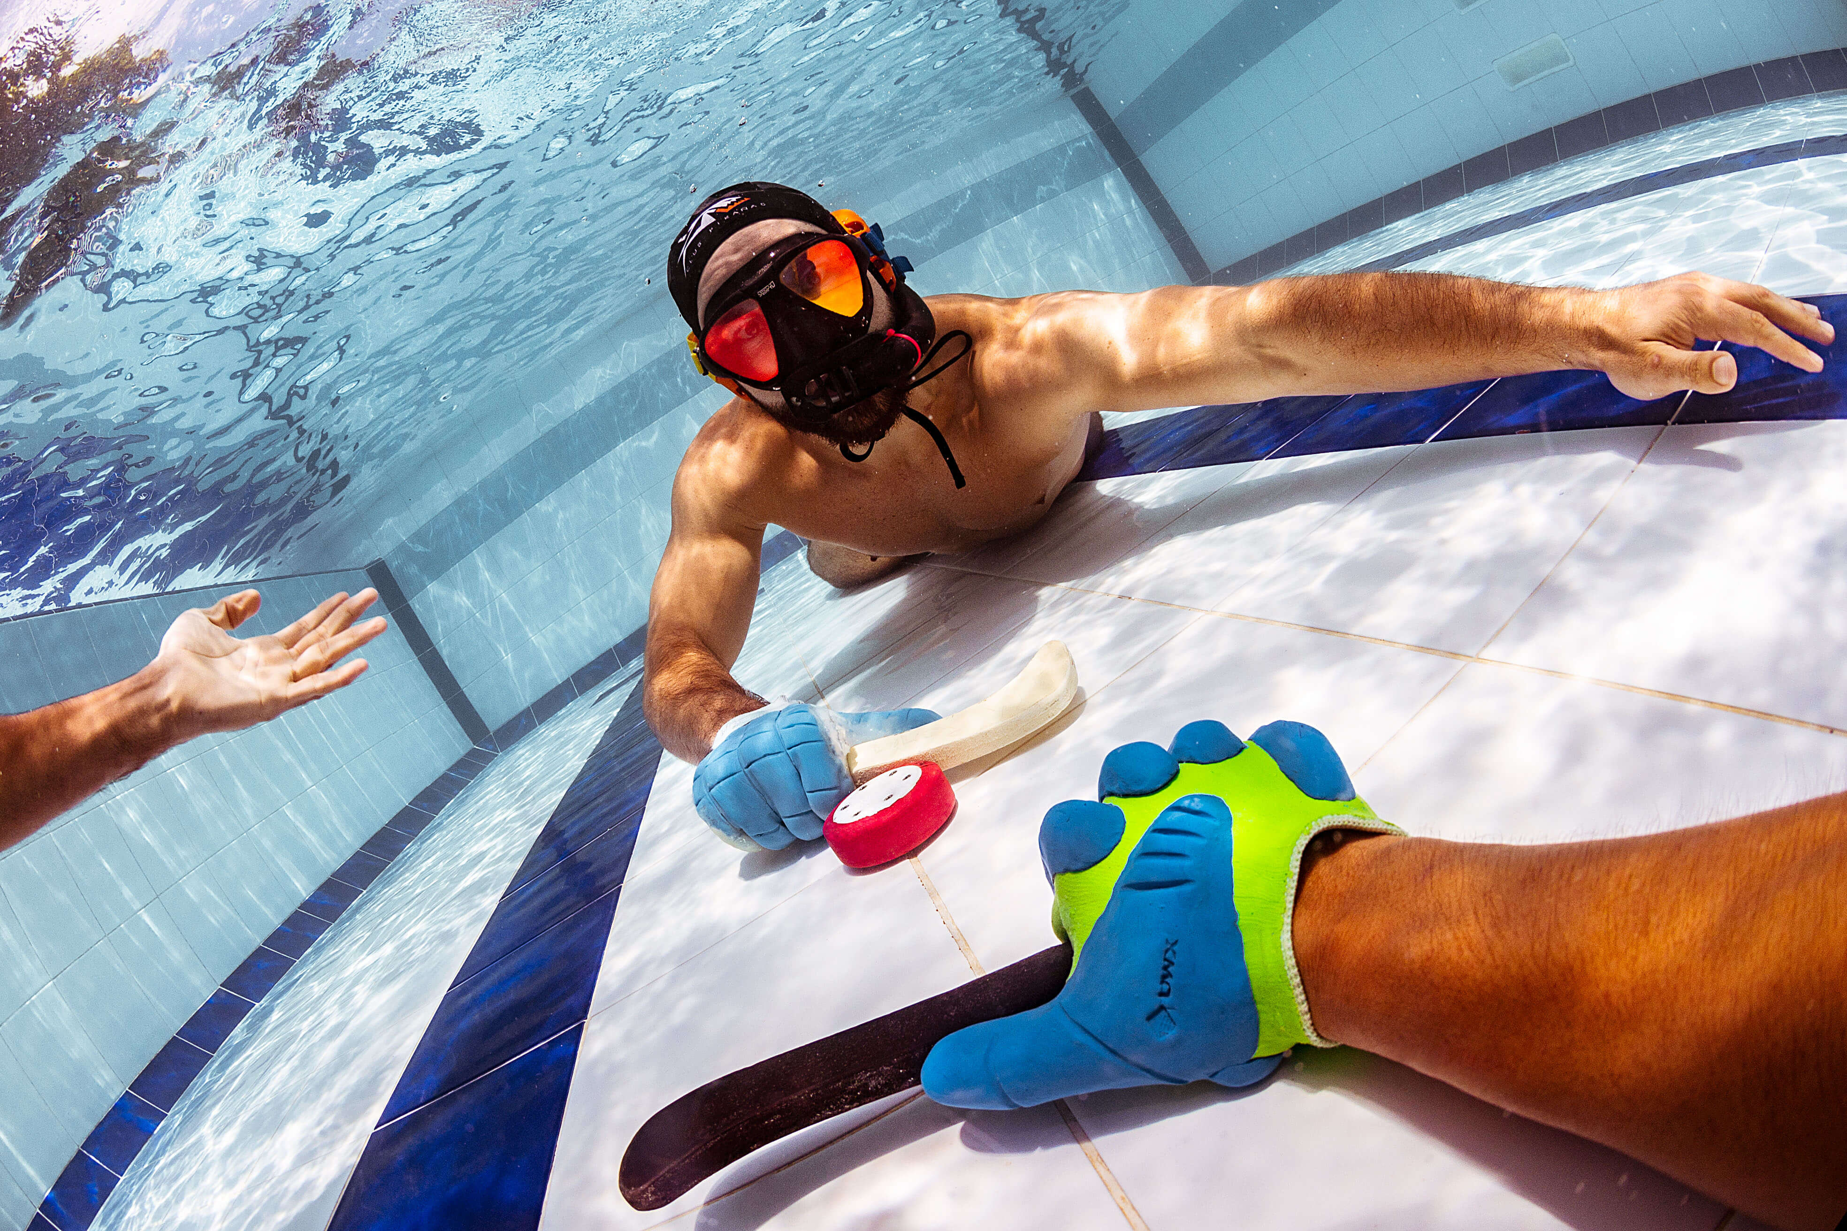
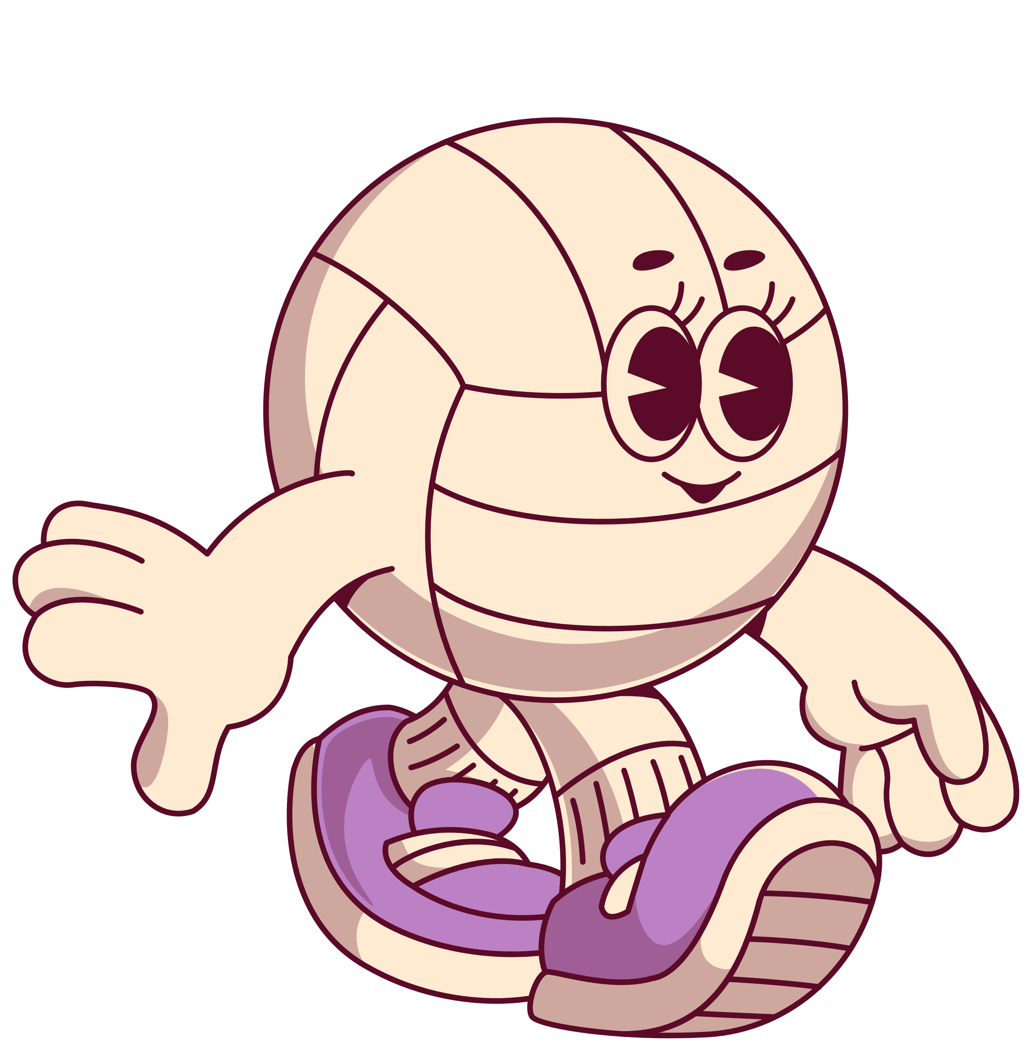
Underwater hockey

Slide 4

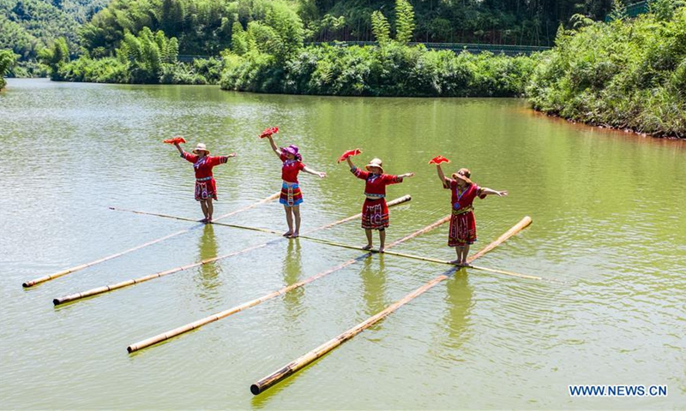
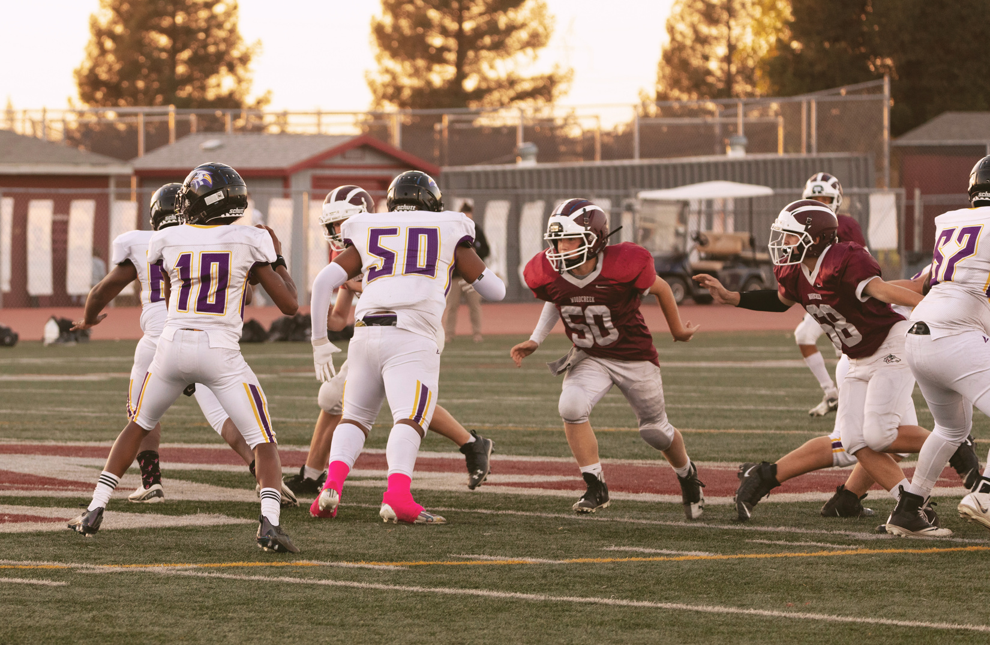
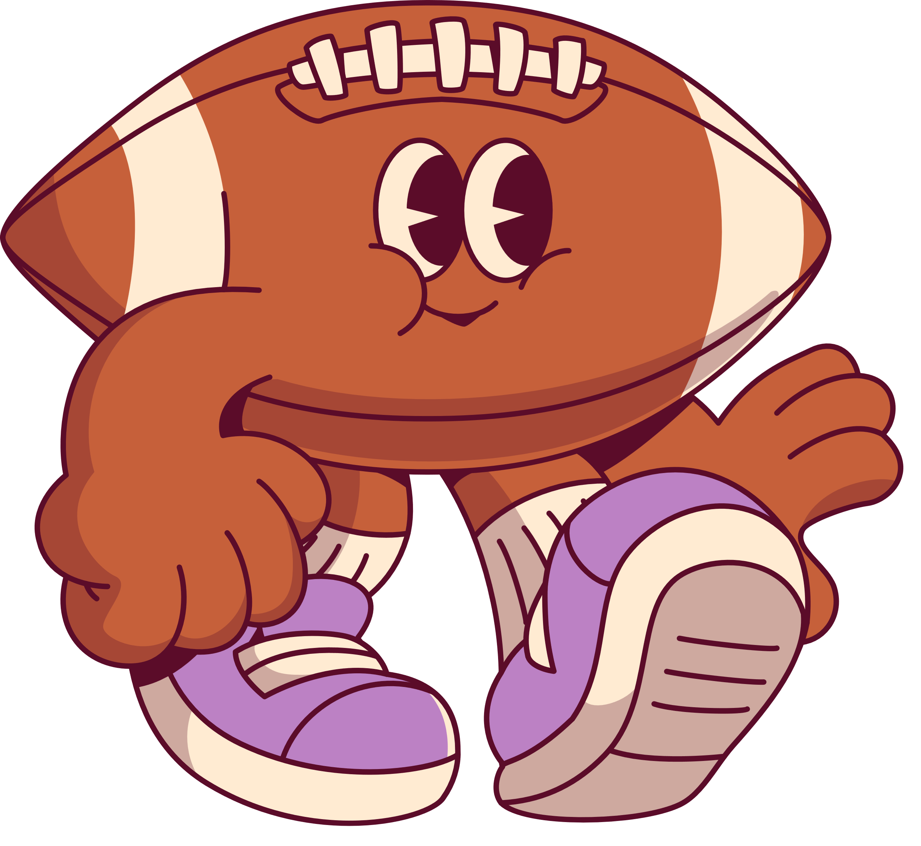
Bamboo
drifting

Slide 5
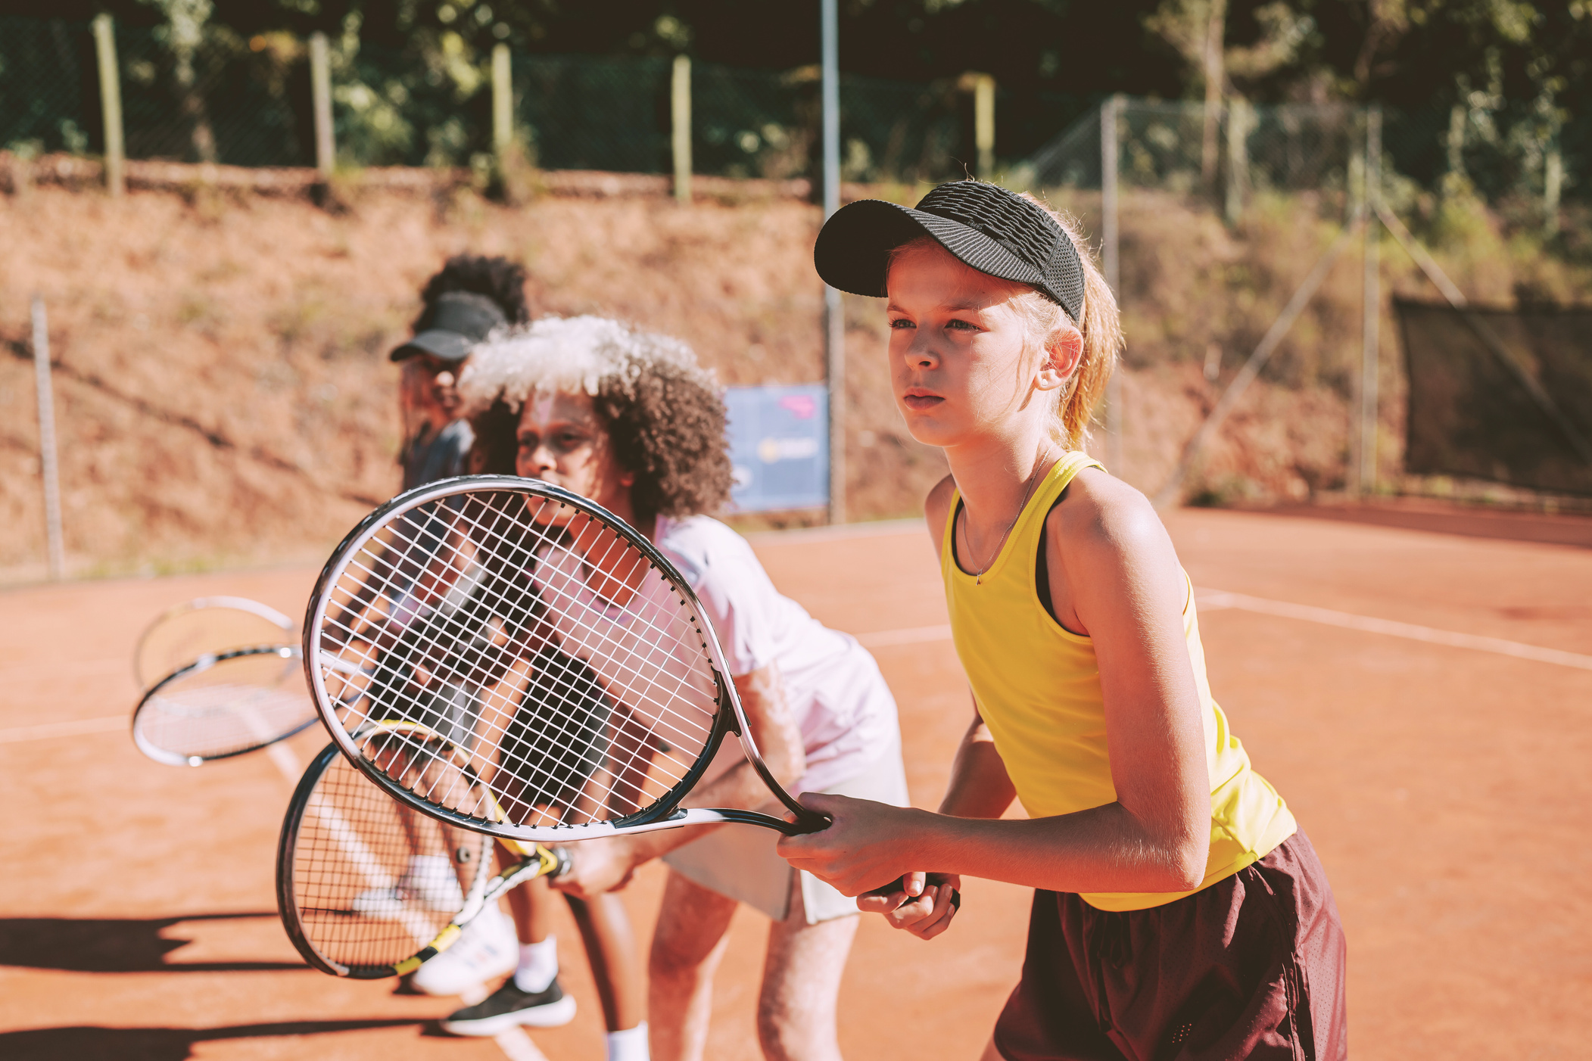
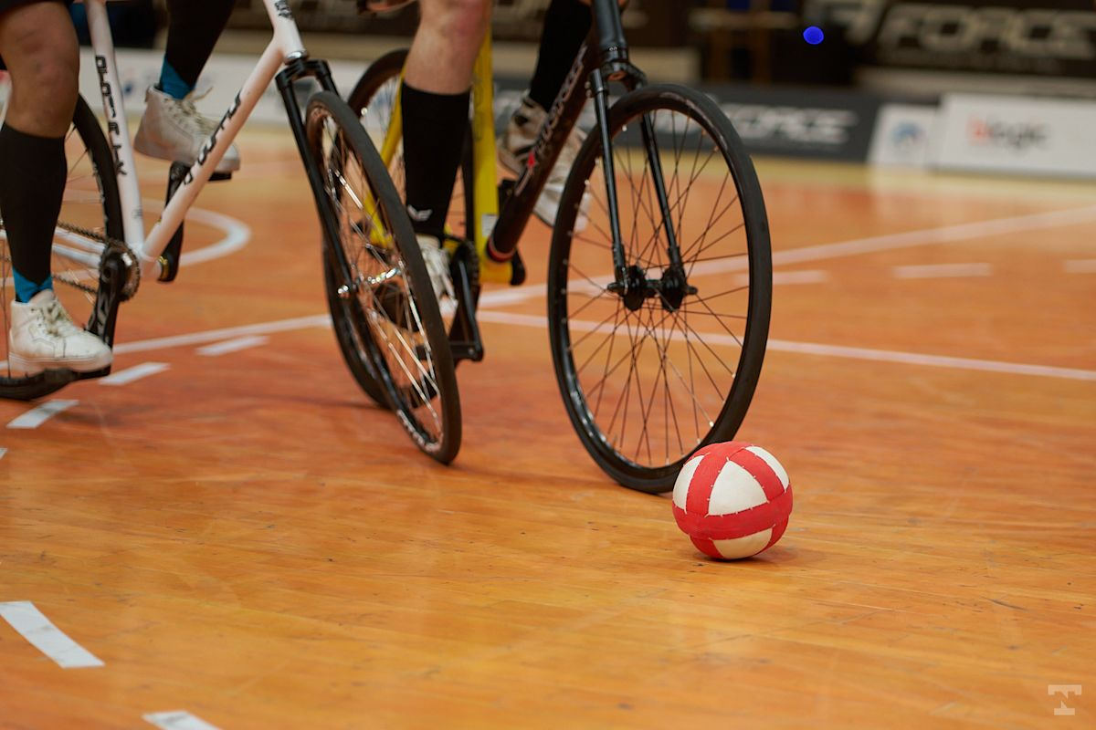
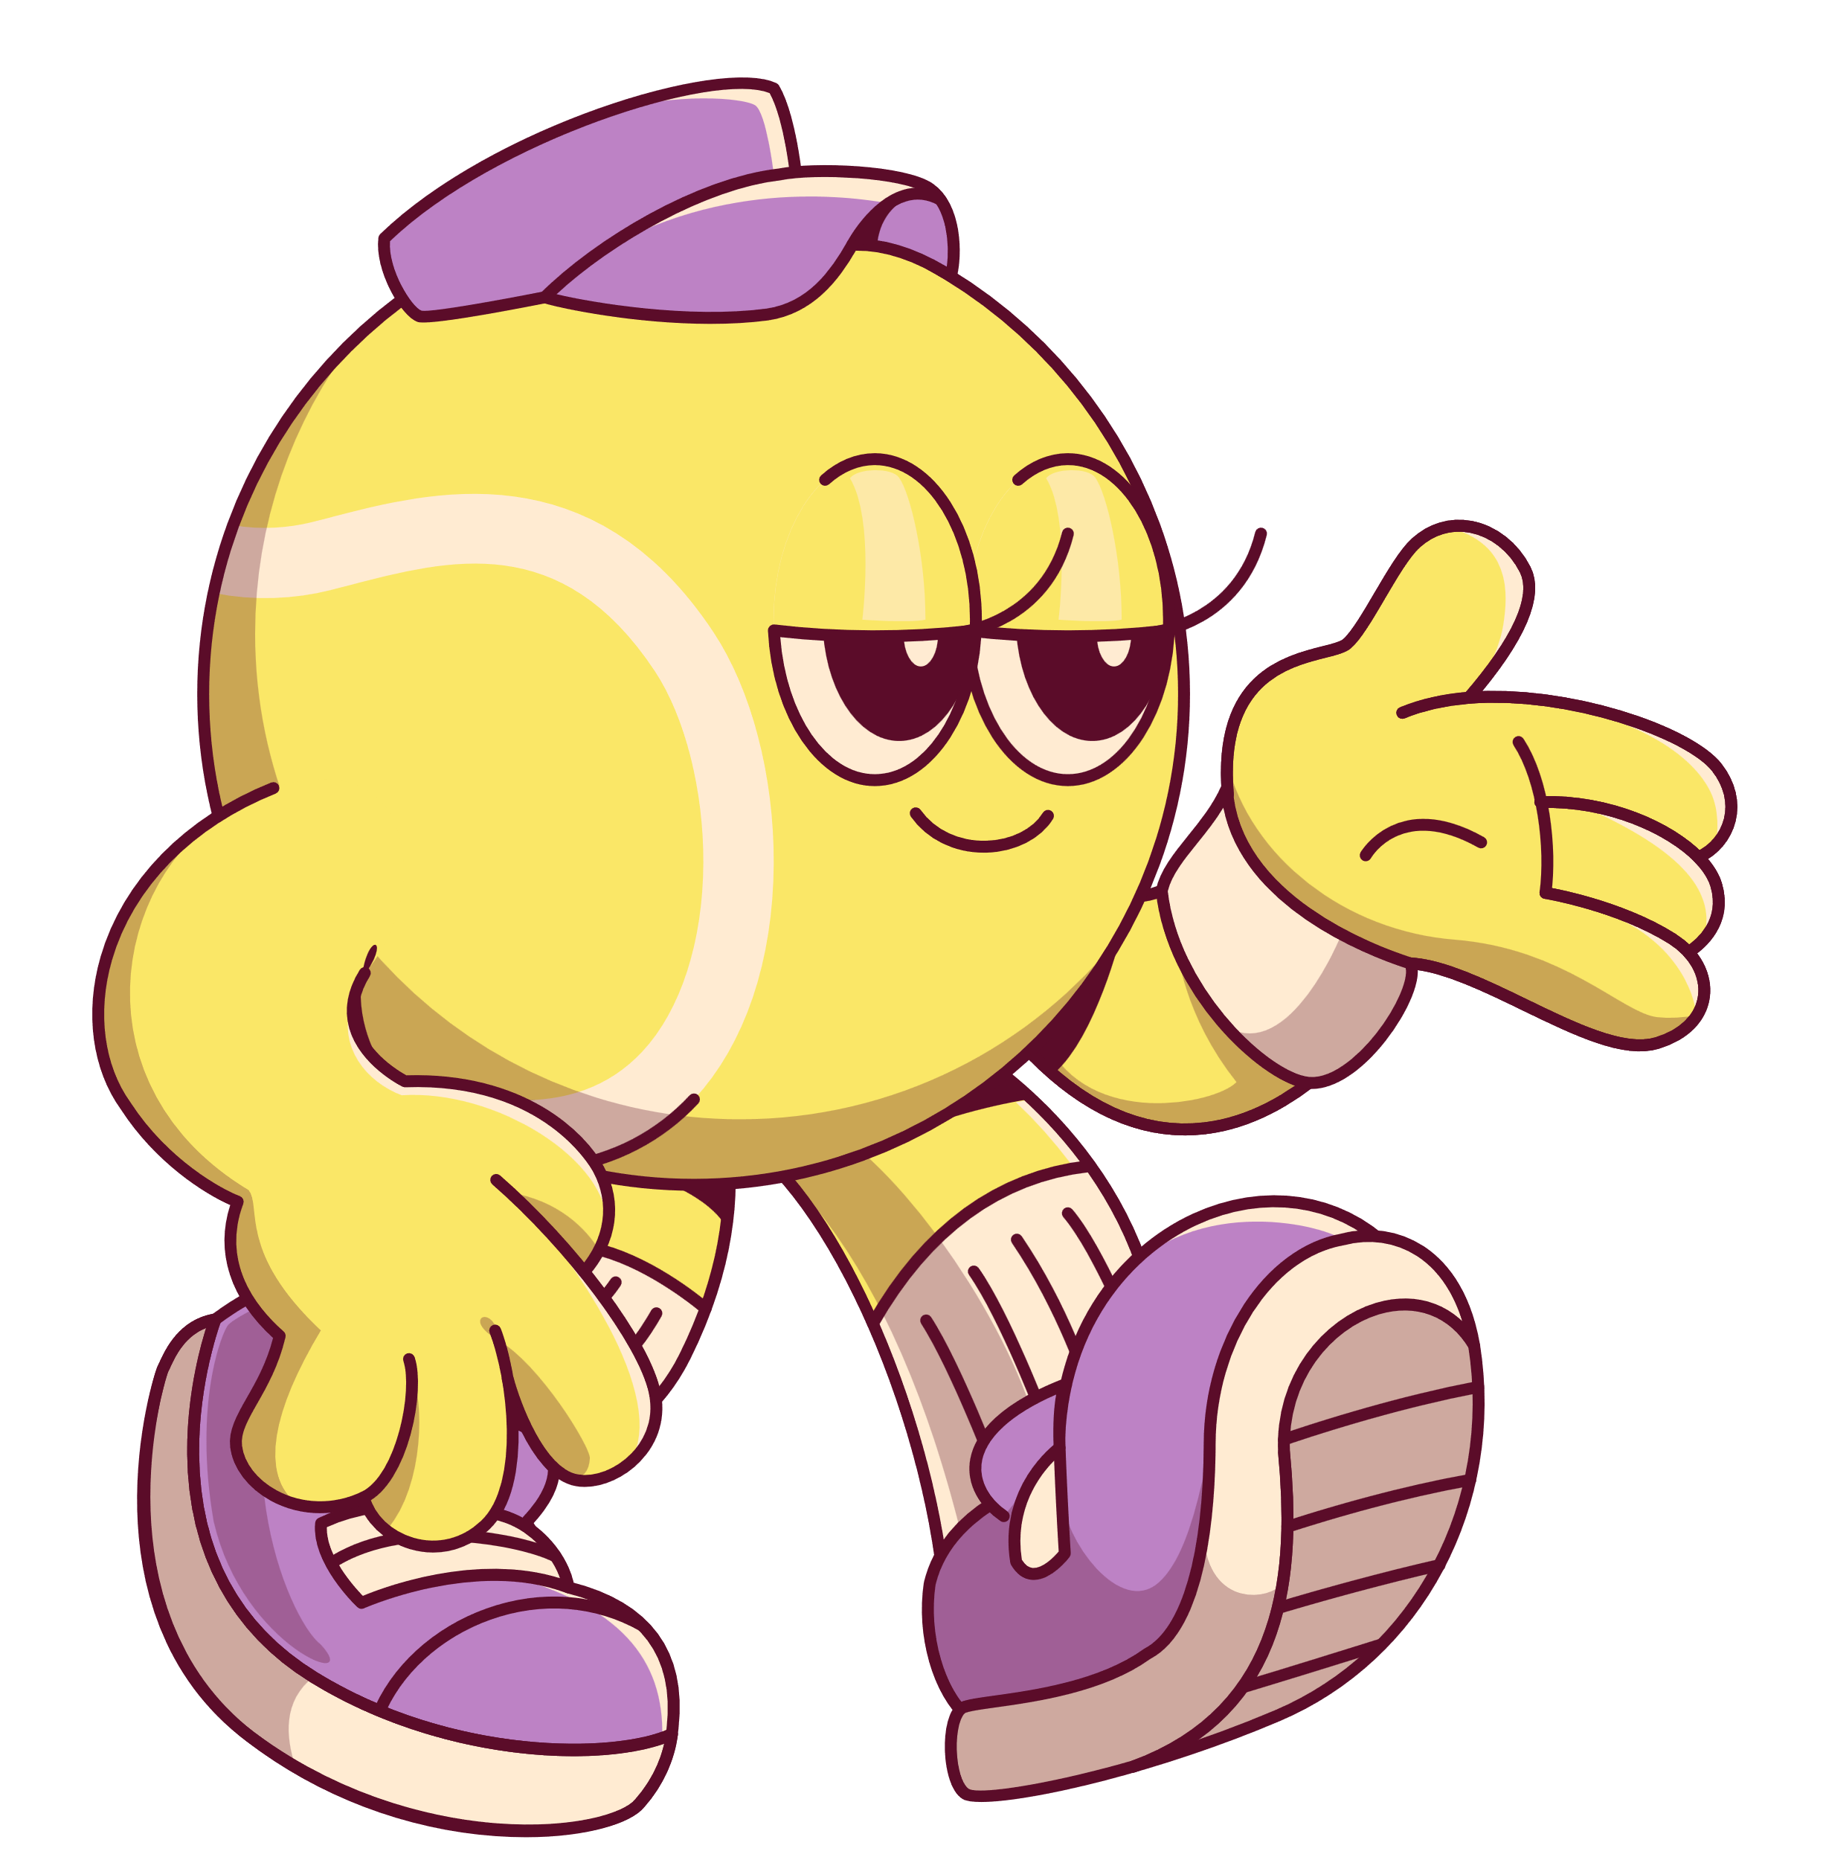
cycleball

Slide 7

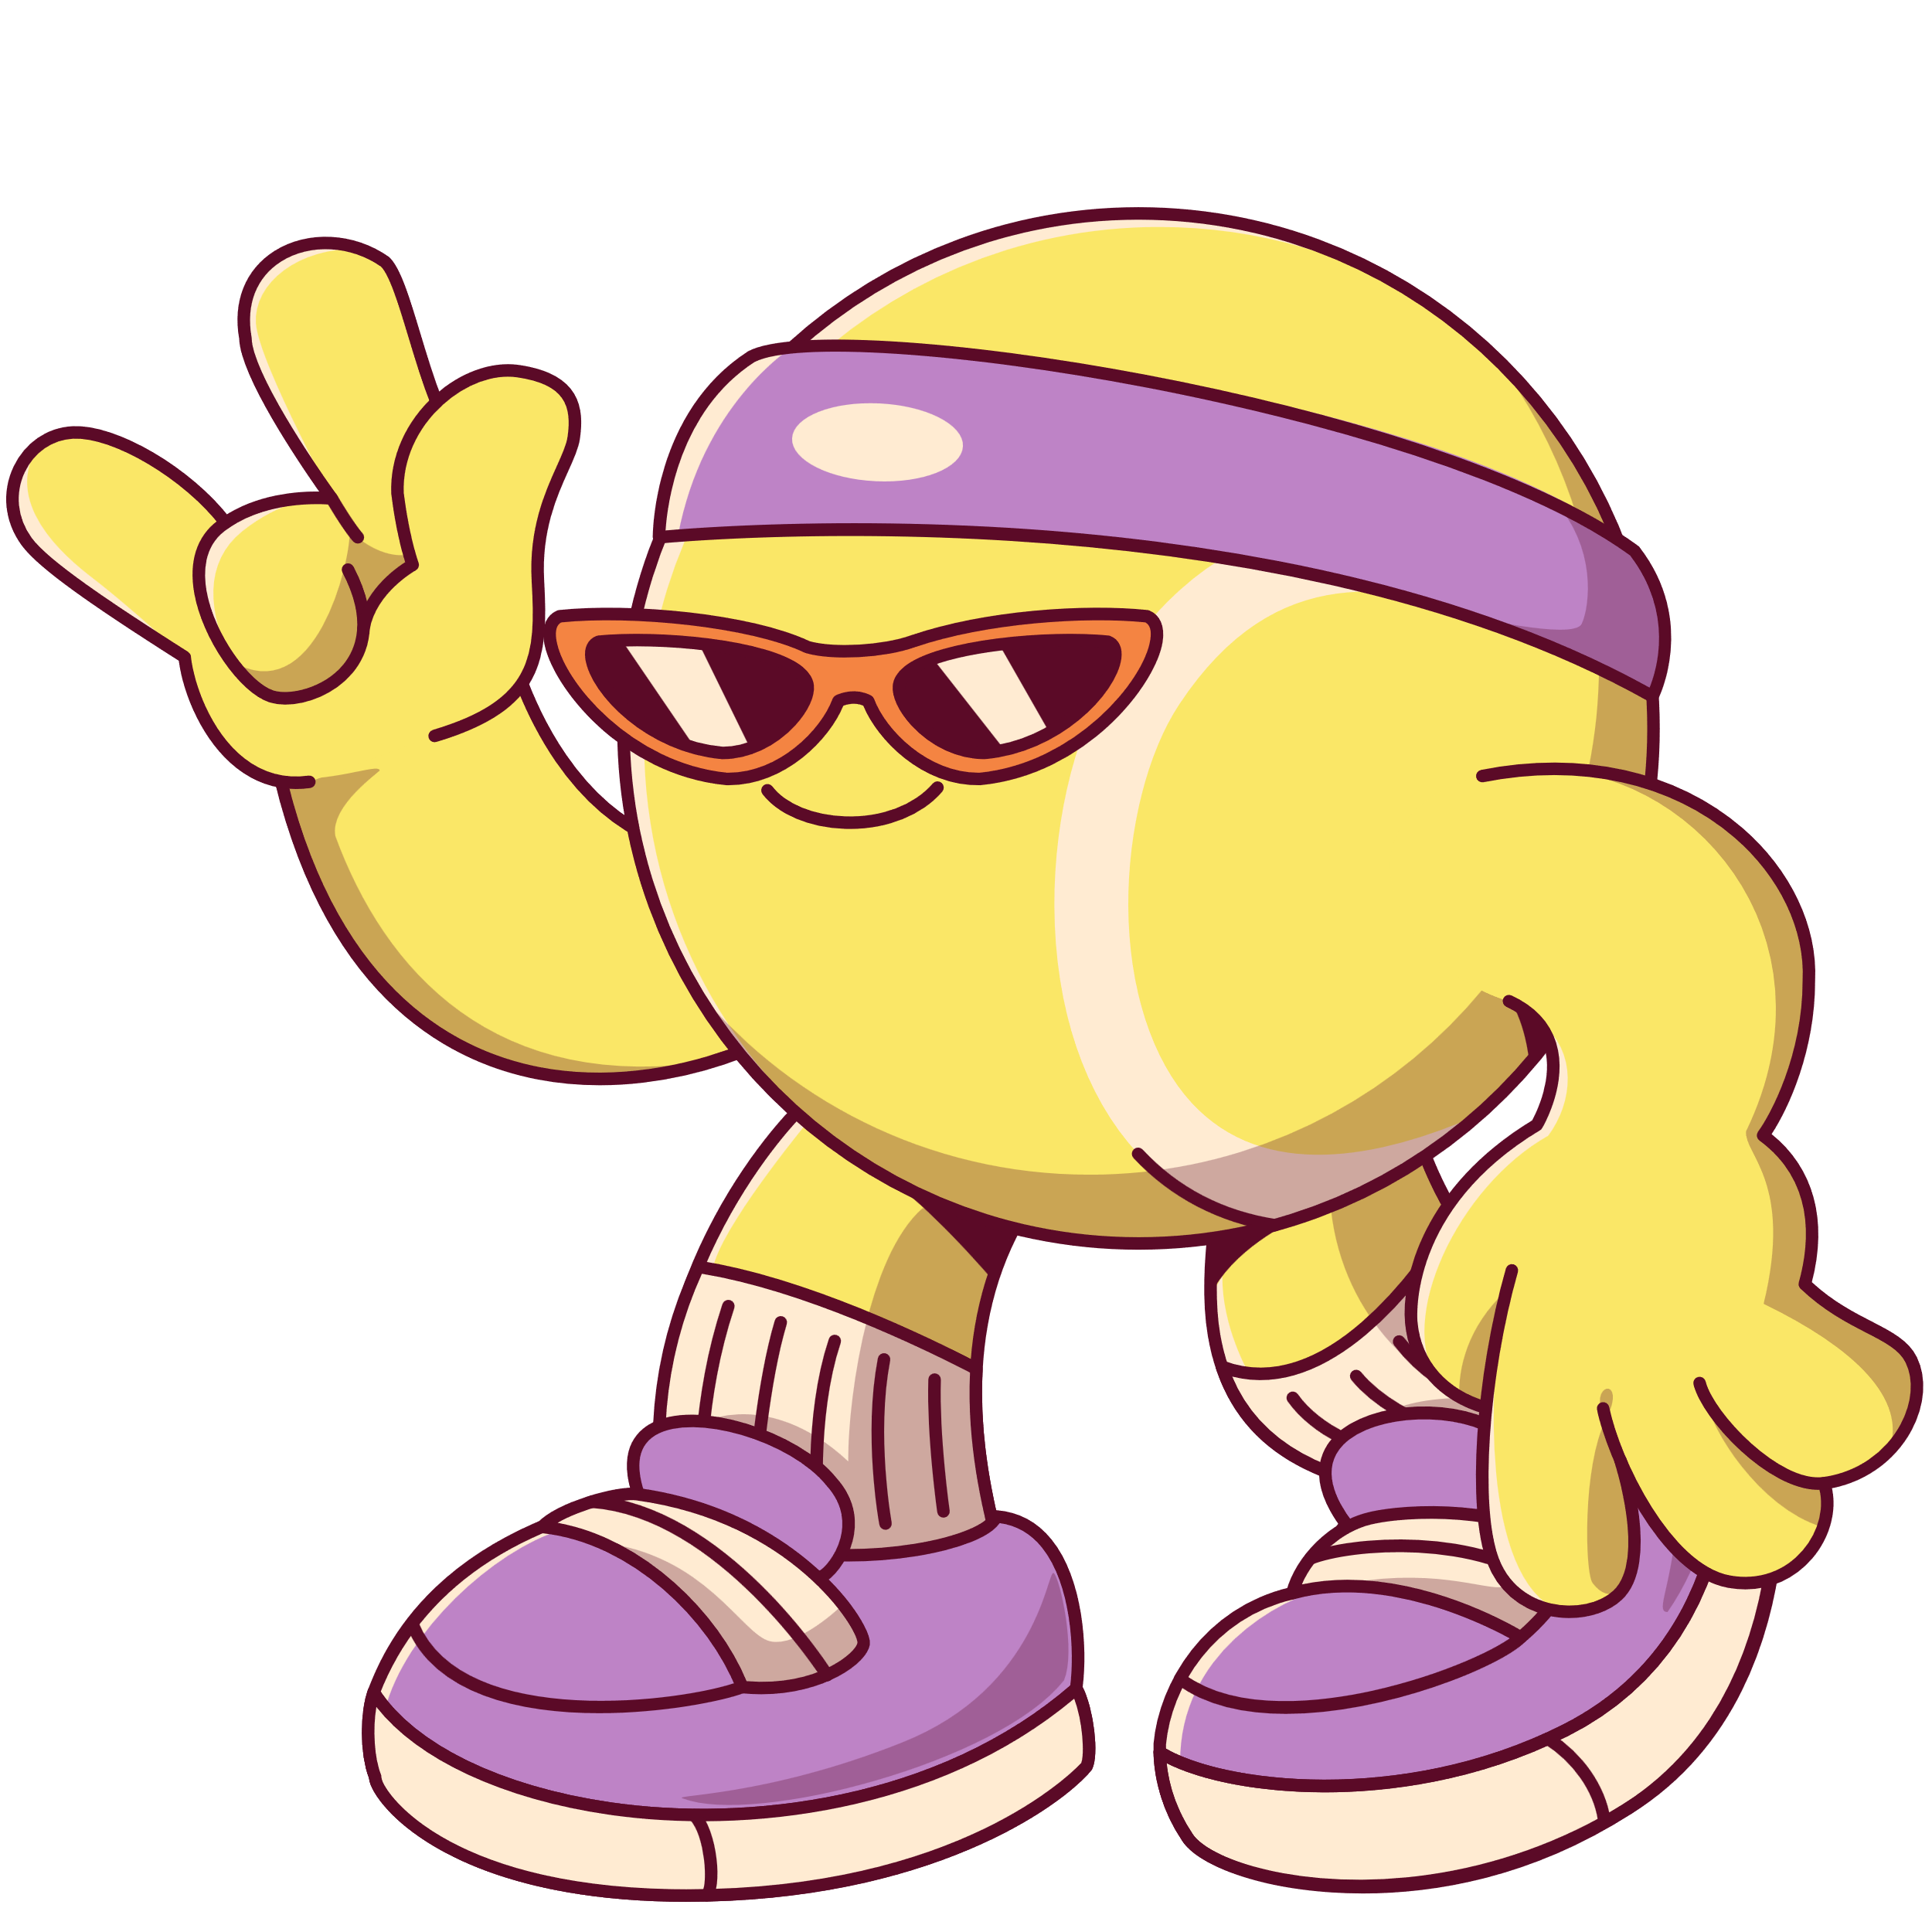
Difficult words
bottom
halves
bamboo
stick
tricks
in charge
opponent

Slide 8

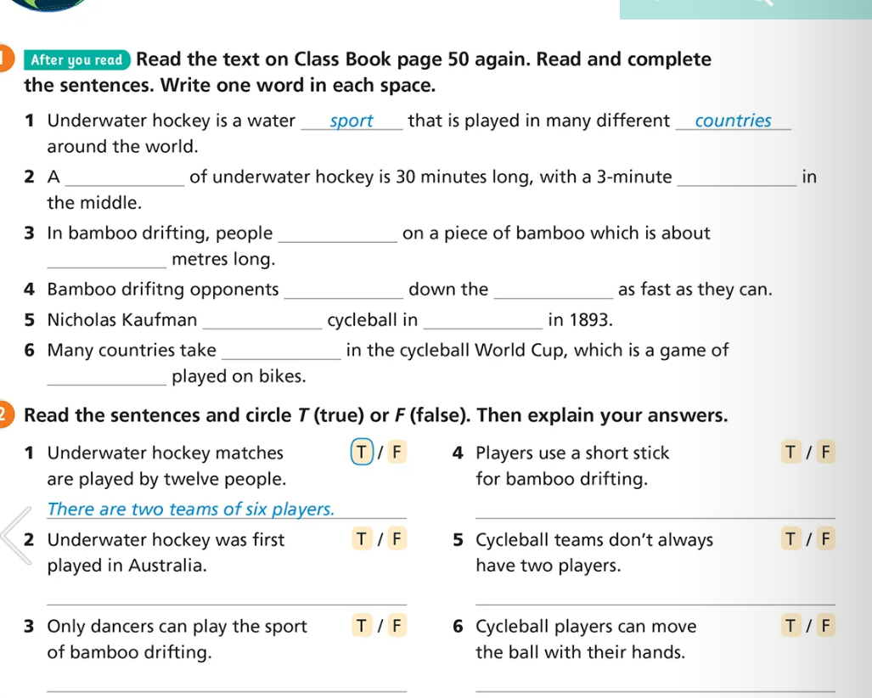
game
break
stand
nine
race
river
started
America
part
football
Players use a long thin stick for bamboo drifting
:
It is first played in the UK
Two,five or six players on each team.
Some people do beautiful dances on the bamboo
Only move the ball using their bikes.

Slide 9


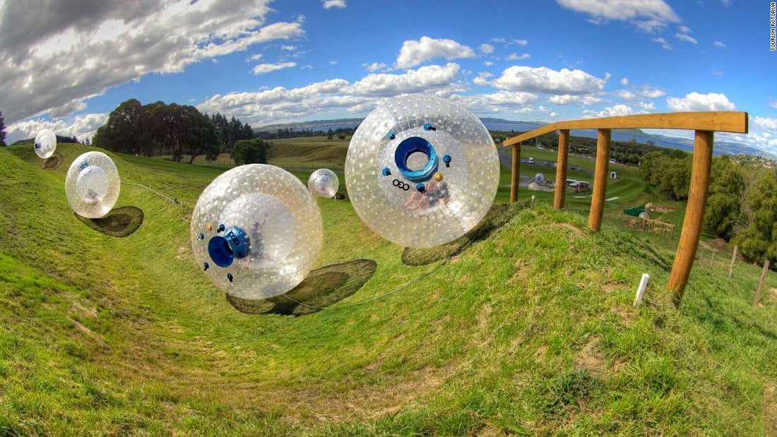
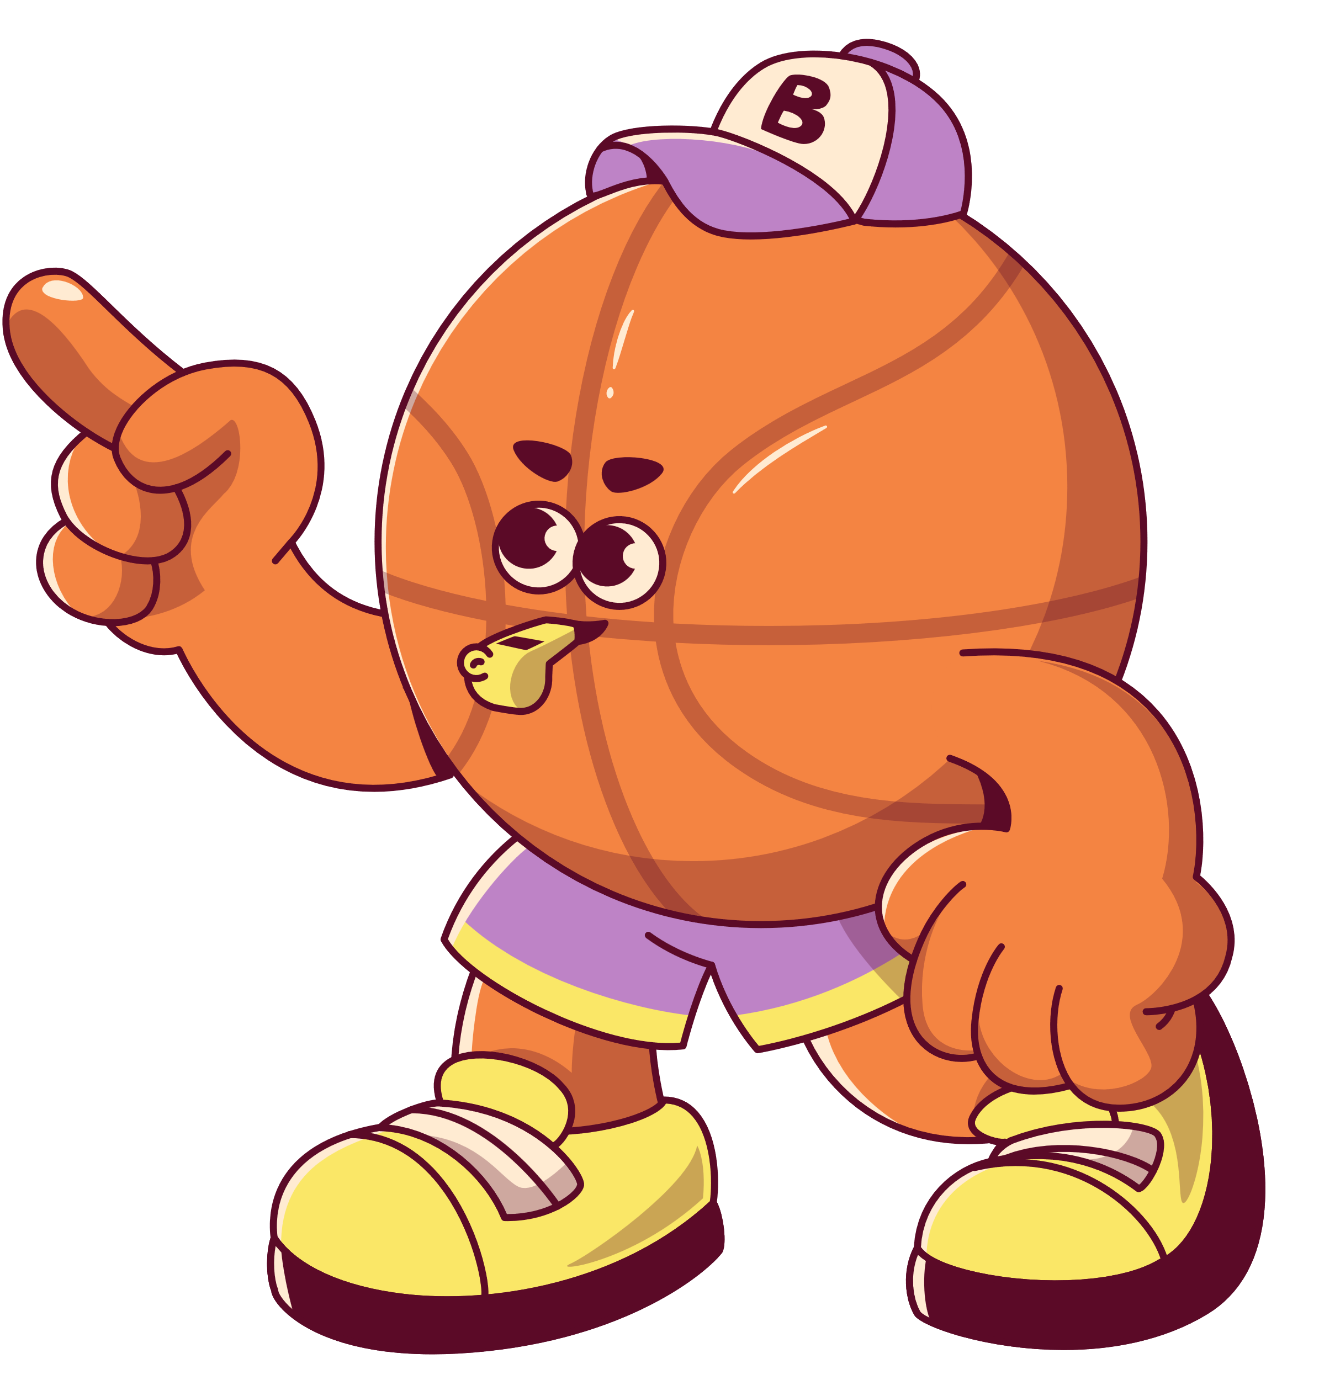
zorbing
The men’s basketball team earned 3rd place at the Open Basket regional tournament
DATE:
February 12–14, 2025
HIGHLIGHT GAME:
65–61 win over “Dynamo Junior”
SCORING LEADER:
Drew Feig – 22 points per game average

Slide 10
2) Large field
3)Plastic
4)Three
5) Racing
6) Fun
7) Water
8) exciting

Slide 11

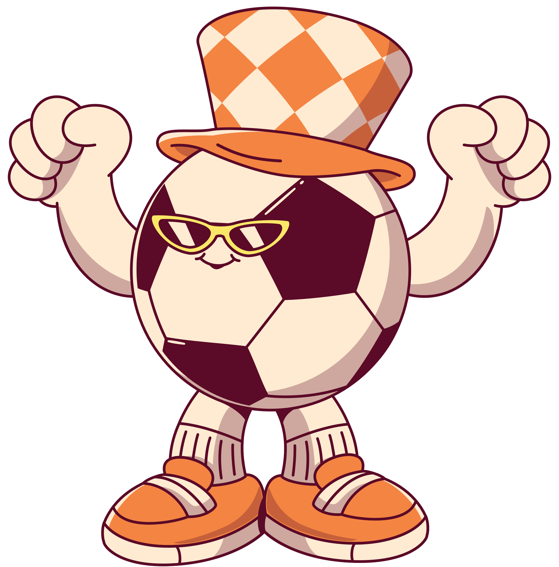

Asking about preferences
I would rather go paragliding
Should we go abseiling or caving
I would rather go horse riding
Would you prefer to go horse riding

Slide 12

Brochures and advert
Perfect
Terrific
Stunning
Gentle
Expert
.

Slide 13
Activity book p. 36
Gentle
Stunning
Terrific
Expert
perfect

Slide 14
1)Climbing adventure
2)Polar adventure
3) Extreme sport adventure
4) Safari Adventure
.

Slide 15
Activity book p. 36
Gentle
Climbing adventure
Polar adventure
Safari adventure
Extreme sport adventure

Slide 16
Activity book p. 36
Gentle
You can go to Indai to see tigers
Because small groups can get close to animals
They can go to the gentle hills in the Salalah Mountain in Oman.
Expert climbers help to keep the climbing adventure safe.
They must go to Antarctia

Slide 17
Activity book p. 36
The weather was awful the first day.
I tried surfboarding and I had a brilliant time.
I like the food in Al Ashkara. It was delicious.
You should visit Al Ashkara. It is brilliant/great.
The weather was terrible/awful so we couldn’t go surfboarding.

