Slide 1
Would you rather
Adjective edition!
Compound Adjectives
Amal Al Ismaili

Slide 2

Would you rather
Adjective edition!

Slide 3
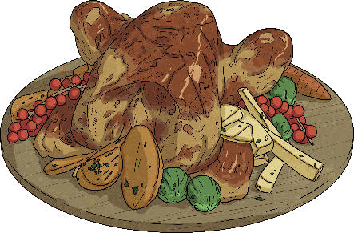
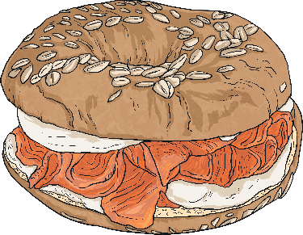
Would you rather
Adjective edition!
Round 1
Eat a delicious
roast chicken
Eat a tasty
salmon bagel
OR

Slide 4
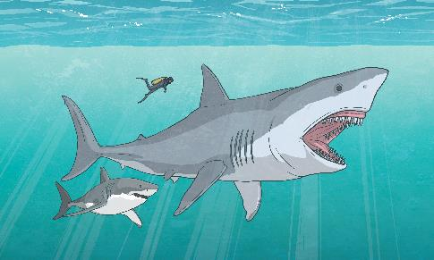
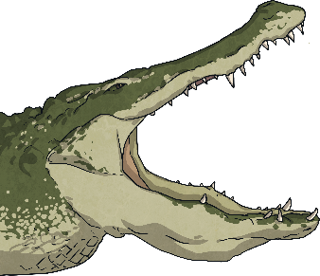
Would you rather
Adjective edition!
Round 2
Swim with the mighty sharks
Feed a crocodile
with sharp teeth
OR

Slide 5
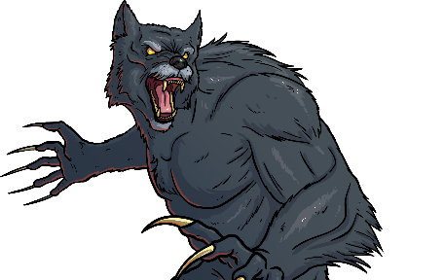
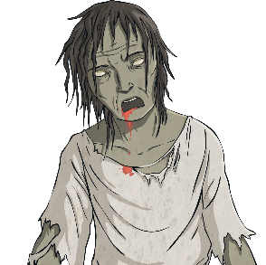
Would you rather
Adjective edition!
Round 3
See a fierce werewolf
See a scary zombie
OR

Slide 6
Adjectives
In the previous slide, you saw adjectives be used in sentences!
Let’s recap what these are:
Adjectives are describing words.
Some other common adjectives are:
delicious
beautiful
scary
fast
enormous
curved

Slide 7
But, what are compound adjectives?
Compound adjectives are adjectives that are made up of two or more words, joined by hyphens, that work together to modify a noun.
There are many different types of compound adjectives, like:
well-known
dimly-lit
ice-cold
old-fashioned
good-looking
mouth-watering

Slide 8
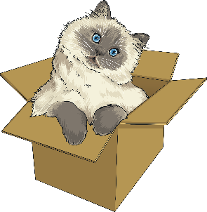
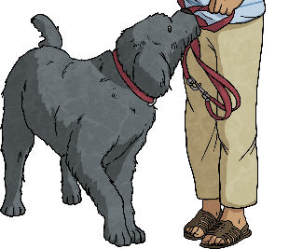
How are these different from adjectives?
Adjectives:
Compound Adjectives:
Adjectives can be single words like "happy," "red," "tall," etc.
Made up of two or more words, often with hyphens.
Basic modifiers: They provide straightforward information about a noun.
Specific modifiers: They offer more detailed about the noun they modify.
Example: The cat is playful.
Example: The well-behaved dog is friendly.

Slide 9
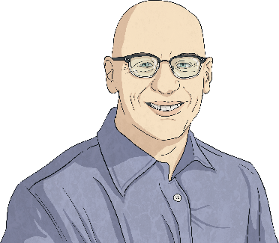
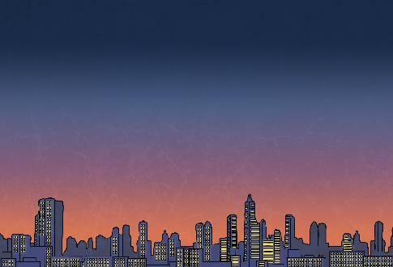
Examples:
The author is very well-known.
This city was dimly-lit at night.

Slide 10
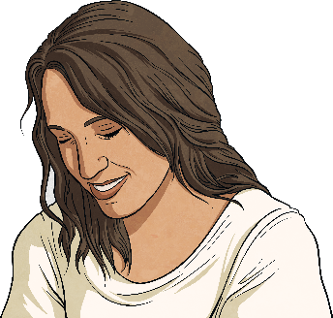
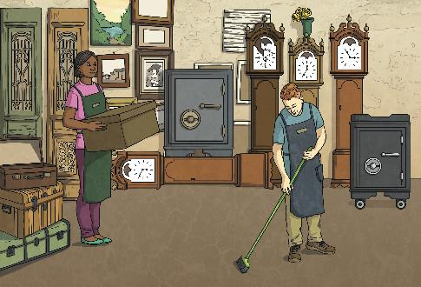
Examples:
She is a
good-looking lady.
The shop had
very old-fashioned furniture in it.

Slide 11
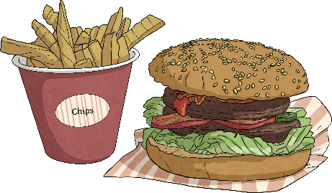
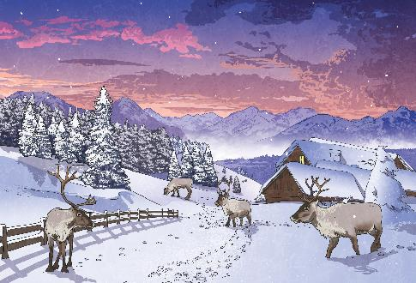
Examples:
It is ice-cold in Finland
in the winter time.
The burger and
chips were
mouth-watering.

Slide 12
Choose the correct compound adjective
The soccer player was in his
home country, Brazil.
well-known
good-looking
dimly-lit
Click to reveal the answer

Slide 13
Choose the correct compound adjective
The ice-cream came straight from the freezer - it was .
old-fashioned
ice-cold
mouth-watering
Click to reveal the answer

Slide 14
Choose the correct compound adjective
The young man with black, curly hair was said to be .
well-known
good-looking
dimly-lit
Click to reveal the answer

Slide 15
Choose the correct compound adjective
The couch was bought on sale at the antique store.
old-fashioned
ice-cold
mouth-watering
Click to reveal the answer

Slide 16
Match it up!
Choose the correct compound adjective to complete the sentence.
1
She was in her town for dancing.
She was well-known in her town for dancing.
2
The weather outside was - it was even snowing!
The weather outside was ice-cold - it was even snowing!
3
My mother made my favorite dinner - it was .
My mother made my favorite dinner - it was mouth-watering.
mouth-watering
ice-cold
well-known
Click to reveal the answer

Slide 17
Match it up!
Choose the correct compound adjective to complete the sentence.
1
The girl with the brown hair and blue eyes was .
The girl with the brown hair and blue eyes was good-looking.
2
The dress my mom wore when she was young is now .
The dress my mom wore when she was young is now old-fashioned.
3
The school was at night.
The school was dimly-lit at night.
old-fashioned
dimly-lit
good-looking
Click to reveal the answer

Slide 18
Make your own sentences!
Spin the wheel and make your own sentence using the compound adjective you land on.
Spin here!

Slide 19
Thank you!

